Slide 1
Digital Revolution
LOs:
Describe an analogue and digital signal
Contrast analogue and digital waves
Argue whether digital is better than analogue
THD: Rearrange the key words and define them:
G l a s i n
Key words: Digital, analogue, signal, transmission, radiation, amplifier
H/W IN:
H/W OUT:

Slide 2
Digital Revolution - starter
Which line is analogue, which is digital?
Explain your answer.

Slide 3
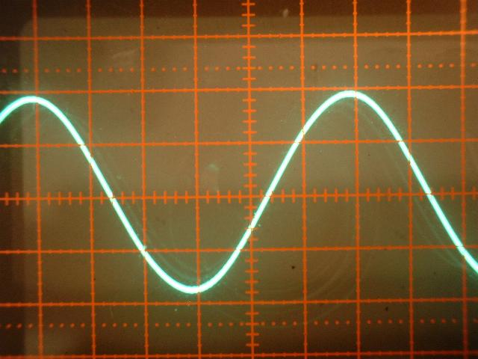
Digital Revolution – analogue signals
Music and speech vary continuously in frequency and amplitude.
analogue signals can vary in frequency, amplitude or both.
Question: think of three examples of analogue equipment…

Slide 4
Digital Revolution – digital signals
Digital signals are a series of pulses consisting of just two states, ON (1) or OFF (0)
There are no values in between.
DAB radio is Digital Audio Broadcast radio – it is transmitted as digital signals.
Question: name three other examples of digital equipment

Slide 5
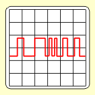
Advantages of digital signals
Digital signals carry more information per second than analogue signals.
This is the same whether optical fibres, cables or radio waves are used.
Digital signals maintain their quality over long distances better than analogue signals.

Slide 6
Digital Revolution
Watch this video, and make notes on any points you haven’t yet got down:
http://www.youtube.com/watch?v=1go6ITQXSlQ&safe=active

Slide 7
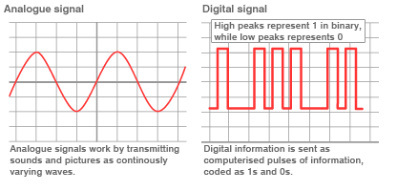
Information can be sent using a carrier wave. The radiowave, visible light or infrared can form the carrier wave. It must be modified to include the information, this is called a signal:
Carrier wave + information = signal
A digital signal is a series of on-off pulses (0 is off, 1 is on). An analogue signal is a continuous wave.

Slide 8
An analogue signal can be change to digital. The voltage is sampled many times per second and the height of the wave (in volts) is coded as a binary number.
These are the 0s and 1s that are used. This is used in photos; each pixel is given a numerical value, which codes its colour and brightness.

