Slide 1
B4
The processes of life

Slide 2
Why are there chemical reactions in cells?
All living things carry out seven life processes –MRS GREN.
Movement
Respiration
Sensitivity
Growth
Reproduction
Excretion
Nutrition
These processes depend on chemicals reactions that happens in cells. Many of the reactions need energy and this energy is obtained from the process respiration. Respiration is a series of chemical reaction that releases energy by breaking down large food molecules in all living cells.

Slide 3
What are enzymes?
Enzymes are biological catalyst, which speeds up chemical reactions in a living without getting used up. Enzymes are proteins, which are made in cells. In cells, genes carry the instructions to make enzymes.
Every reaction has its own enzyme. The reacting enzyme must fit exactly into the active site of the enzyme so the enzyme has its own shape. This is lock and key model
The lock and key model:
An enzyme has an active site
Only the correct molecule fits into the active site
The reaction takes place in the active site
The products leaves the active site and the enzyme can be used again.

Slide 4
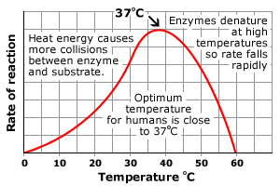
What conditions do enzymes need?
Enzymes work best at optimum temperature.
Below the optimum temperature, reactions are low
Above the optimum temperature, an enzyme changes its shape so it no longer catalyses its reaction. Enzyme has denature.
An enzyme’s activity at different temperatures is a balance between the two bullet points.
Enzymes work best at their optimum pH. At other pH values, shape of enzyme’s active site changes. The protein molecules it breaks down no longer fit into its active site.
At low temperatures, the rate of reactions are low. As the temperature rises, there are more successful reactions. At the enzyme’s optimum temperature, there is a high rate of reaction. At high temperatures, the enzyme’s active site has changed. Molecules cannot fit into the active site. The rate of reaction slows.

Slide 5
What is photosynthesis?
At the start of every food chain is a plant. Plants use energy from sunlight to make their own food by photosynthesis. Photosynthesis happens like this:
Chlorophyll – absorbs light energy
In plant cells, this energy brings about a series of reactions in which carbon dioxide and water molecules join to make glucose
Oxygen is waste product
Photosynthesis also happens in some microorganisms, in phytoplankton.

Slide 6
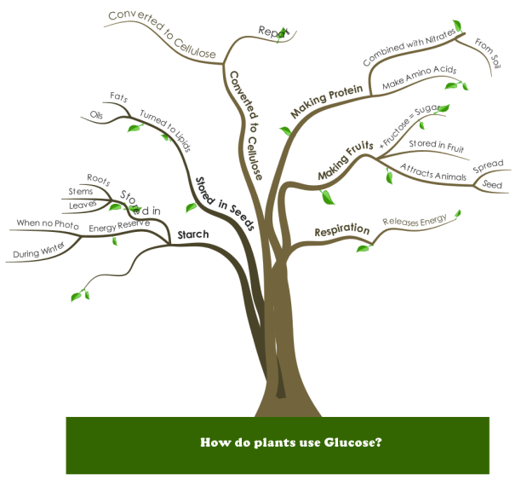
What happens in glucose?
The glucose made in photosynthesis has three main uses:
Some glucose is made into the chemicals that plant cells need to grow, for example, cellulose, chlorophyll, proteins
Some glucose molecules join together to make starch molecules. Starch is a storage chemical. It breaks down into glucose molecules when the plant needs more glucose
Some glucose is used in respiration

Slide 7
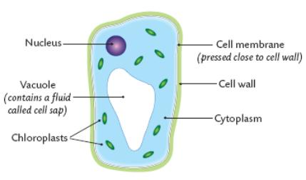
What is in a plant cell?
Each part of a plant cell has a vital function:
Chloroplasts – contain chlorophyll and the enzymes for photosynthesis
Nucleus contains DNA, which carries the genetic code for making enzymes and other proteins needed for photosynthesis
Enzymes and other proteins are made in the cytoplasm
Cell membrane lets gas and water molecules into the cell, but stops chemicals with bigger molecules getting out
Respiration happens in mitochondria
Vacuole contains glucose molecules, dissolved in water
Cell wall is rigid and is made up of cellulose.

Slide 8
How do chemicals get into cells?
Molecules get into and out of cells by diffusion. In diffusion, molecules move from a region of higher concentration to a region of their lower concentration. Diffusion is a passive process – it doesn’t need extra energy. Carbon Dioxide molecules diffuse into leaves through tiny pores. Oxygen molecules diffuse out of leaves through these same pores.
Active transport moves nitrate ions across cell membranes. Energy from respiration helps transport the particles from a region of lower concentration outside the cell to a region of higher concentration inside the cell. Plants take in minerals such as nitrates through root cells. They use nitrogen atoms from nitrates to make proteins.
Active transport:
Molecules to be transported across the membrane through the carrier protein in the cell membrane. Energy from respiration is used to change the shape of the carrier protein. The molecule is released on the other side of the membrane. Molecules can be transported across a membrane in one different only, and against their diffusion gradient. The carrier protein goes back to its original shape.

Slide 9
How do chemicals get into cells?
Water gets into and out of a cell through its partially permeable membrane. Small molecules can get through the membrane, but the bigger one cannot. Water molecules diffuse through the membrane from a dilute solution to a more concentrated solution. This type of diffusion is osmosis. Water moves into root cells by osmosis.

Slide 10
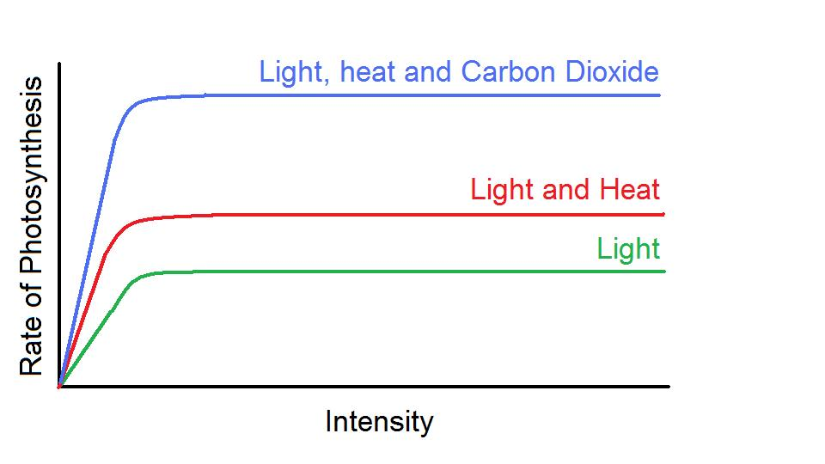
What speeds up photosynthesis?
The rate of photosynthesis depends on several factors, including:
Temperature –photosynthesis is faster at higher temperatures
Carbon dioxide concentration – increasing this speeds up photosynthesis
Light intensity – at low light levels, increasing the amount of light increases the rate of photosynthesis. But above a certain point, increasing the amount of light no longer increases the rate of photosynthesis. Some other factor, carbon dioxide concentration, now limits the rate. This is the limiting factor.

Slide 11
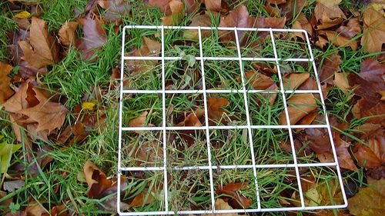
How can we investigate plants and light?
You can investigate the plants in different habitats using:
Light meter to measure light intensity
Quadrat and identification key to survey the plants in a square metre.
To investigate how plant species change gradually from one area to another, take samples at intervals along a transect

Slide 12
Why do living organisms need energy?
Living organisms use energy from respiration from some chemical reactions in cells, including those involved in:
Movement
Active transport
Synthesising big molecules:
Polymers from glucose in plants
Amino acid to make proteins in plant, animal and microbial cells.

Slide 13
What is aerobic respiration?
Aerobic respiration releases energy and happens in plant and animal cells and in some microorganisms. It need oxygen.

Slide 14
What is anaerobic respiration?
Anaerobic respiration releases less energy per glucose molecule than aerobic respiration. It happens in plant and animal cells, and in some microorganisms, when no oxygen is present or it is presented in small amounts. For example:
Human muscle cells during vigorous exercise
In plant cells, when the soil is waterlogged
In bacteria, deep-puncture wounds

Slide 15
What is anaerobic respiration?
Anaerobic respiration in animal cells and in some bacteria’s equation:
Glucose → lactic acid
In plant cells and in some microorganisms such as yeast’s equation:
Glucose → carbon dioxide + ethanol
The carbon dioxide produced could make the bread rise and the ethanol could be used for making alcoholic drinks.
Some bacteria produce methane gas when they break down organic materials such as manure. This biofuel is a useful gas.

Slide 16
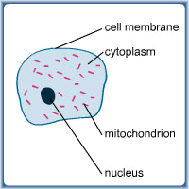
What is in a cell? – Animal
Cytoplasm – where enzymes are made. Locations of reactions in anaerobic respiration.
Nucleus – holds genetic code for enzymes involved in respiration
Mitochondrion –contains enzymes for aerobic respiration
Cell membrane – allows gases and water molecules to pass freely into and out of the cell. Controls the passage of other molecules

Slide 17
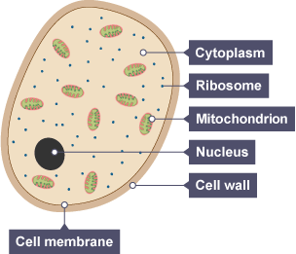
What is in a cell? – Yeast
Cytoplasm – where enzymes are made. Locations of reactions in anaerobic respiration.
Nucleus – holds genetic code for enzymes involved in respiration
Mitochondrion – contains enzymes for aerobic respiration when oxygen available
Cell membrane - allows water and gasses to pass through freely while presenting a barrier to other chemicals.

Slide 18
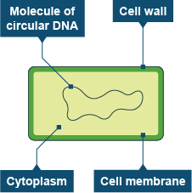
What is in a cell? – Bacteria
Cytoplasm – where enzymes are made. Locations of reactions in anaerobic respiration.
Cell membrane - allows water and gasses to pass through freely while presenting a barrier to other chemicals.
Strand of circular DNA – holds genetic code for enzymes involved in respiration.

Slide 19
Quiz Show
Question and Answer

Slide 20
1. List the seven life processes

Slide 21
Mrs Gren – movement, respiration, sensitivity, growth, reproduction, excretion, nutrition

Slide 22
2. True or false

Slide 23
2A. The waste product of photosynthesis is carbon dioxide

Slide 24
2A. False

Slide 25
2b. In aerobic respiration, glucose and oxygen react to make glucose and carbon dioxide

Slide 26
2B. True

Slide 27
2C. Anaerobic respiration releases more energy per glucose molecule than aerobic respiration

Slide 28
2C. False

Slide 29
2D. Enzymes are carbohydrates that speed up chemical reactions

Slide 30
2D. False

Slide 31
2E. Photosynthesis happens in plant and phytoplankton cells

Slide 32
2C. True

Slide 33
3. Complete the following equations

Slide 34
3A. Carbon dioxide + water →

Slide 35
3A. Carbon dioxide + water → glucose + water

Slide 36
3B. Glucose + oxygen →

Slide 37
3B. Glucose + oxygen → water + carbon dioxide

Slide 38
3C. Glucose →

Slide 39
3C. Glucose → lactic acid OR glucose → ethanol + carbon dixoxide

Slide 40
4. Define the following Key Terms 4a. Diffusion 4b. Osmosis 4C. Synthesis

Slide 41
4a. Diffusion – movement of molecules from a region of high concentration to a region of low concentration 4B. Osmosis – movement of water through a partially permeable membrane to a region of higher concentration to a region of lower concentration 4C. Synthesis – making a chemical with bigger particles from ones with smaller particles

Slide 42
5. Fill in the blank

Slide 43
5. Polymers such as ….. And …. Are synthesised from ….. In …. Cells. Amino Acids are synthesised in plant, animal and microbial cells from glucose and ….. . The amino acids join together to make ….

Slide 44
6. List three places in which anaerobic respiration happens.

Slide 45
6. -in bacteria cells deep puncture wounds -plant cells, when soil is waterlogged -human cells during vigorous excerisce.

Slide 46
7. Write balanced equations for the following:

Slide 47
7A. photosynthesis

Slide 48
7A.

Slide 49
7B. Aerobic respiration

Slide 50
7A.

Slide 51
8.Complete the sentence below using these words: roots, reparation, nitrates energy In active transport, chemicals such as ….. are absorbed by plant …. . The process requires …. .This comes from the process of …..

Slide 52
6 mark Question: Describe and explain how substances move in and out of different types of plant cell by diffusion, including osmosis.

