Slide 1
B5 Growth and Development

Slide 2
Outline the process of development of an embryo, from a zygote through the 8 cell stage to beyond the 8 cell stage. You must mention the processes of cell specialisation and mitosis.

Slide 3
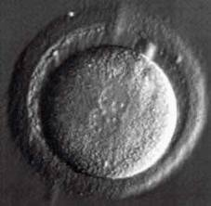
Development
Egg to child
Development
Zygote
Embryo – stem cells
Specialised cells

Slide 4
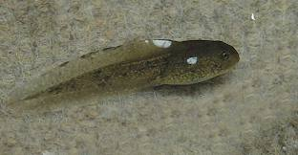
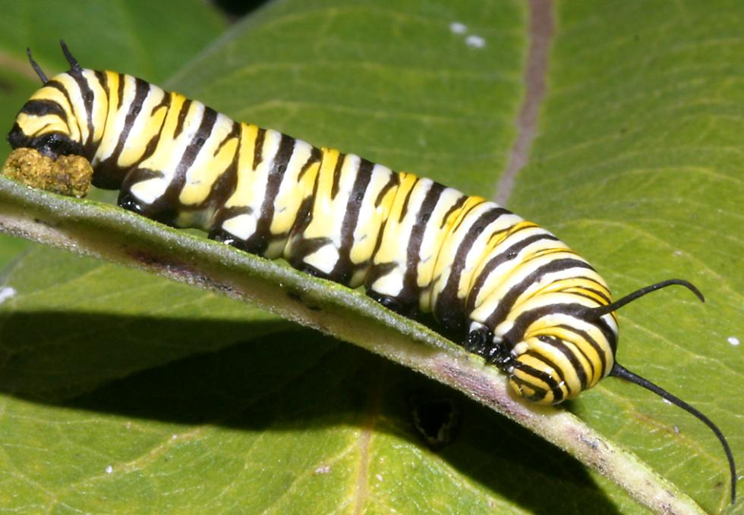
Big Changes

Slide 5
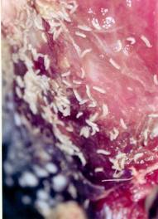
Francesco Redi
1668
‘Appeared’
Did experiments with flies to show:
Flies lay eggs
Hatch into maggots
Maggots into pupae
Re-organise into fly

Slide 6
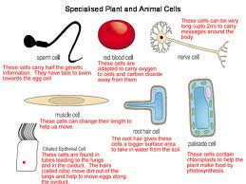
Specialised cells

Slide 7
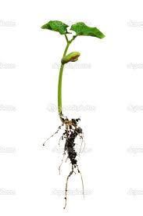
Plant Systems
Specialised cells
Tissues
Organs
Plant

Slide 8
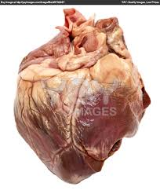
Body systems
Specialised cells
Tissues
Organs
Body Systems

Slide 9
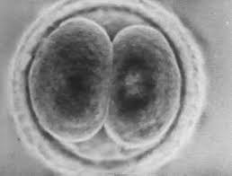
Zygote
All body cells from one original cells
Fertilised egg
Instructions in DNA to make all different tissues
List as many different types of tissues as possible

Slide 10
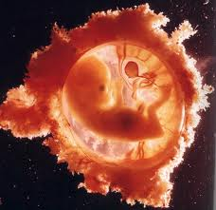
Egg to embryo
Sperm and egg cell
Fertilisation
Zygote
Division of cells by mitosis
Embryo
100 cells – becomes specialised
2months main organs have formed - foetus

Slide 11
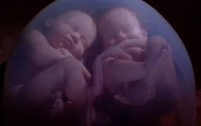
Identical Twins
Embryo – 8cells
Clones
Cells which are identical and unspecialised
Embryonic stem cells

Slide 12
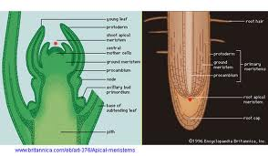
Meristem cells
Stems grow taller
Roots get longer
Stems get wider
New cells at tips of roots and shoots
Rings of dividing cells in stems and roots to increase thickness - meristems

Slide 13
Stem Cells
Why can’t we replace whole organs?
Plants keep some unspecialised meristem cells all their lives, so when leaves are picked they can grow back.
The same can happen in newts

Slide 14
Meristems make more plants...
Cuttings – roots or leaves from a plant
Rooting powder – plant hormones, cause meristem cells to develop into root cells
Genetically identical clones

Slide 15
Plants cannot move....
So the conditions in the soil may affect it and it may die
Phototropism – growing towards light
Higher concentrations of plant hormones cause shoot cells to grow faster on the shady side.

Slide 16
Chromosomes contain genes..
Nucleus contains chromosomes
Long molecule of DNA
1M in each nucleus
30,00 genes
Each gene codes for a protein
23 pairs of chromosomes

Slide 17
Cells grow and divide
Before a cell divides it needs to make copies of its organelles and chromosomes
Mitosis
Reproduce asexually using mitosis
Clones

Slide 18
Cell cycle
Cell growth:
Chromosomes copy
Number of organelles increase
Mitosis:
Chromosomes separate
Nucleus divides

Slide 19
Gametes
Males make many, swim or are carried
Females have large gametes that stay in one place
Sperm in testes
Egg cells in ovaries

Slide 20
Meiosis
Gametes have half the chromosomes of a normal cell
Sperm cell fertilises egg cell; nuclei fuse; full set of 46 chromosomes
Gametes made by meiosis
All different – show genetic variation

Slide 21
Bases
A- Adenine
T – Thymine
C – Cytosine
G – Guanine
Base pairing – A always with T and C always with G.

Slide 22
DNA Info
DNA copies itself
Weak bonds split between bases
Two strands formed from free bases in cell
New chains identical to original

Slide 23
DNA to Proteins
How amino acids are arranged determines the shape and structure of proteins
About 20 different amino acids
Crick 1961 worked out that triplet codes make amino acids. 64 possible codes, so some have more than one code
Codes for start and stop

Slide 24
Where in the cell?
DNA in nucleus contains code for proteins
Proteins made on ribosomes in cytoplasm
mRNA travels out of nuclear pores and into cytoplasm
One strand
Uracil used instead of Thymine to pair with Adenine

Slide 25
Structural Proteins
Protein | Found in... | Property
Keratin | Hair, nails, skin | Strong and insoluble
Elastin | Skin | Springy
Collagen | Skin, bone, tendons, ligaments | Tough and not very stretchy

Slide 26
Functional Proteins
Essential for chemical reactions which take place in our bodies
Enzymes
Antibodies

Slide 27
Link between genes and proteins
All cells from zygote
Begin to specialise
By controlling what proteins a cell makes, genes control how a cell develops
Each cell has a copy of ALL genes, however some differentiate – genetic switches

Slide 28
Gene Switching
Each gene controls a protein. One per protein
Approx 20-25,000 genes
Not all genes are active, some switched off
Eg in a hair cell or salivary gland cell

Slide 29
Gene switching in embryos
Early embryo made entirely of embryonic stem cells
Unspecialised up to 8 cell stage
All genes switched off
As the embryo grows, genes switch on as cells become specialised
In adults there is regular replacement of worn out cells. These can only develop into cells of a particular organ, so some genes must be switched on.

Slide 30
Stem Cells
Treatment of some diseases/replacement of damaged tissue
Stem cells come from early embryos, umbilical cord blood and adults.
Embryonic stem cells most useful as unspecialised.

Slide 31
Cloning
Therapeutic cloning
Tissues do not match
Remove nucleus of zygote and replace with patient’s body cell nucleus.
Adults – bone marrow, harvest for storage
Claudia Castillo

