Slide 1
OCR B7 Further Biology Revision

Slide 2
Learning Outcomes
MUST describe the structure of a joint.
SHOULD explain how properties of ligaments, cartilage and tendons enable joints to function correctly.
COULD describe common injuries to joints and their symptoms and treatment.

Slide 3
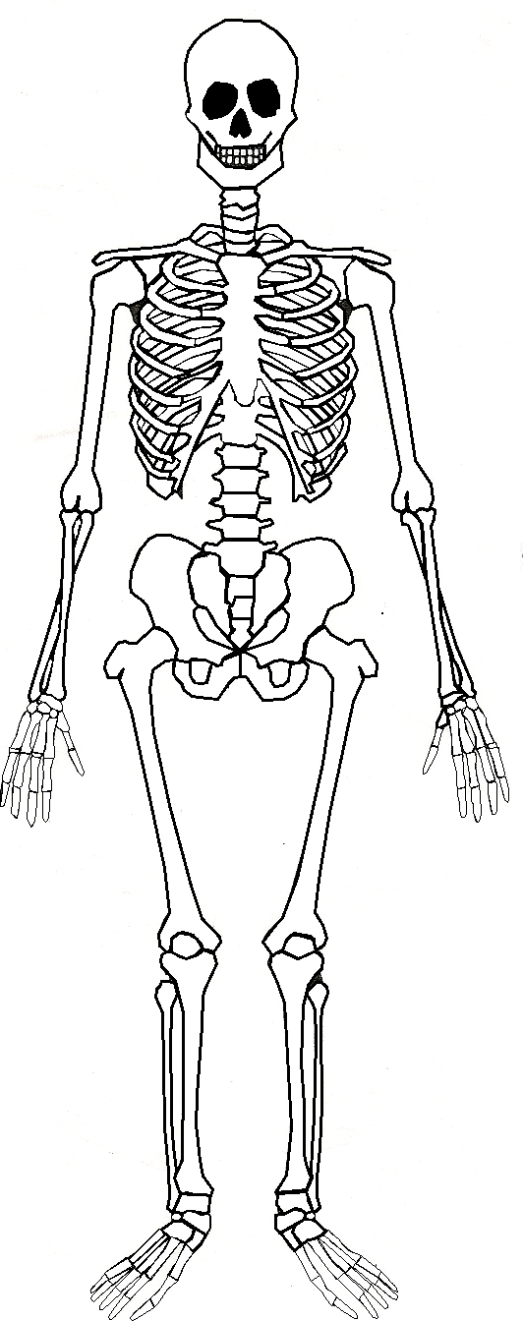
B7.1 Peak performance – movement and exercise 1. Understand that the internal skeleton of vertebrates is needed for support and movement
Tasks:
Label as many bones in the skeleton as you can.
Annotate your diagram with the four functions of the skeleton.
Describe how exercise changes bones.
Answers:
Stores minerals; makes red blood cells, platelets and some white blood cells; allows the body to move; protects internal organs.
Increases its strength and density.

Slide 4
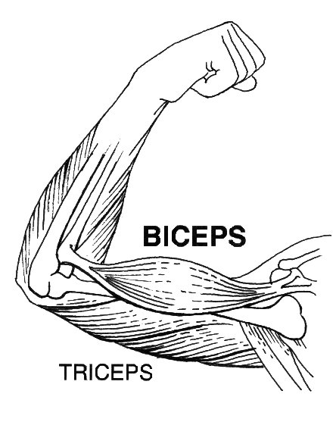
B7.1 Peak performance – movement and exercise 2. Understand that muscles can only move bones at a joint by contraction, and thus operate in antagonistic pairs.
Tasks:
Identify the antagonistic pair of muscles in your diagram.
Explain what the term ‘antagonistic’ means.
Explain how the biceps and triceps allow the arm to move.
Antagonistic = when one muscle opposes the movement of another muscle

Slide 5
B7.1 Peak performance – movement and exercise
Recall the structure and function of the components of a joint, to include:
smooth layer of cartilage and synovial fluid to reduce friction between bones
elastic ligaments to stabilise joints while allowing movement
tendons to transmit the forces between muscle and bones
Tasks:
Label the knee joint with the names and functions of each component.

Slide 6
B7.1 Peak performance – movement and exercise 4. Understand how the specific properties of ligaments, cartilage and tendons enable them to function effectively
6 MARKS

Slide 8
B7.1 Peak performance – movement and exercise 10. Recall common injuries that can be caused by excessive exercise, to include sprains, dislocations, and torn ligaments or tendons
Tasks:
Create a mind map to include:
The names of the four different types of injury that you need to know.
A description of what each type of injury is.
B7.1 Peak performance – movement and exercise 11. Recall symptoms and basic treatments for a sprain
Add to your mind map:
Symptoms of a sprain.
Basic treatment of a sprain.

Slide 10
B7.1 Peak performance – movement and exercise 12. Describe the role of the physiotherapist in treatment of skeletal-muscular injury.
Tasks:
Use the textbook and your revision guide to write a summary of the role of the physiotherapist in treatment of skeletal-muscular injury.
What are the advantages of physiotherapy when you have an injured joint?
Why is it important to comply with the treatment your physiotherapist gives you?

Slide 11
Learning Outcomes
Tues. 04/06
MUST state factors that need to be disclosed before an exercise regime is started.
SHOULD calculate BMI using the correct equation.
COULD analyse data to assess the fitness of an individual.

Slide 12
B7.1 Peak performance – movement and exercise 5. Explain why certain factors in a person’s medical or lifestyle history need to be disclosed before an exercise regime is started
Tasks:
Create a mind map to include:
The medical and lifestyle factors that need to be disclosed before an exercise regime is started.
Why it is important for these things to be disclosed.
What baseline data may be gathered when starting an exercise regime?
Answers:
Heart rate; blood pressure; recovery period; proportion of body fat; BMI.

Slide 13
B7.1 Peak performance – movement and exercise 6. Interpret data obtained when monitoring a person during and after exercise
Tasks:
Answer the above questions.
Explain your answers.

Slide 14
B7.1 Peak performance – movement and exercise 7. Use proportion of body fat and body mass index (BMI) as measurements of fitness
Tasks:
What is the equation to calculate body mass index (BMI)?
What does BMI tell us?

Slide 17
B7.1 Peak performance – movement and exercise 8. Use the equation: BMI = body mass (kg)/[height (m)]²
Tasks:
Calculate the BMI of each of the people in the table below. Making sure you show all of your working out.
How many of the people are underweight?
How many are overweight?
Is anyone clinically obese?
Person | Mass (kg) | Height (m) | Height² | BMI
Derek | 79 | 1.68
Ben | 70 | 1.72
Debbie | 89 | 1.56
Amy | 49 | 1.61

Slide 18
B7.1 Peak performance – movement and exercise 9. Understand that any assessment of progress needs to take into account the accuracy of the monitoring technique and the repeatability of the data obtained
Tasks:
What is the difference between accuracy and repeatability?
How could you mistakenly calculate that you are fitter than you actually are?
Answers:
Accuracy: Equipment or method gives a ‘true’ value.
Repeatability: Get similar results with each repeat.
BMI: Mass will vary at different times of the day.
BP/Pulse: Faulty equipment, incorrect technique.

Slide 21
Learning Outcomes
Weds. 05/06
MUST state what is meant by a double circulation system.
SHOULD relate the components of blood to their function, including red blood cells and tissue fluid.
COULD describe the main structures of the circulatory system.

Slide 22
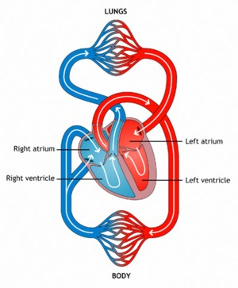
B7.2 Peak performance – circulation 1. Explain what is meant by a double circulatory system.
Tasks:
Explain what is meant by a double circulation system.
What are the advantages of a double circulatory system?

Slide 23
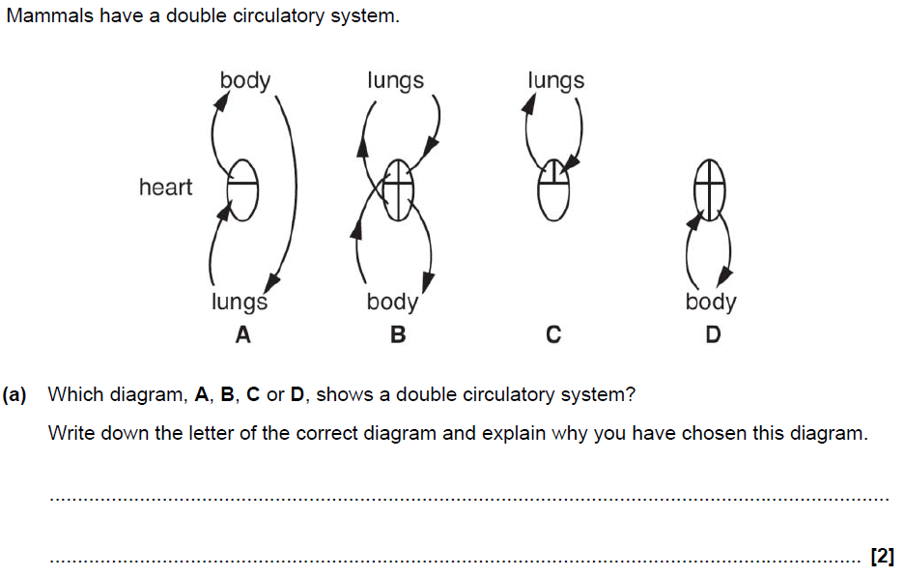
B7.2 Peak performance – circulation 1. Explain what is meant by a double circulatory system.

Slide 24
B7.2 Peak performance – circulation 2. Understand that the blood carries glucose molecules and oxygen to the muscles, and waste products away from muscles
Tasks:
Which substances are carried to the muscles by blood?
What are these substances used for when they get to the muscles?
Which substances are carried away from the muscles by blood?
How are these substances excreted by the body?

Slide 25
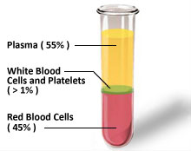
B7.2 Peak performance – circulation
Relate the components of the blood to their functions:
red blood cells – transport oxygen
white blood cells – fighting infections
platelets – blood clotting at injury sites
plasma – transporting nutrients, antibodies, hormones and waste.
Tasks:
Label the diagram to show the components of blood.
Complete the table to describe the function of each component.

Slide 26
B7.2 Peak performance – circulation
Understand how red blood cells are adapted to their function:
packed with haemoglobin (to bind oxygen)
no nucleus (more space for haemoglobin)
biconcave shape (increased surface area for oxygen exchange)
Tasks:
Label the diagram of a red blood cell to show how they are adapted to their function.

Slide 27
B7.2 Peak performance – circulation 5. Describe and name the main structures and blood vessels of the heart
Tasks:
Label the diagram of the heart to identify the main structures and blood vessels of the heart.
On your diagram, draw arrows to show the passage of blood into, and out of the heart.

Slide 28
B7.2 Peak performance – circulation 6. Describe the function of valves in the heart and veins
Tasks:
Where are valves found in the circulatory system?
What is the function of these valves.
What causes the ‘lub dub’ sound of a heartbeat?

Slide 29
6 MARKS

Slide 31
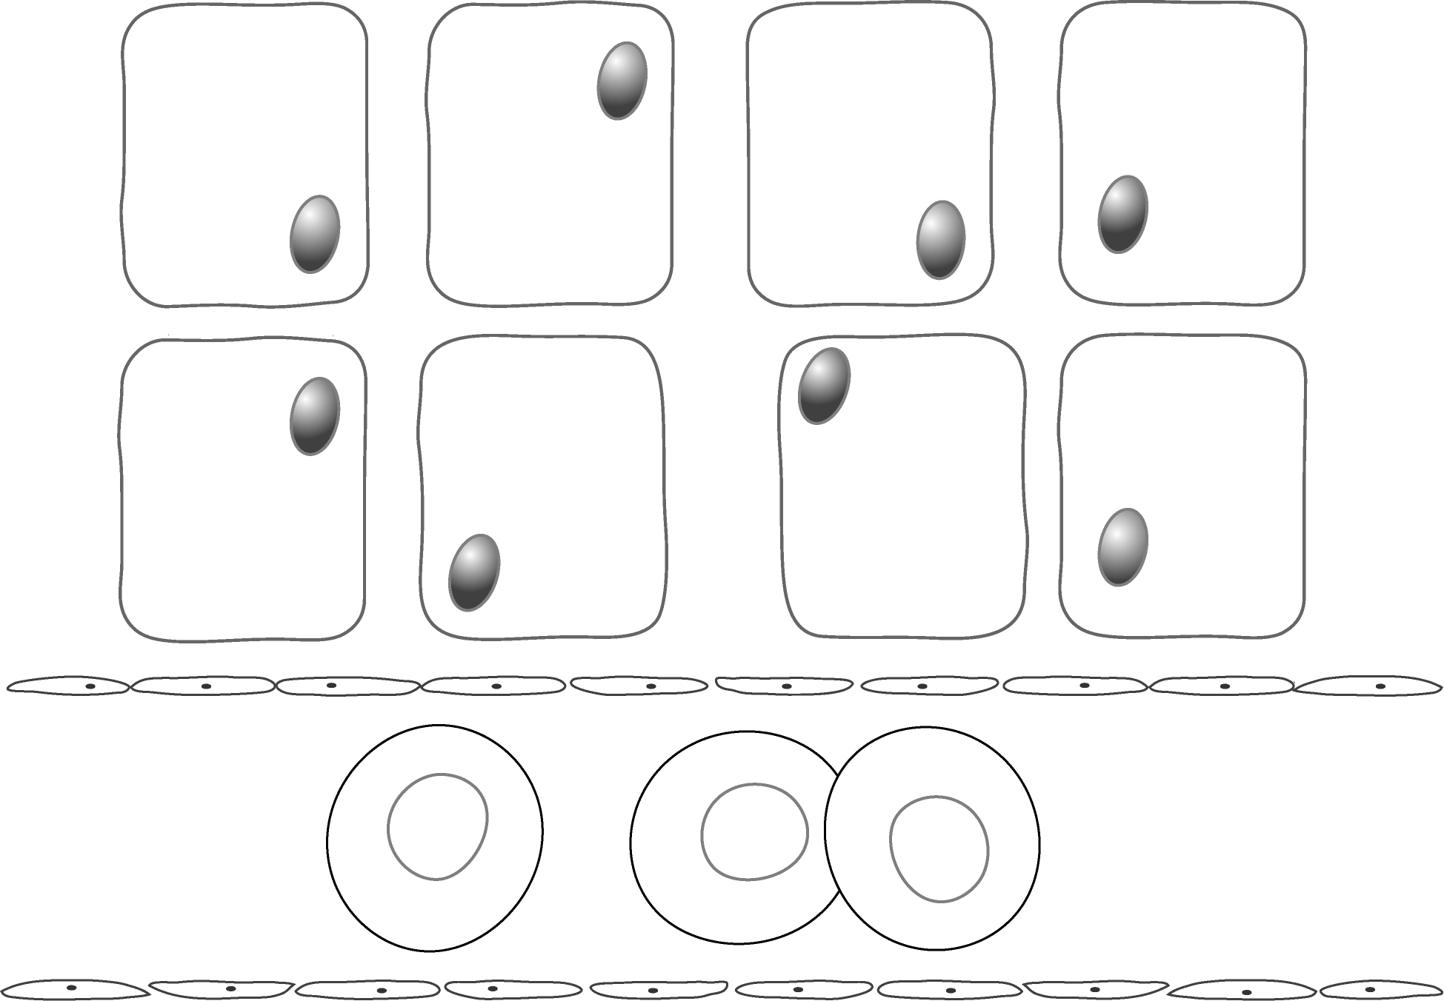
B7.2 Peak performance – circulation 7. Understand how tissue fluid is formed in capillary beds and describe its function.
Tasks:
Add arrows and labels to your diagram to show:
How tissue fluid leaves the capillary
The exchange of nutrients and waste products
The return of much of the fluid to the capillary

Slide 32
B7.2 Peak performance – circulation 7. Understand how tissue fluid is formed in capillary beds and describe its function.

Slide 33
B7.2 Peak performance – circulation 7. Understand how tissue fluid is formed in capillary beds and describe its function.
Tasks:
How is tissue fluid formed?
What is the function of tissue fluid?
Answers:
Blood enters the capillary at high pressure, blood plasma is squeezed out of the capillary, this forms a liquid called tissue fluid.
Bathes all of the cells; contains dissolved raw materials (e.g. glucose, oxygen) which diffuse into cells; waste products diffuse out of cells into tissue fluid.

Slide 34
Learning Outcomes
Fri. 07/06
MUST describe how the body reacts to high temperatures.
SHOULD describe how the body reacts to low temperatures.
COULD explain how effectors working antagonistically is a benefit.

Slide 35
B7.3 Peak performance – energy balance 1. Understand that to maintain a constant body temperature, heat gained is balanced by heat lost
Tasks:
List ways in which the body gains and loses heat.
What is the word equation for respiration? How does respiration cause your body temperature to increase?
What two things must be balanced to keep your body temperature constant?
Which part of your body is the warmest? Which parts are the coolest?
At what temperature does the warmest part need to be maintained?

Slide 36
B7.3 Peak performance – energy balance 2. Recall that temperature receptors in the skin detect external temperature
Tasks:
Where in your body would you find temperature receptors?
Label the diagram on your worksheet to show the structure of skin.

Slide 37
B7.3 Peak performance – energy balance 3. Recall that temperature receptors in the brain (hypothalamus) detect the temperature of the blood
Tasks:
Where in your brain would you find temperature receptors?
Label the diagram on your worksheet to show the structure of skin.
What is the job of the cerebral hemispheres in maintaining body temperature?

Slide 38
B7.3 Peak performance – energy balance 4. Understand that the brain acts as a processing centre, receiving information from the temperature receptors, and sending instructions to trigger the effectors automatically
Tasks (from B6):
How does the information from the temperature receptors get to the effectors?
B7.2 Peak performance – energy balance 5. Recall the names of two effectors for controlling body temperature.
Tasks:
State the names of two effectors for controlling body temperature.

Slide 39
B7.3 Peak performance – energy balance
Understand what happens at high body temperatures:
more sweat is produced by sweat glands which cools the body when it evaporates
blood vessels supplying the capillaries of the skin dilate (vasodilation) allowing more blood to flow through skin capillaries which increases heat loss
Tasks:
Describe how the body reacts at high temperatures.
How does this reaction cool you down?
What are the effectors that cause this reaction?

Slide 41
B7.3 Peak performance – energy balance 7. Explain how exercise produces increased sweating, and can produce dehydration, which may lead to reduced sweating and further increase of core body temperature
Tasks:
Describe and explain the fluctuations in body temperature in the graph above.

Slide 42
B7.3 Peak performance – energy balance
Understand what happens at low body temperatures:
the increased rate of respiration stimulated when muscles contract rapidly (shivering) results in some of the energy transferred in respiration warming the surrounding tissues
blood vessels supplying the capillaries of the skin constrict (vasoconstriction) restricting blood flow through skin capillaries which reduces heat loss
Tasks:
Describe how the body reacts at low temperatures.
How does this reaction cool you down?
What are the effectors that cause this reaction?

Slide 43
Tasks:
Summarise the processes leading to vasodilation and vasoconstriction by completing the diagram below.

Slide 44
B7.3 Peak performance – energy balance 9. Understand that some effectors work antagonistically, which allows a more sensitive and controlled response

Slide 45
B7.3 Peak performance – energy balance
6 MARKS

Slide 46
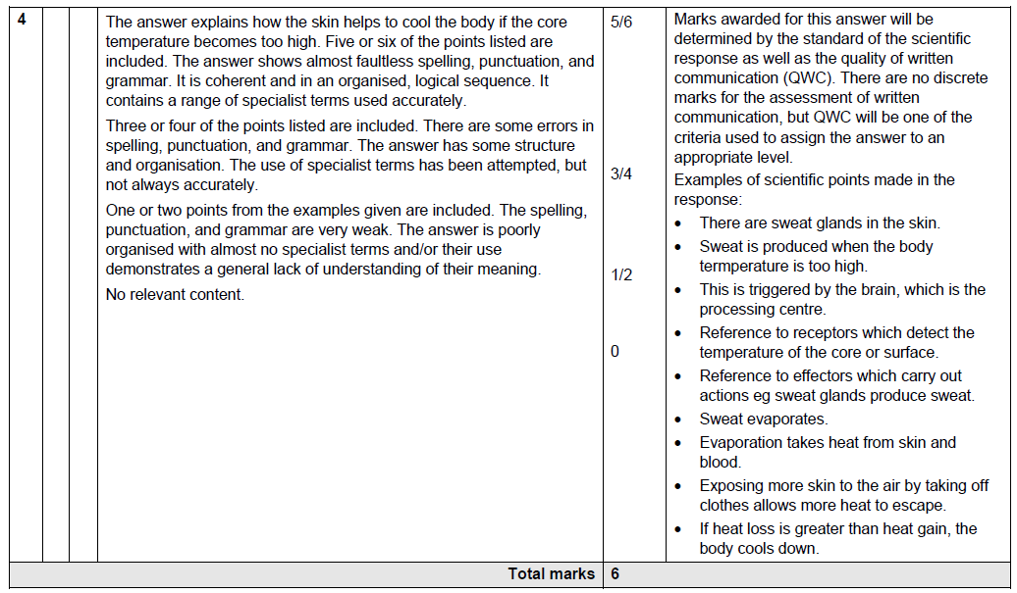

Slide 47
Learning Outcomes
Mon. 10/06
MUST describe the effect that high sugar foods have on the blood.
SHOULD describe the difference between type 1 and type 2 diabetes.
COULD interpret data on risks associated with an unhealthy lifestyle.

Slide 48
B7.3 Peak performance – energy balance 10. Understand that high levels of sugar, common in some processed foods, are quickly absorbed into the blood stream, causing a rapid rise in the blood sugar level
Tasks:
What is the name of the hormone that removes sugar from the blood?
What types of food can keep your blood sugar level balanced?
How do these types of food do this?

Slide 49
B7.3 Peak performance – energy balance 11. Recall that there are two types of diabetes and that it is particularly late onset diabetes which is more likely to arise because of poor diet or obesity
B7.3 Peak performance – energy balance 12. Understand what causes the two different types of diabetes.
Tasks:
Create a table to summarise the causes, symptoms and treatment of type 1 and type 2 diabetes.
 | Type 1 | Type 2
Causes
Symptoms
Treatment

Slide 50
B7.3 Peak performance – energy balance 13. Recall that type 1 diabetes is controlled by insulin injections and that type 2 diabetes can be controlled by diet and exercise

Slide 51
B7.3 Peak performance – energy balance 14. Explain how a diet high in fibre and complex carbohydrates can help to maintain a constant blood sugar level
6 MARKS

Slide 53
Learning Outcomes
Tues. 11/06
MUST state the difference between open and closed loop systems and give examples.
SHOULD describe why the production of large quantities of reproductive structures is a necessary strategy for successful reproduction.
COULD explain how humans depend on ecosystems.

Slide 54
B7.4 What can we learn from natural ecosystems? 1. Recall what a perfect closed loop system is.
Tasks:
What is a perfect closed loop system?
Answers:
A system that has no waste because the output from one part of the system becomes the input to another part
B7.4 What can we learn from natural ecosystems? 2. Understand why an ecosystem is a type of closed loop system
Tasks:
Is an ecosystem a closed or open loop system? Why?
Answers:
A closed loop system since most waste materials are not lost but are used as food or reactants.

Slide 55
B7.4 What can we learn from natural ecosystems?
Name examples of waste products in natural ecosystems:
oxygen (from photosynthesis)
carbon dioxide (from respiration)
dead organic matter such as fallen petals, leaves and fruits, and faeces
Tasks:
Give some examples of waste products in natural ecosystems.
How may each product become food or reactants for other organisms in the ecosystem?
B7.4 What can we learn from natural ecosystems? 4. Understand how these waste products may become food or reactants for animals, plants and microorganisms in the ecosystem, including the role of the digestive enzymes of microorganisms

Slide 56
B7.4 What can we learn from natural ecosystems? 5. Interpret closed loop system diagrams and data on the storage and movement of chemicals through an ecosystem, including water, carbon, nitrogen and oxygen
Tasks:
Find a diagram of the carbon cycle and the nitrogen cycle in a textbook or your revision guide.
Describe how a carbon atom in the carbon dioxide in the air can become a carbon atom in an animal.
Describe how a nitrogen atom in an animal can become a nitrogen atom in the air.

Slide 59
B7.4 What can we learn from natural ecosystems? 6. Understand that no ecosystem is a perfect closed loop system
Tasks:
Why is no ecosystem a perfect closed loop system?
Answers:
Some output is always lost, e.g. migration of organisms and loss of nutrients transferred by air or water
B7.4 What can we learn from natural ecosystems? 7. Understand that in stable ecosystems the output (losses) is balanced by gains
Tasks:
Describe an example of an ecosystem where output is balanced by gains.

Slide 60
B7.4 What can we learn from natural ecosystems? 8. Understand why the production of large quantities of reproductive structures is a necessary strategy for successful reproduction
Tasks:
Give the names of some reproductive structures that are produced in large quantities.
Why is it necessary for organisms to produce large quantities of these structures for successful reproduction?
Answers:
Eggs, sperm, pollen, flowers, fruit.
To maximise chances of reproducing successfully.

Slide 61
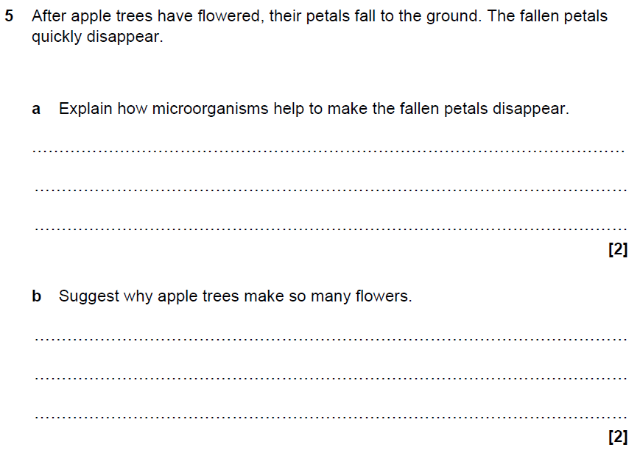
B7.4 What can we learn from natural ecosystems? 9. Understand that, in stable ecosystems, the production of large quantities of these reproductive structures is not wasteful, since the surplus is recycled in the ecosystem

Slide 62
B7.4 What can we learn from natural ecosystems? 10. Recall that vegetation in stable ecosystems prevents soil erosion and extremes of temperature, and promotes cloud formation
Tasks:
What is desertification?
What factors make it more likely to happen?
B7.4 What can we learn from natural ecosystems? 11. Understand how vegetation reduces soil erosion.
Tasks:
List the ways in which plants can protect soil from erosion.

Slide 63
B7.4 What can we learn from natural ecosystems? 12. Understand that humans depend on natural ecosystems to provide ‘ecosystem services’.
Tasks:
In what ways do humans depend on natural ecosystems?
B7.4 What can we learn from natural ecosystems? 13. Understand that human systems are not closed loop systems.
Tasks:
Why are human systems not closed loop systems?
Give examples of waste that leaves the system.
Answers:
Some waste leaves the system.
Non-recycled waste from households, agriculture and industry, and emissions from burning fossil fuels

Slide 64
Learning Outcomes
Weds. 12/06
MUST describe the environmental impact of removing biomass from natural closed loop systems for human use.
SHOULD describe the tensions between conserving natural ecosystems and the needs of local human communities
COULD explain the processes of eutrophication and bioaccumulation.

Slide 65
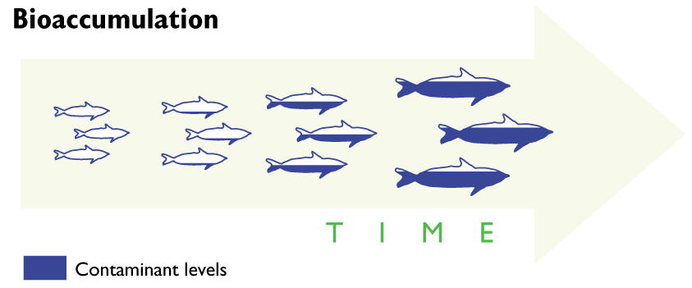
B7.4 What can we learn from natural ecosystems? 14. Understand that some non-recycled waste can build up to harmful levels, including bioaccumulation in food chains
Tasks:
Describe the process of bioaccumulation.
DDT was banned in the UK in 1984 but is still detectable in animals living in areas where it was used. How can you explain this?

Slide 66
B7.4 What can we learn from natural ecosystems? 15. Understand that human activity can unbalance natural ecosystems by altering the inputs and outputs, and that this leads to change
Tasks:
Give three examples of waste materials that are not recycled.
Which do you think is most dangerous? Why?
What three things does damage done by waste depend on?

Slide 67
B7.4 What can we learn from natural ecosystems? 16. Describe and explain the process of eutrophication
Tasks:
What is eutrophication?
Why is it dangerous to the environment?
How is eutrophication an example of long-term damage to ecosystems by humans?

Slide 68
6 MARKS
B7.4 What can we learn from natural ecosystems?

Slide 69
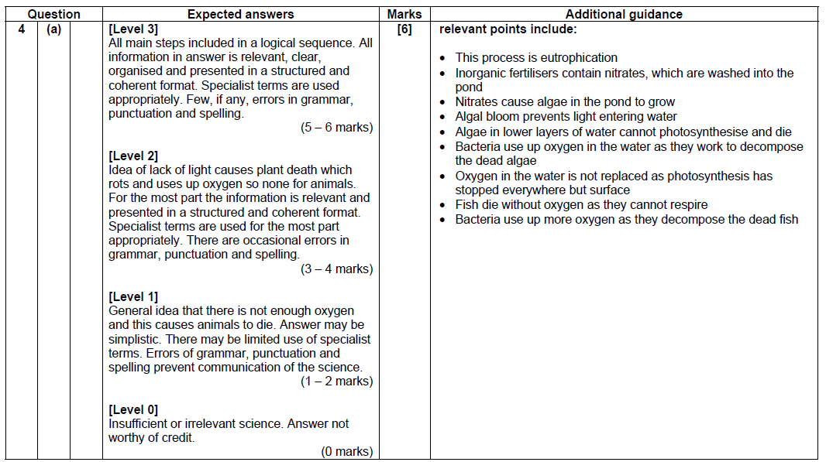

Slide 70
B7.4 What can we learn from natural ecosystems? 17. Describe the environmental impact of removing biomass from natural closed loop systems for human use, to include unsustainable timber harvesting and fishing
Tasks:
What do the terms ‘biodiversity’ and ‘sustainable’ mean?
What is the environmental impact of unsustainable timber harvesting? How could this be made sustainable?
Are fish farms sustainable? Give a reason for your answer.
What is the environmental impact of unsustainable fishing?

Slide 71
B7.4 What can we learn from natural ecosystems? 18. Explain the impact of replacing vegetation in natural ecosystems with agricultural crops and livestock, to include the loss of biodiversity, silting of rivers and desertification
Tasks:
How does replacing vegetation with agricultural crops and livestock lead to the following:
Loss of biodiversity
Silting of rivers
Desertification
A more biodiverse area is more likely to offer more ecological services. Explain why.

Slide 72
B7.4 What can we learn from natural ecosystems? 19. Understand that the use of natural resources by humans can only be sustainable if used at a rate at which they can be replaced
Tasks:
Explain what slash-and-burn agriculture is.
State three problems with the slash-and-burn approach to developing the rainforest.
How can forestry in the rainforest be sustainable?

Slide 73
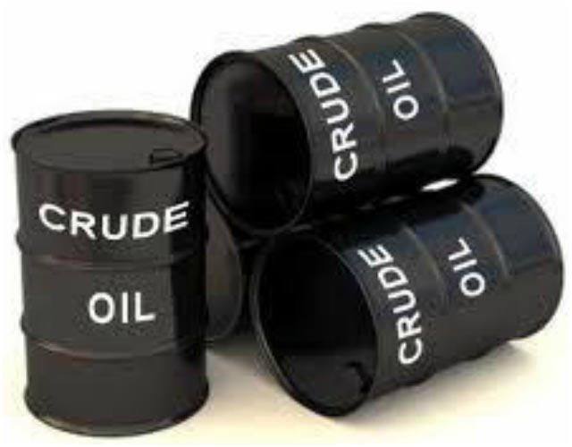
B7.4 What can we learn from natural ecosystems?
Understand why the use of crude oil does not fulfil the requirements of a closed loop system:
Crude oil takes millions of years to form from the decay of dead organisms
Energy released from burning crude oil originated from the Sun when these organisms were alive (‘fossil sunlight energy’)
Tasks:
How is crude oil formed?
What is released when crude oil is burned?
Why does the use of crude oil not fulfil the requirements of a closed loop system?

Slide 74
6 MARKS
B7.4 What can we learn from natural ecosystems?

Slide 75
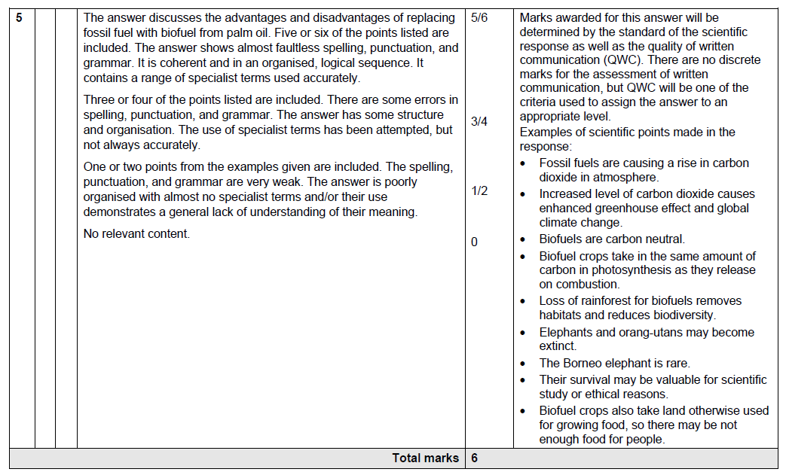

Slide 76
B7.4 What can we learn from natural ecosystems? 21. Recall and understand solutions to allow sustainable harvesting of natural resources such as timber and fish, including the use of quotas and restocking/replanting
Tasks:
What is a quota?
Explain how timber harvesting can be made sustainable.
Explain how fishing can be made sustainable.
How does the size of fish taken from the sea affect the growth of the fish population.

Slide 77
B7.4 What can we learn from natural ecosystems? 22. Describe the role of sunlight as a sustainable source of energy for natural ecosystems and sustainable agriculture
Tasks:
Why is sunlight a sustainable source of energy?
How does sunlight produce energy for natural ecosystems and sustainable agriculture?

Slide 78
B7.4 What can we learn from natural ecosystems? 23. Understand the tensions between conserving natural ecosystems and the needs of local human communities.
Tasks:
Describe the feelings the following people might have about fishing quotas for the North Sea cod stocks:
A fish conservation officer.
A local fisherman from Grimsby.
Suggest why politicians often set fish quotas higher than scientists would like.

Slide 79
B
E
C
D
A
F

Slide 80
Learning Outcomes
Fri. 14/06
MUST describe how bacteria can be used in industry.
SHOULD describe applications of nanotechnology.
COULD explain how biomedical engineering is used.

Slide 81
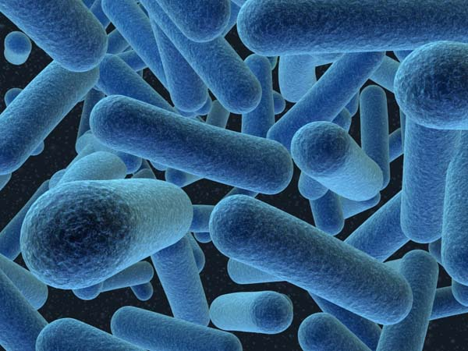
B7.5 New technologies
Recall the features of bacteria that make them ideal for industrial and genetic processes:
rapid reproduction
presence of plasmids
simple biochemistry
ability to make complex molecules
lack of ethical concerns in their culture
Tasks:
What features do bacteria have that make them ideal for industrial and genetic processes?
Why are each of these features an advantage?

Slide 82
B7.5 New technologies

Slide 83
B7.5 New technologies
Understand that bacteria and fungi can be grown on a large scale (fermentation) to include production of:
antibiotics and other medicines
single-cell protein
enzymes for food processing, for example chymosin as a vegetarian substitute for rennet
enzymes for commercial products, such as washing powders and to make biofuels
Tasks:
Describe what fermentation is.
List the four things that can be produced by fermentation of bacteria and fungi.
Explain why it is important to control the conditions inside a fermenter.

Slide 84
B7.5 New technologies 3. Recall what genetic modification is.
Tasks:
Describe what genetic modification is.
Answers:
Where a gene from one organism is transferred to another and continues to work
B7.5 New technologies 4. Recall the main steps in genetic modification: a. isolating and replicating the required gene b. putting the gene into a suitable vector (virus or plasmid) c. using the vector to insert the gene into a new cell d. selecting the modified individuals
Tasks:
What are the main steps in genetic modification?

Slide 85
B7.5 New technologies

Slide 86
B7.5 New technologies
6 MARKS

Slide 88
B7.5 New technologies 5. Recall examples of the application of genetic modification.
Tasks:
Draw a labelled diagram of a bacterial cell. Highlight the parts of the cell that contain genetic material.
Give examples of genetic modification in bacteria and plants.
Describe the stages involved in
recombinant DNA.
Answers:
Bacterial synthesis of medicines
(insulin); herbicide resistance in
crop plants.

Slide 89
B7.5 New technologies
Understand and explain the use of DNA technology in genetic testing:
isolation of a DNA sample from white blood cells
production of a gene probe labelled with a fluorescent chemical
addition of the labelled gene probe (marker) to the DNA sample
use of UV to detect the marker and therefore indicate the position of the gene or the presence of a specific allele in the DNA sample
Tasks:
Create a flow diagram of the stages involved in genetic testing.
What is a genetic probe? Why can it only bind to a particular area of DNA?

Slide 90
B7.5 New technologies 7. Recall that nanotechnology involves structures that are about the same size as some molecules
Tasks:
How many nanometres are there in a metre?
B7.5 New technologies 8. Describe the application of nanotechnology in the food industry.
Tasks:
Describe how nanotechnology is used in the food industry.
Give two factors that affect the rate that oxygen passes through food wrap.

Slide 91
B7.5 New technologies 9. Describe applications of stem cell technology in tissue and organ culture, including the treatment of leukaemia and the potential to treat spinal cord injuries
Tasks:
Describe what a stem cell is and why they are so useful to doctors.
Identify the key stages in treatment of leukaemia by stem cells.
How can stem cell technology be used to treat spinal cord injuries?

Slide 92
B7.5 New technologies 10. Describe the role of biomedical engineering in pacemakers and the replacement of faulty heart valves.
Tasks:
What is a pacemaker used for?
Why might heart valves need to be replaced?
What are the advantages of using an artificial heart valve over a biological valve?

