Slide 1
C2 revision

Slide 2
Hydrocarbons
Crude oil contains hydrocarbons of different chain lengths
There are intermolecular forces between the different chain length
Intermolecular forces are forces between molecules
The longer the chain the bigger the forces between molecules

Slide 3
Fractional distillation
Different length hydrocarbons have different properties
Longer chains have a higher b.p/m.p than shorter molecules
More energy needed to over come the intermolecular forces compared to shorter chains
More heat needed to turn the hydrocarbon fractions from a liquid to a solid
(diagram)

Slide 4
Polymerisation
Some long chain hydrocarbons that do not have much use are split into smaller, more useful hydrocarbons e.g. Petrol
A by-product of this process is an alkene e.g. Ethene
Ethene is then used to make plastics in polymerisation
During polymerisation, small ethene molecules, called monomers are joined together to form long chain molecules, called polymers
E.g. Ethene monomers join together to form polyethene

Slide 5
Why do we swap more traditional materials for plastics?
Why swap paper for plastic when making bags?

Slide 6
Modifying polymers
Plastics traditionally have long chains that can slide past each other, allowing the plastic to bend (flexible)
Polymers can be modified to increase chain length to make the polymer stiffer and increase m.p
Plastics with weaker forces have chains that slide past each other easily and have a low melting point
Plastics with stronger forces have chains that stay in position and have a high melting point
Polymer chains packed tighter together have a higher density than polymers packed more loosely together

Slide 7
Cross-linking allows cross links to form between chains, making the polymer stiffer and increasing m.p
Plasticisers will make a polymer softer, allowing it to be shaped easier and lowers the m.p
(HT) a polymer can be made more crystalline. Branched chains are more bendy but crystalline polymers have straight chains so they pack closer together, making the polymer stronger, more dense and have a higher m.p

Slide 8
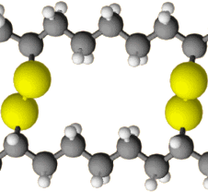

Slide 9
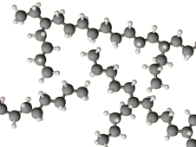

Slide 10
