Slide 1
C2: Material Choices

Slide 2
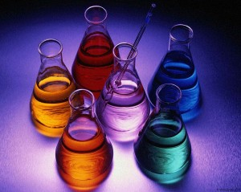
What are materials made from?
Every material is a chemical or mixture of chemicals, including:
Ceramics, for bricks, wall tiles and plates
Metals, for vehicles, high-rise buildings, and jewellery
Polymers, for packaging and protective clothing
We obtain or make materials from:
Living things, for example cotton, wool, leather and wood
Non-living things, for example limestone and oil

Slide 3
What are properties of materials?
Manufactures look at materials’ properties to choose the best material from which to make a product. Important properties include melting point, strength in tension, strength in pulling, stiffness, hardness and density.
The effectiveness and durability of a product depend on the properties of its materials. A product that is durable lasts for a long time before breaking or rotting.

Slide 4
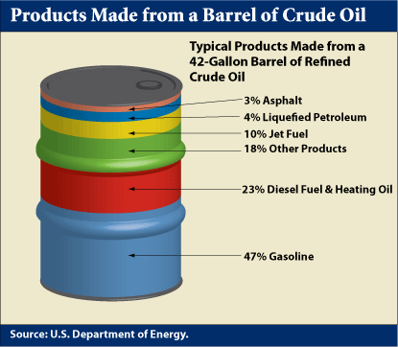
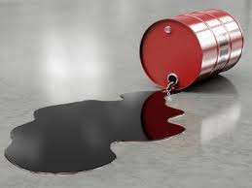
What’s in crude oil?
Crude oil is a thick, dark-coloured liquid. It is mainly a mixture of hydrocarbon molecules of different lengths
Hydrocarbon molecules are made from hydrogen and carbon only, for example, propane and octane.

Slide 5
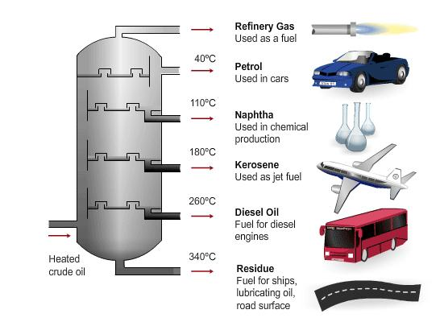
How is crude oil used?
Crude oil is not much use as it is so companies use fractional distillation to separate crude oil into fractions-mixture of hydrocarbons with similar boiling points.
Fractional distillation happens in a fractionating tower and works like this:
Crude oil is heated in a furnace and compounds evaporate and become gases
Gases enter the tower. As they move up, they cool down. Different fraction condense at different levels:
Compounds with small molecules have low boiling points because the forces between the molecules are weak, so only a little energy is needed for them to break out a liquid and form a gas. These molecules rise to the top of the tower
Compounds with big molecules have higher boiling points. They condense at the bottom of the tower.
Different fractions have different uses, including:
Fuels, e.g. methane, petrol, diesel and liquefied petroleum gas
Lubricants, e.g. Vaseline and engine oil
Raw materials to make new materials in chemical synthesis

Slide 6
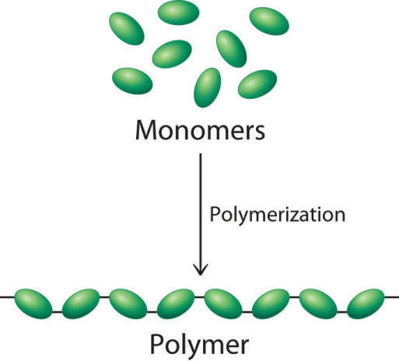
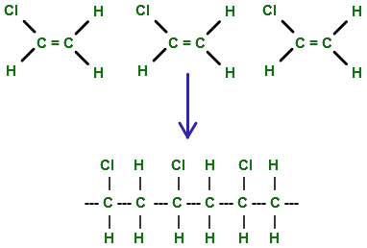
How are polymers made?
Many of the chemicals obtained from crude oil are used as fuels. Just 4% of the crude oil makes synthetic materials such as polymers. Synthetic materials from raw materials from the Earth.
Polymers are very long molecules and they form when many monomers join together and this type of chemical reaction is called polymerisation.
In polymerisation reactions – as in all chemical reactions – there are same number of atoms of each element in both the reactants and products. The atoms are rearranged.
There are many polymers, all made from different starting materials. Each polymer has unique properties. Synthetic polymers have replaced natural materials in many products. For example, rope is made from polypropene instead of sisal. Clothes are made from nylon instead of cotton because nylon is more durable.

Slide 7
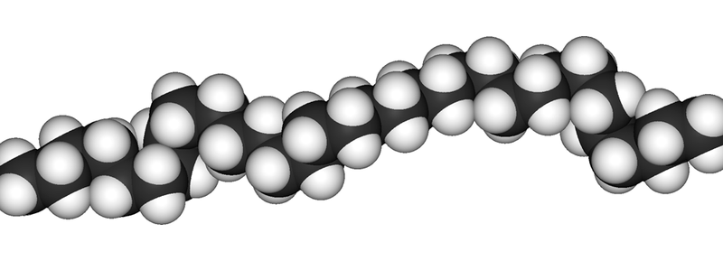
What gives polymers their properties?
The properties of polymers depend on how their molecules are arranged and held together. For example, wax has shorter molecules than polythene. This means that:
Polythene is stronger since its molecules are tangled and difficult to separate
Polythene has high melting point since there are stronger forces between long polythene molecules than between wax molecules.

Slide 8
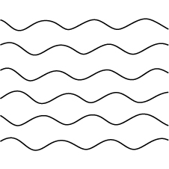
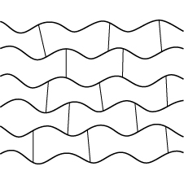
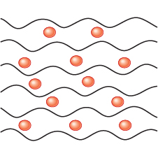
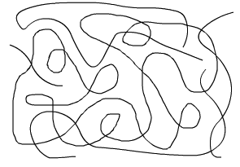
What makes polymer properties?
Method | How properties change
Making chains longer | Stronger
Adding cross-links | Harder Stronger Less flexible
Adding plasticisers | Softer More flexible
Increasing crystallinity by lining up polymer molecules | Stronger denser

Slide 9
What is nanotechnology?
Nanotechnology is the use and control of tiny structure. Nanoparticles are about the same size as some molecules, between 1 and 100 nanometers(nm) across.
Nanoparticles have different properties compared with larger particles of the same material because nanoparticles have bigger surface area compared with their volume. They can occur:
Naturally, in sea spray
By accident, when fuels burn
By design, for example:
Silver nanoparticles give fibres antibacterial properties, in medical dressings and socks
Adding nanoparticles to plastics for sport equipment such as tennis rackets makes them stronger
Nanoparticles may have harmful effects on health, Some people think these effects should be studied more closely before using nanoparticles more widely.

Slide 10
