Slide 1
1. Clues in rocks
Geologists look for clues in rocks. They study them to see how the Earth’s surface has changed. They look at how the rocks have formed and how they have changed.
Copy the table below and explain the following clues that can be found in rocks.
Clues | What the clue tells us?
Magnetic particles in rocks.
Fossils in the rocks.
Ripples in the rocks.
Minerals in the rocks

Slide 2
2. Salt mining
There are 3 main methods of extracting salt. Some have more impact on the environment than others. Different methods are more suitable for particular uses of salt as well.
Copy and complete the table
Method of mining | Description | Environmental impact
Mining for rock salt for use in spreading salt on roads etc.
Solution mining for a range of uses.
Evaporation from sea water.

Slide 3
3. Salt in food
Salt is commonly used in food. It is an essential part of a healthy diet, but it is important that this is in a moderate amount.
The main sources of salt are
Cereal products, breads and cakes
Processed meat and fish
Some dairy products including cheese
Copy and complete the table below.
Benefits of using salt in food | Risks of eating too much salt

Slide 4
4. Alkalis
One common alkali is Sodium hydroxide.
Alkalis used to come from potash (burnt wood) and from urine.
Alkalis are used for
Neutralising soil
To convert fats and oils into soap
To make glass
To make chemical for binding dye to cloth
Complete the following reactions with alkalis.
Hydroxide + acid → salt + water
Sodium hydroxide + hydrochloric acid →
Potassium hydroxide + hydrochloric acid →
Carbonate + acid → salt + carbon dioxide + water
Potassium carbonate + hydrochloric acid →
Sodium carbonate + hydrochloric acid →

Slide 5
5. Chlorine
Chlorine is a group 7 element. It is a highly toxic and is a gas at room temperature. It was once used as a gas during the war. However chlorine compounds can be safe enough to be used in drinking water.
Use page 88 and 89 of the text book to help you to recall the benefits and risks of chlorination.
Benefits of chlorination | Risks of chlorination

Slide 6
6. Chemicals from salt
The three main chemicals from salt are chlorine, sodium hydroxide and hydrogen.
Think about the uses of these chemicals and make notes about them.
Chlorine
Sodium hydroxide
Hydrogen

Slide 7
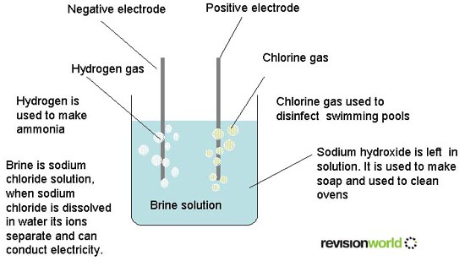
7. Electrolysis
Explain how electrolysis can be used to separate brine.
2H⁺ + 2e⁻ → H₂
2Cl⁻ → Cl₂ + 2e⁻
Na⁺ + OH⁻ → NaOH

Slide 8
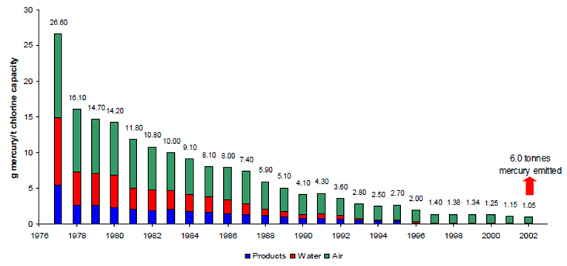
8. Environmental impacts
This graph shows the environmental impacts in terms of product made, and the amount of water and air used in the making.
Use the graph to explain the environmental impact of the electrolysis method.

Slide 9
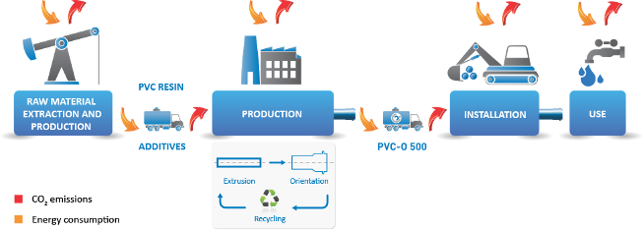
9. Life cycle of PVC
PVC is a polymer that is commonly used. Most chlorine is produced for the manufacture of PVC. uPVC is the plastic used for guttering, pipes and window frames. By adding plasticisers it can be more flexible and used in clothing.
Explain how you could reduce the environmental impact in the life cycle of PVC. (use the diagram to help)

Slide 10
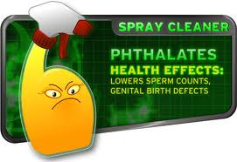
10. Risks of plasticisers
Toymakers like to use PVC because it is very versatile. The most common plasticiser used to make the PVC soft and flexible is phthalates.
Some campaigners argue that phthalates should be banned.
Think about things that
The public could do
Governments could do
Scientists could do

Slide 11
11. Impacts of chemical production
The production of chemicals can have an impact not only on the environment but also on the economy, and the local community.
Consider the possible impacts it can have on the following.
ENVIRONMENT
LOCAL ECONOMY
LOCAL COMMUNITY

Slide 12
12. Tectonic plates
Tectonic plates have moved over time. They are made up of the Earths crust and the top part of the upper mantle. They move slowly due to convection currents in the underlying mantle.
Use the knowledge of tectonic plates to explain the following.
How did Britain come to be in its current location.
Why Britain has experienced a range of different climates over time
Why some continents, which are separated by large oceans, contain similar fossils and rock patterns.

Slide 13
13. Formation of salts
The name of the salt depends on the type of acid used in its production.
Hydrochloric acid makes CHLORIDE salts
Sulphuric acid makes SULPHATE salts
Nitric acid makes NITRATE salts
Ethanoic acid makes ETHANOATE salts
Name the salt produced with the following reactants…
Sodium hydroxide + sulphuric acid
Potassium hydroxide + hydrochloric acid
Lithium hydroxide + nitric acid
Sodium hydroxide + ethanoic acid

