Slide 1
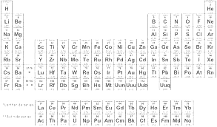
C4: CHEMICAL PATTERNS
WHAT HAVE YOU LEARNT???

Slide 2
Where are the metals on the Periodic Table? (1)
Name all sub-atomic particles and state their charges. (3)
Which group and period is oxygen in? (1)
State the amount of each sub-atomic particle in magnesium (3)
Draw the electronic configuration of sulphur (1)
What is the electronic structure of calcium? (1)
Define the words (3)
atom
ion
molecule

Slide 3
Identify these chemical symbols (6)
a) b) c)
d) e) f)

Slide 4
When metals are burned in oxygen they produce different colours. What is the unique pattern called that they produce? (1)
Why is lithium less reactive than potassium? (3)
Write the chemical formula for the following compounds using the charges of the ions. State the charges of each (4)
lithium fluoride
magnesium oxide
beryllium chloride
aluminium sulphide
Lithium will react with water to form a salt and hydrogen gas. Write a fully balanced chemical equation for this reaction including state symbols. (3)
State the trend in reactivity of the group 1 metals (1)
Compare the reactions between sodium and water, with potassium and water (4)

Slide 5
What is a displacement reaction? (1)
Chlorine will displace bromine when potassium bromide is reacted with chlorine. Write a fully balanced chemical equation for this reaction (3)
What is the charge on (a) metal ion (b) non-metal ion (2)
State the colours and state of matter at room temperature of group 7 halogens, chlorine through to iodine. (4)

