Slide 1
C7 revision
Higher tier

Slide 2
Percentage yield
percentage yield = actual yield x 100
theoretical yield
You may first have to work out the theoretical yield

Slide 3
Heating with a catalyst converts cyclohexanol, C₆H₁₁OH, to cyclohexene, C₆H₁₀.
What is the percentage yield if 20 g of cyclohexanol gives 14.5 g of cyclohexene?
5. The reaction involving cyanide in the older process for making the active ingredient for Roundup was exothermic. The replacement reaction in the newer process is endothermic. Suggest why this difference contributes to safety.

Slide 4
100 g cyclohexanol gives a theoretical yield of 82 g cyclohexene.
Theoretical yield from 20 g cyclohexanol = 0.2 × 82 g = 16.4 g
Percentage yield = 14.5/16.4 × 100% = 88%

Slide 5
Atom economy
Atom economy= total RFM of useful product x100 total RFM of reactants

Slide 6
Heating with a catalyst converts cyclohexanol, C₆H₁₁OH, to cyclohexene, C₆H₁₀.
What is the atom economy, assuming that the catalyst is recovered and reused?

Slide 7
Atom economy = 82/100 × 100% = 82%

Slide 8
16 g of methane (CH₄) was burned in the air. 32 g of carbon dioxide was collected during the reaction. During the reaction, some sooty deposits were noticed. The equation for the combustion of methane is:
CH₄ + 2O₂ CO₂ + 2H₂O
What was the percentage yield of carbon dioxide?
Calculate the atom economy for the reaction.

Slide 9
16 g of methane gives a theoretical yield of 44 g of carbon dioxide. Percentage yield = 32/44 × 100% = 73%
Atom economy = 44/80 × 100% = 55%

Slide 10
Balanced symbol equations
Same number of atoms on left and right
State symbols
Aq
S
L
g

Slide 11
Reactions of alcohols with sodium
Reacts with sodium like water
Due to both water and alcohol having an –OH group
Products with water are sodium hydroxide and?
Products with alcohol are?
Sodium ethoxide and hydrogen
H atom of –OH group reacts with sodium – why don’t the other H atoms in the hydrocarbon section react?
Unreactive
Forms an ionic bond between the oxygen of the ethoxide ion and the sodium ion
Sodium is an ionic compound and is solid at room temperature

Slide 12
Making an ester
Made from a carboxylic acid and an alcohol (with concentrated sulphuric acid as a catalyst)
Heating under reflux – chemicals are volatile so an open Liebig condenser is used to condense any vapours to prevent loss of reactant and prevent loss of yield (why not stopper the condenser?)
Distillation - after refluxing two layers are formed. The ester boils at a lower temperature and is collected (impure)

Slide 13
Impure product shaken with aqueous reagents - this removes impurities. Mixture placed in a tap funnel and lower product layer collected
Drying - granules of calcium chloride added to remove impurities
Distillation - pure dry ethyl ethanoate collected from distillate due to lower b.p

Slide 14
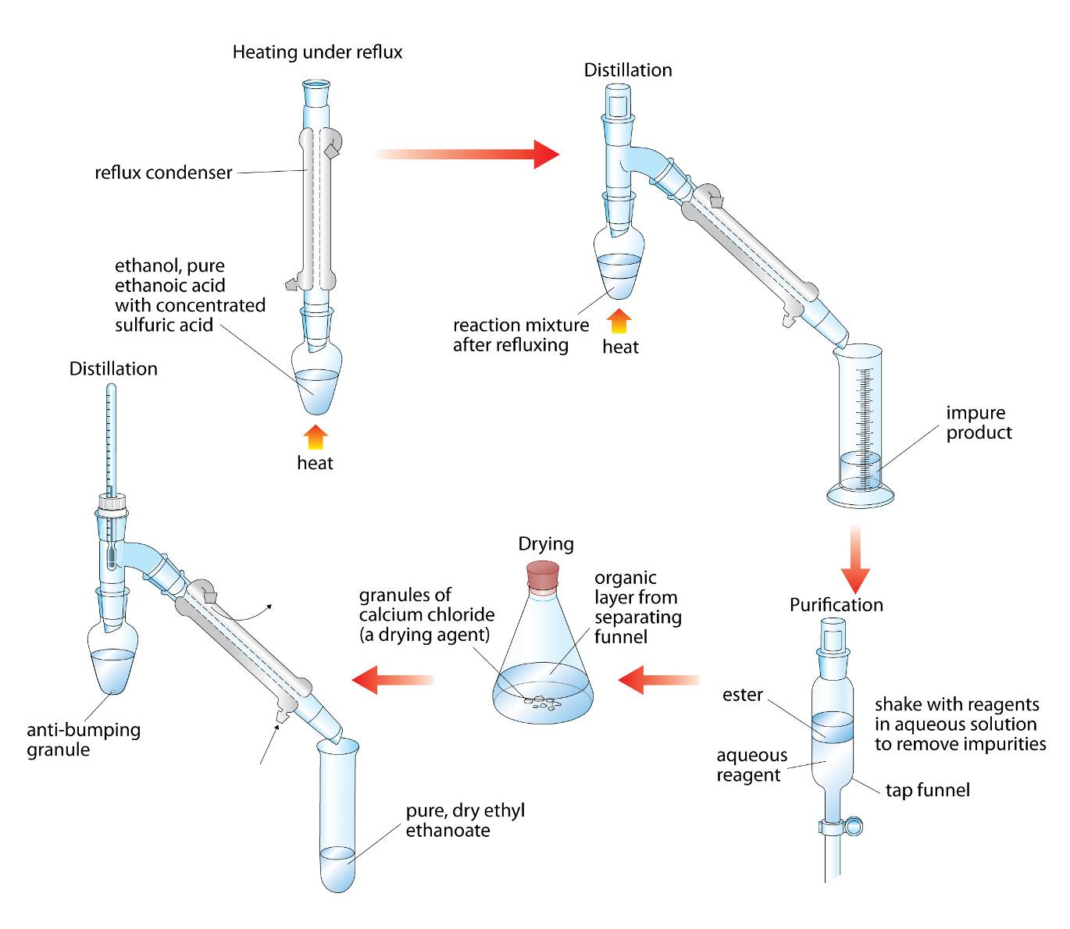

Slide 15
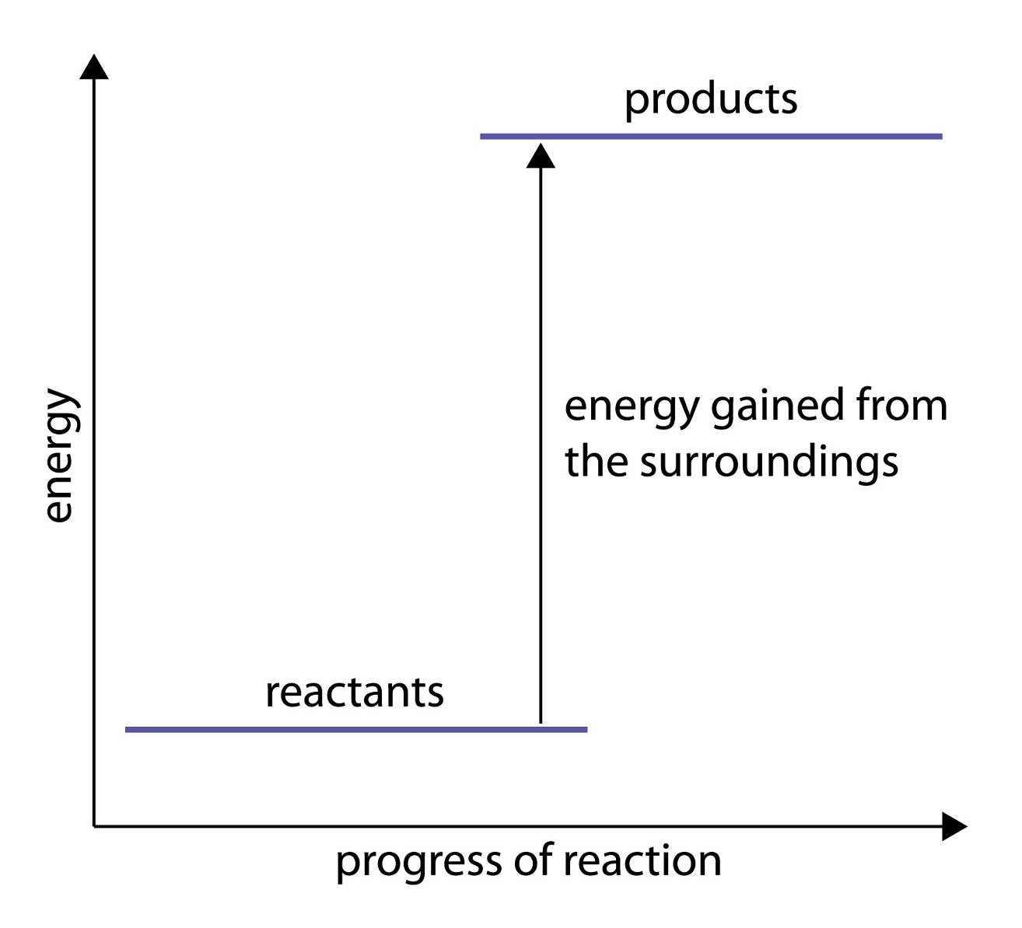
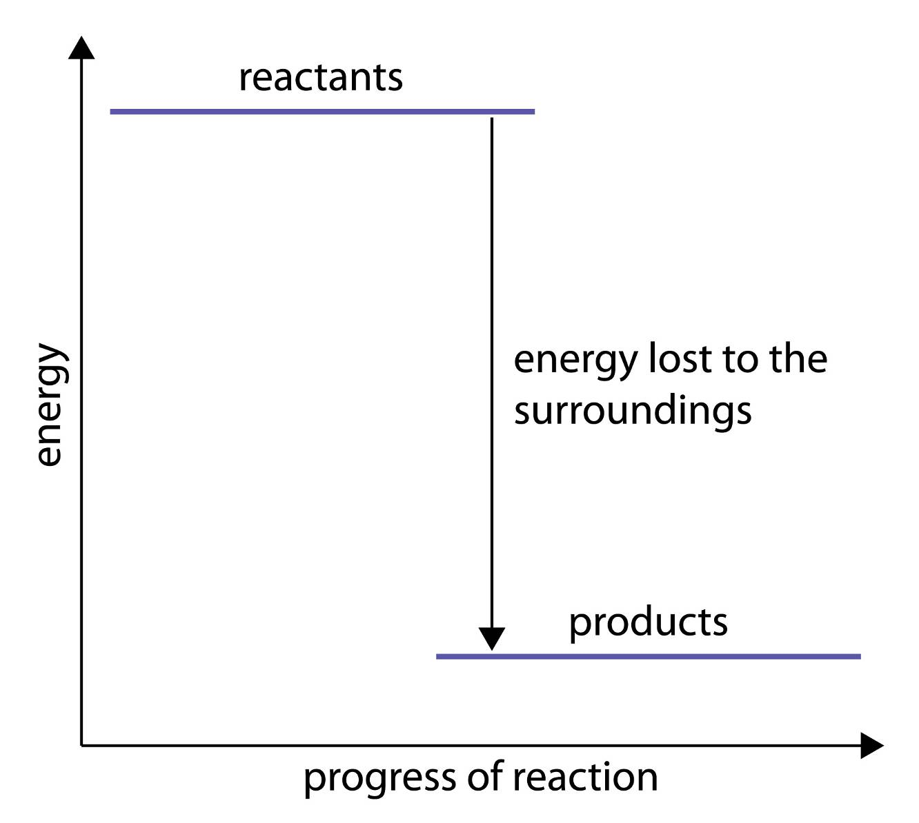
Calculating energy change

Slide 16
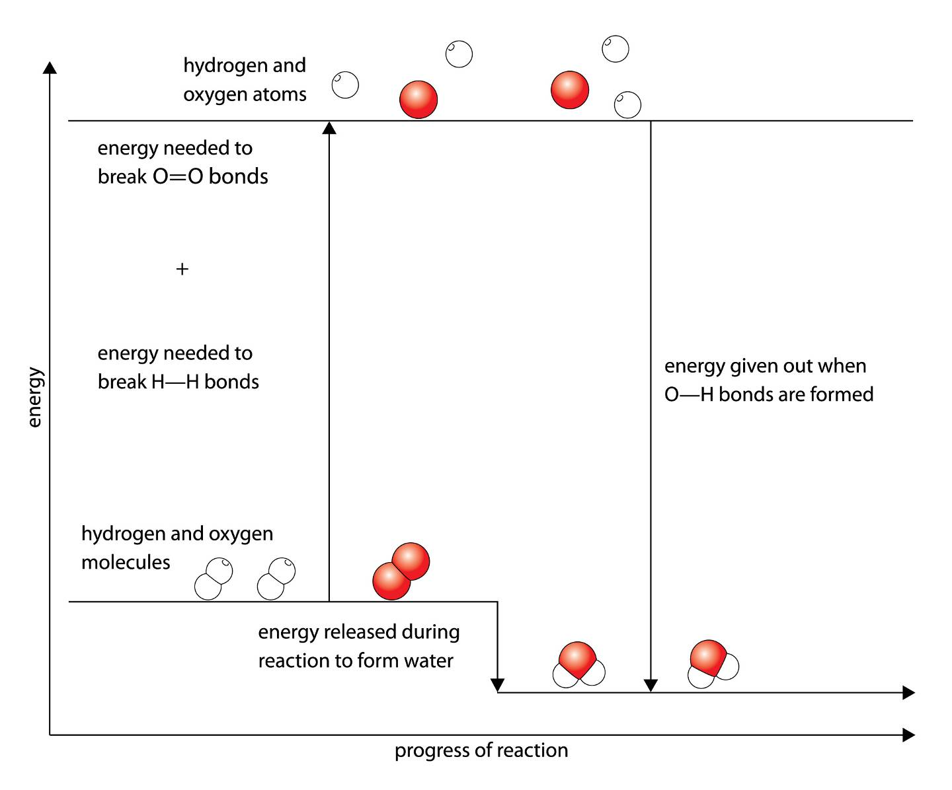

Slide 17
Calculating energy change
Calculate energy used in breaking bonds
Calculate energy formed from formation of bonds
Calculate difference (- means exothermic)
Formation of steam or hydrogen halides

Slide 18
3. Hydrogen burns in chlorine.
H₂(g) + Cl₂(g) 2HCl(g)
a Which bonds are broken during the reaction?
b Which bonds are made during the reaction?
c Use the data in the table to calculate the overall energy change for the reacting masses shown in the equation. Is
d. Is this reaction exothermic or endothermic?
e Draw an energy-level diagram for the reaction.
Bond | Energy change for the formula masses (kJ)
H—H | 434
Cl—Cl | 242
H—Cl | 431

Slide 19
Use the data in the table to calculate the overall energy change for the reacting masses shown in the equation.
Energy to break bonds = 434 kJ + 242 kJ = 676 kJ
Energy given out on forming bonds = 2 × 431 kJ = 862 kJ
Overall energy change = 186 kJ given out

Slide 20
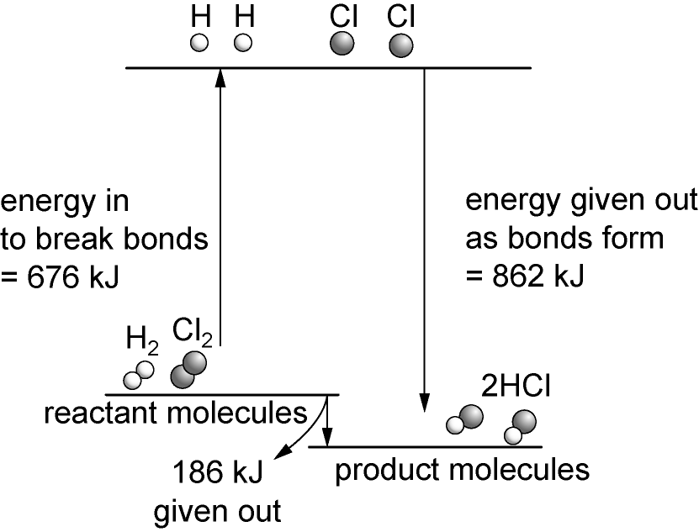

Slide 21
Haber process – optimising conditions
3H₂ + N₂ 2NH₃
High temperature and high pressure
Pressure favours side of reaction with fewer molecules as pressure increase causes reaction to try and counteract this
Why not higher pressure?
Temperature – exothermic reaction is forward reaction therefore formation of ammonia favours low temperature
Have high temperature – why?

Slide 22
Quantitative measurement
measuring out accurately a specific mass or volume of the sample
working with replicate samples
dissolving the samples quantitatively
measuring a property of the solution quantitatively
calculating a value from the measurements
estimating the degree of uncertainty in the results

Slide 23
Concentration
1 dm³ =1000cm³
Concentration = mass (g) / volume (dm³)
500g in 1 dm³ solvent =
500g/dm³
500g in 500 cm³ solvent =
1000g/dm³

Slide 24
Re-arrange
What is the mass?
1000cm³ sample with a concentration of 500g/dm³
500g
20cm³ sample with a concentration of 10g/dm³
0.02g

Slide 25
What is the concentration of these solutions in grams per litre (g/dm³):
a a solution of sodium carbonate made by dissolving 4.0 g of the solid in water and making the volume up to 500 cm³ in a graduated flask?
b a solution of citric acid made by dissolving 2.25 g of the solid in water and making the volume up to 250 cm³ in a graduated flask?

Slide 26
What is the mass of solute in these samples of solutions?
A 10 cm³ sample of a solution of silver nitrate with a concentration of 2.55 g/dm³.
A 25 cm³ sample of a solution of sodium hydroxide with a concentration of 4.40 g/dm³.

Slide 27
8.0 g/dm³
9.0 g/dm³
0.0255 g
0.11 g

Slide 28
Titration – quantify to calculate the concentration of a solution

Slide 29
Calculating the concentration of an unknown sample
Calculate the mass of your known solution in the titrated volume
Calculate the mass of your unknown sample
Calculate the concentration of your unknown sample using the equation

