Slide 1
Ionic charge and electrical conduction
L.Q

Slide 2
Formulae of ionic compounds
A formula uses chemical symbols and numbers to show the ratio of atoms of each element present in the compound.
To work out the formula of an ionic compound, follow this procedure:
1. Write down the symbol for each atom.
2. Calculate the charge for each ion.
3 Balance the number of ions so the positive and negative
charges equal zero. This gives a ratio of ions.
4. Write down the formula without the ion charges – the metal is always written first.

Slide 3
Formula of sodium fluoride
What is the formula of sodium fluoride?
Symbol
Ion charge
Balance the number of ions
Ratio of ions Formula
Na
F
1+
1-
1 sodium ion is needed for each fluoride ion
1 : 1
NaF
Na
F
Na⁺
F⁻
1 electron

Slide 4
Formula of aluminium bromide
What is the formula of aluminium bromide?
Symbol
Ion charge
Balance the number of ions
Ratio of ions Formula
Al
Br
3+
1-
3 bromide ions are needed for each aluminium ion
1 : 3
AlBr₃
Br
Br⁻
Al
1 electron for each atom
Br
Al³⁺
Br⁻
Br
Br⁻

Slide 5
Formula of aluminium oxide
What is the formula of aluminium oxide?
Symbol
Ion charge
Balance the number of ions
Ratio of ions Formula
Al
O
3+
2-
2 aluminium ions are needed for 3 oxide ions
2 : 3
Al₂O₃
Al
O
O²⁻
Al³⁺
2 electrons for each atom
O
O²⁻
Al³⁺
Al
O
O²⁻

Slide 6
More ionic formulae
Work out the formulae of all the possible ionic compounds from combinations of these metals and non-metals.
 | Li | Ca | Na | Mg | Al | K
F
O
N
Br
S
Cl
metals
non- metals
LiF CaF₂ NaF MgF₂ AlF₃ KF
Li₂O CaO Na₂O MgO Al₂O₃ K₂O
Li₃N Ca₃N₂ Na₃N Mg₃N₂ AlN K₃N
LiBr CaBr₂ NaBr MgBr₂ AlBr₃ KBr
Li₂S CaS Na₂S MgS Al₂S₃ K₂S
LiCl CaCl₂ NaCl MgCl₂ AlCl₃ KCl

Slide 7
Compound ions
Ionic compounds can contain ions consisting of groups of atoms rather than a single atom. These are compound ions.
Ion Formula Charge Atoms present
hydroxide OH⁻
1-
O
H
sulfate SO₄²⁻
2-
S
O
O
O
O
nitrate NO₃⁻
1-
N
O
O
O
carbonate CO₃²⁻
2-
C
O
O
O
ammonium NH₄⁺
1+
N
H
H
H
H
hydrogen- carbonate
HCO₃⁻
H
C
O
O
O
1-

Slide 8
More complicated formulae
Working out the formulae for compounds containing compound ions is the same as for simple ionic compounds. The compound ion is treated as a single particle, not individual particles.
1. Write down the symbol for each atom.
2. Calculate the charge for each ion.
3 Balance the number of ions so the positive and negative
charges equal zero. This gives a ratio of ions.
4. Write down the formula without the ion charges. If more than one compound ion is required, brackets must be put around the ion, before the number.

Slide 9
Formula of lithium nitrate
What is the formula of lithium nitrate?
Symbol
Ion charge
Balance the number of ions Ratio of ions
Formula
Li
NO₃
1+
1-
1 lithium ion is needed for each nitrate ion
1 : 1
LiNO₃

Slide 10
Formula of magnesium nitrate
What is the formula of magnesium nitrate?
Symbol
Ion charge
Balance the number of ions
Ratio of ions Formula
Mg
NO₃
2+
1-
2 nitrate ions are needed for each magnesium ion
1 : 2
Mg(NO₃)₂
The brackets around NO₃ indicate that the ‘2’ refers to a complete nitrate ion.

Slide 11
Formula of sodium sulphate
What is the formula of sodium sulfate?
Symbol
Ion charge
Balance the number of ions
Ratio of ions Formula
Na
SO₄
1+
2-
2 sodium ions are needed for each sulfate ion
2 : 1
Na₂SO₄
Although ‘Na’ contains 2 letters, it represents a single atom, so no brackets are required.

Slide 12
Formula of aluminium hydroxide
What is the formula of aluminium hydroxide?
Symbol
Ion charge
Balance the number of ions
Ratio of ions Formula
Al
OH
3+
1-
3 hydroxide ions are needed for each aluminium ion
1 : 3
Al(OH)₃

Slide 13
Formula of ammonium sulphate
What is the formula of ammonium sulfate?
Symbol
Ion charge
Balance the number of ions
Ratio of ions Formula
NH₄
SO₄
1+
2-
2 ammonium ions are needed for each sulfate ion
2 : 1
(NH₄)₂SO₄

Slide 14
Formula of aluminium carbonate
What is the formula of aluminium carbonate?
Symbol
Ion charge
Balance the number of ions
Ratio of ions Formula
Al
CO₃
3+
2-
2 aluminium ions are needed for 3 carbonate ions
2 : 3
Al₂(CO₃)₃
Although ‘Al’ contains 2 letters, it represents a single atom, so no brackets are required.

Slide 15
What are the charges on the following ions:
Rb₂SO₄
FeSO₄
Fe₂O₃
Fe(OH) ₃
KCl
Na₂O
MgCl₂
Al₂ (SO₄) ₃
CuO
AlCl₃

Slide 16
Ionic lattices
In an ionic compound, millions and millions of ions are packed together in a regular cubic arrangement, joined by ionic bonds. This forms a giant 3D structure called an ionic lattice.
+
-
+
-
+
-
-
+
-
+
-
+
-
-
-
-
+
-
+
-
+
+
+
+
-
-
-
+
-
+
-
+
-
+
+
+
-
-
-
-
-
+
-
+
-
+
+
+
-
+
-
+
+
+
-
-
-
-
+
-
+
-
+
+
+
+
-
-
-
-
+
-
+
-
+
-
+
-
+
-
+
+
+
+
-
-
-
+
-
+
-
+
-
+
+
+
-
-
-
-
+
-
+
-
+
+
-
+
-
+
-
+
+
+
-
-
-
-
+
-
+
-
+
+
+
+
-
-
-
+
-
+
-
+
-
+
-
+
+
+
-
+
-
+
+
-
+
-
+
-

Slide 17
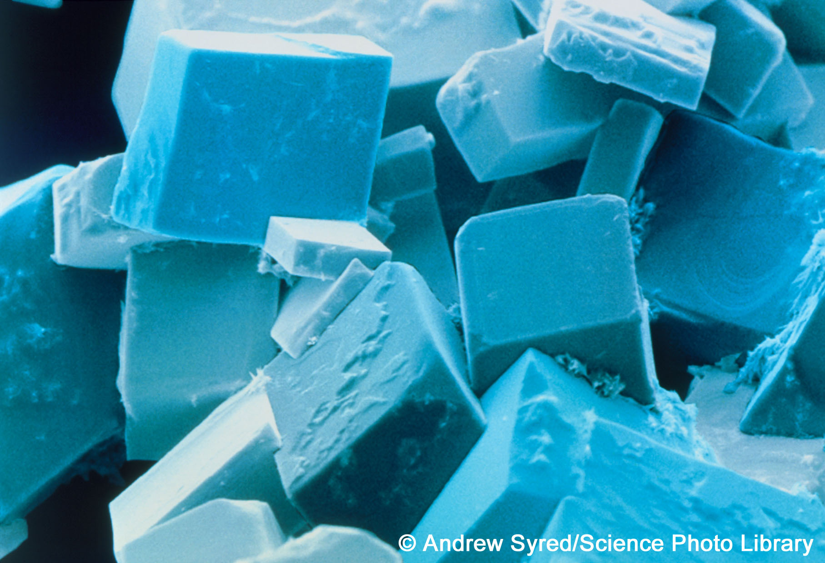
Ionic lattices and crystals
The structure of the lattice means that the ionic compound forms a crystal. This has flat sides and straight edges.
These are crystals of sodium chloride.
All ionic compounds form lattices and crystals when solid.
Notes:
Acknowledgement
The image is a coloured scanning electron micrograph (SEM) of common salt, sodium chloride, recrystallised from distilled water. The salt crystal is built up from a cubic lattice of sodium and chloride ions. In the absence of impurities the exact cubic crystal form is produced. This micrograph shows that in practice this basic cube is usually disrupted by dislocations; these give rise to crystals with a variety of shapes, although they all retain the basic cubic symmetry. Magnification: x280 at 5x7cm size. x975 at 10x8‘.
Credit: Andrew Syred/Science Photo Library

Slide 18
Heating ionic compounds
Ionic bonds are strong and require a lot of heat to break them. This means that ionic compounds are solid at room temperature.
A larger ionic charge produces stronger ionic bonds, which means that more heat is required to break the bonds.
Compound Ion Melting Boiling
charges point (°C) point (°C)
sodium
chloride
1⁺ and 1⁻ 801 1,413
magnesium
oxide
2⁺ and 2⁻ 2,852 3,600

Slide 19
Electricity, solubility and ionic compounds
Ionic compounds do not conduct electricity when they are solid because the ions are packed together and cannot move.
When molten, however, the lattice breaks up and the ions are free to move. Because they are charged particles, they can carry an electric current.
Ionic compounds are usually soluble in water because water molecules have a slight electrical charge and can attract the ions away from the lattice.
When dissolved, the ions are free to move and can carry an electric current.

