Slide 1
Mining for Salt
1. understand the importance of salt (sodium chloride) for the food industry, as a source of
chemicals and to treat roads in winter
2. recall that salt can be obtained from the sea or from underground salt deposits
3. understand how underground salt can be obtained by mining, or by solution in water
4. understand why the method used to obtain salt may depend on how the salt is to be used
5. understand how the methods of obtaining salt can have an impact on the environment

Slide 2
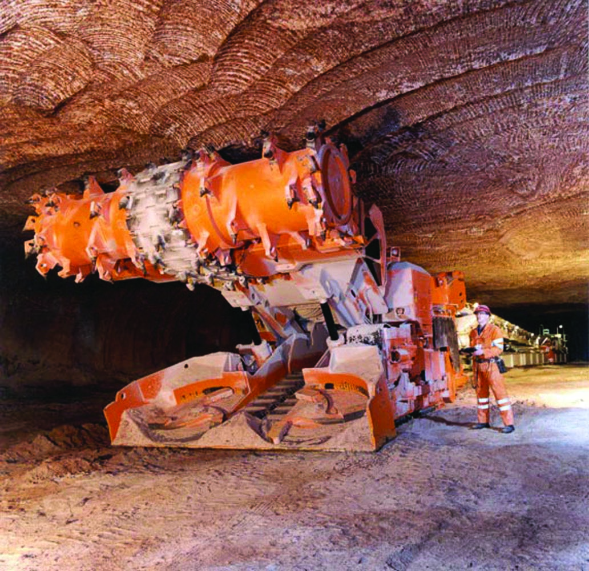
Mining for Rock Salt
Large earth moving equipment is used to extract rock salt. This method of extraction leaves the salt with insoluble impurities such as reddish clay. The clay is insoluble and cannot be removed easily. This kind of salt is used to put on roads during freezing weather and does not need to be pure.
Questions
What is rock salt mainly used for?
What is a major disadvantage of mining for salt?
Answers
Melting ice on roads in winter
It is impure and contains clay which cannot be removed easily.

Slide 3
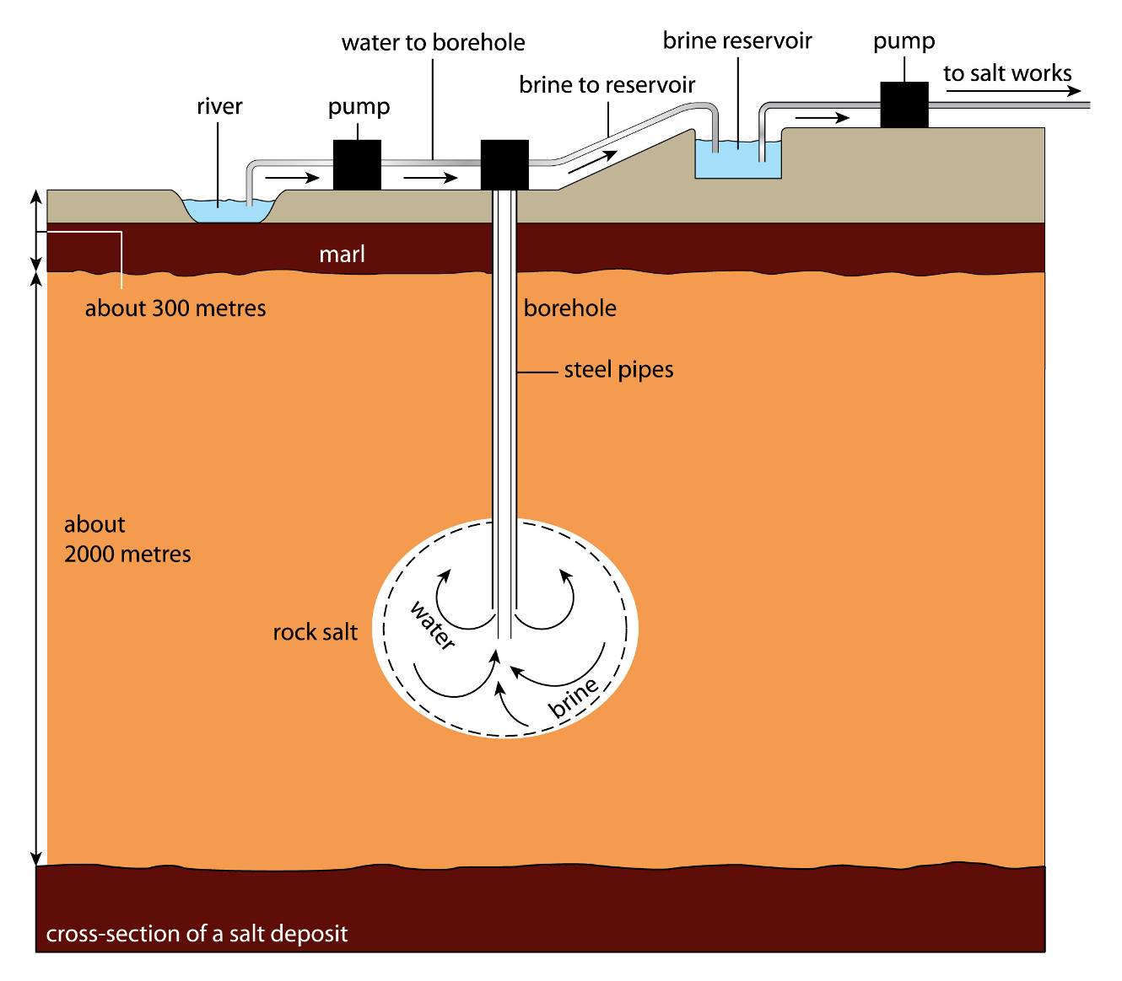
Solution Mining
When pure salt for industrial purposes is needed a different method is used. Water is forced down a borehole into rock. The salt dissolves making a solution of brine and this solution is withdrawn to the surface and pumped to a purification plant. Water is evaporated from the brine under a range of pressures making the process more efficient. The salt crystallises and is separated from any remaining brine by filtering or using a centrifuge. Salt solutions are used to make other chemicals in industry
Questions
What is salt solution used for?
How does water remove salt from the rocky deposits?
Answers
To make other chemicals
Salt is soluble and so dissolves in the water and is pumped to the surface

Slide 4
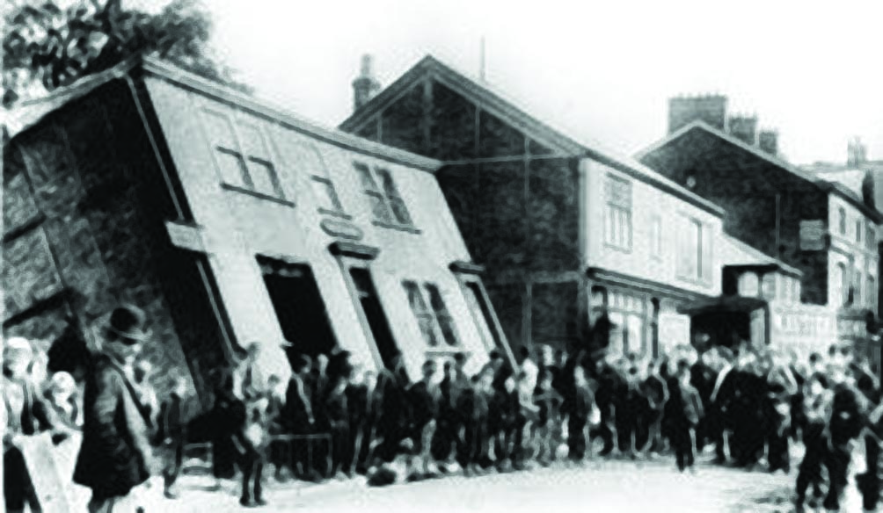
Environmental Impacts
Extracting salt in solution can create large underground caverns. This can lead to bedrock collapsing and as a consequence, cause the lowering of the Earth’s surface. This is known as subsidence. It can be avoided by sensibly spacing out the holes created so the surface is supported by a sufficient amount of rock underground.
Subsidence caused by salt mining in 1891.The rear of Castle Chambers in Northwich suddenly sank into the ground.

Slide 5
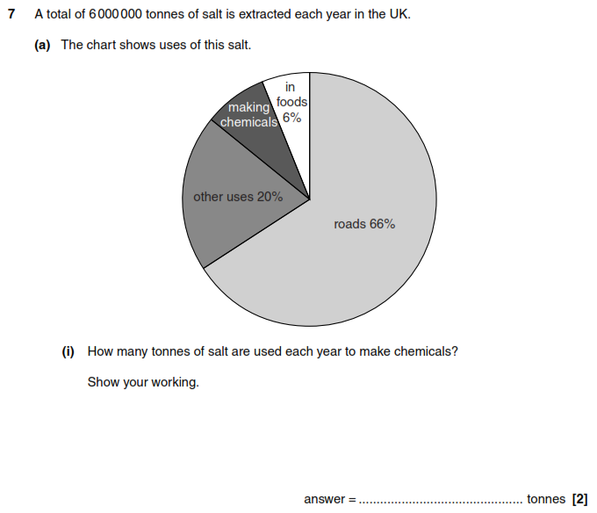
Exam Questions
Step 1.
Find out how much salt is used to make chemicals. This is the remainder of the pie chart.
= 100 – 66- 20 – 6 = 8%
Step 2.
Find 8% of 6,000,000 tonnes
= (8÷100) x 6,000,000 = 480 000

Slide 6
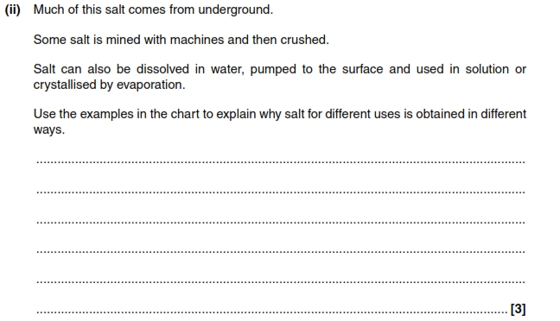
Exam Questions

Slide 7
Example Answer
Mining produces rock salt which is impure. This is used on the roads and doesn’t need to be pure.
Solution mining produces pure salt solution. This can be used to produce alkalis or evaporated to make pure salt used for food.

Slide 8
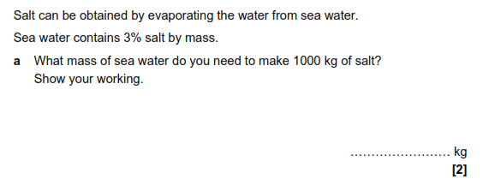
Exam Questions
Step 1.
The water contains 3% salt so we need to make our answer 100/3 times bigger.
Step 2.
100/3 x 1000 = 33,333.33333333333… (this can be rounded down to 33,333)

Slide 9
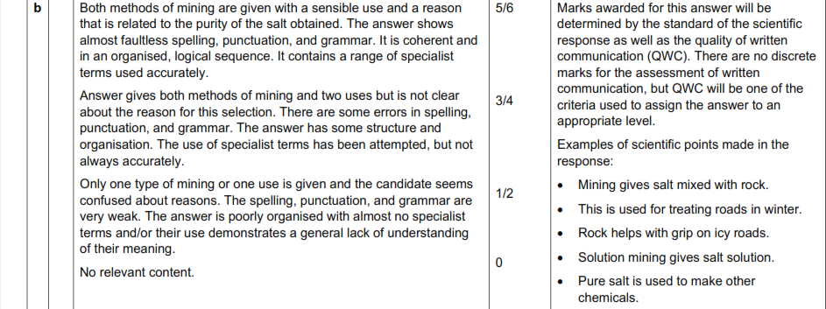
Exam Questions

Slide 10
Example Answer
I have chosen to discuss the rock salt and solution mining methods of salt extraction.
When rock salt is mined it is extracted as an impure solid which contains insoluble impurities. These cannot be easily removed so this form of salt is used on roads in winter where pure salt is not needed.
In solution mining the salt is removed by water. Water is pumped to the rock underground where only the sodium chloride dissolves leaving other impurities like clay behind. This produces a pure salt solution called brine. This can then be used as a precursor to make other chemicals.
I think that solution mining is the best way of extracting salt as it produces a pure salt solution, whereas mining it does not.

