Slide 1
Obtaining alkalis/chlorine
7. understand that the first process for manufacturing alkali from salt and limestone using coal as a fuel caused pollution by releasing large volumes of an acid gas (hydrogen chloride) and creating great heaps of waste that slowly released a toxic and foul smelling gas (hydrogen sulphide)
8. understand that pollution problems can sometimes be solved by turning wastes into useful chemicals
9. understand that oxidation can convert hydrogen chloride to chlorine, and that the properties of a compound are completely different from the elements from which it is made
14. understand that an electric current can be used to bring about chemical change and make new chemicals through a process called electrolysis
15. recall that chlorine is now obtained by the electrolysis of salt solution (brine)

Slide 2
Making Alkalis
Traditional
Extracted from burnt wood (potash – this is where the word potassium comes from) and urine (urea is broken down to form ammonia which is alkali dissolved in water. This is why boys urinals smell so bad!)
Le Blanc Process
Sodium chloride (NaCl) was mixed with sulphuric acid (H₂SO₄ before being heated with charcoal (carbon, C) and limestone (Calcium carbonate, CaCO₃).
This process was hideously inefficient. For every tonne of sodium carbonate produced it produced 2 tonnes of toxic hydrogen chloride gas and a tonne of solid waste. This waste produced hydrogen sulphide gas which is toxic.
Question:
Calculate the efficiency of the Le Blanc process. In other words, what percentage of the total products were useful.
Answer: In total for every 1 tonne of product, 3 tonnes of waste were made. 4 tonnes were made over all. (1 ÷ 4) x 100 = 25%

Slide 3
Making Chlorine
The hydrogen chloride produced by the Le Blanc process could be turned into less harmful chlorine by oxidation (reaction with oxygen).
Word Equation:
Hydrogen Chloride + Oxygen → Chlorine + Water (steam)
Symbol Equation:
4HCl + O₂ → 2Cl₂ + 2H₂O
Picture Equation:
→

Slide 4
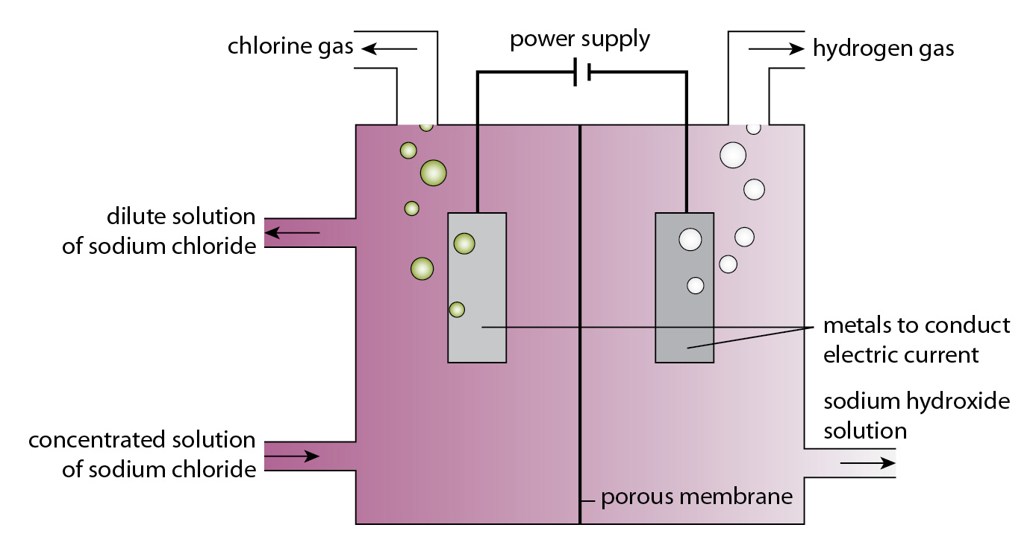
Electrolysis of Brine
Electrolysis is the splitting of compounds using electricity. (lysis is Ancient Greek for cutting)
Brine is a solution made of salt, sodium chloride (NaCl) and water (H₂O)
What 4 elements does this contain?
Sodium, Chlorine, Hydrogen and Oxygen
Electrolysis splits the brine into Chlorine gas (Cl₂), Hydrogen gas (H₂) and Sodium Hydroxide (NaOH). Sodium hydroxide is a common alkali.
Sodium Hydroxide and chlorine can be reacted to form bleach.
Since all the products are used it is 100% efficient.

Slide 5
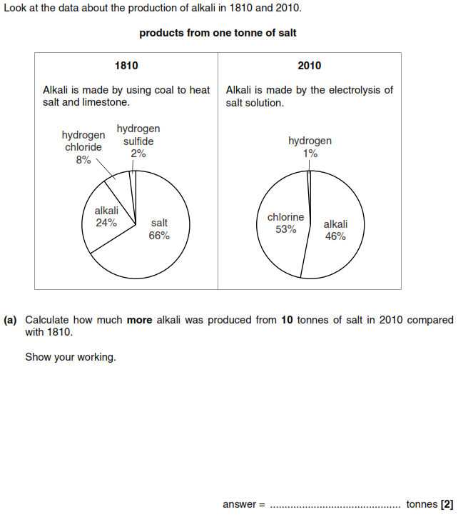
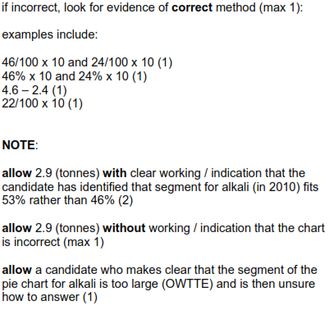
Exam Questions
1810: From one tonne = 24% of 1 = 0.24
From ten tonnes = 0.24 x 10 = 2.4
2010: From one tonne = 46% of 1 = 0.46
From ten tonnes = 0.46 x 10 = 4.6
Difference = 4.6 – 2.4 = 2.2

Slide 6
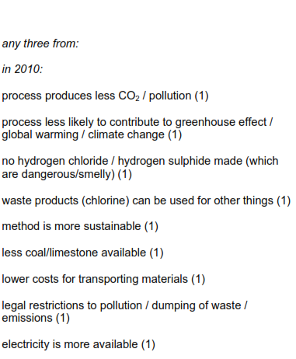
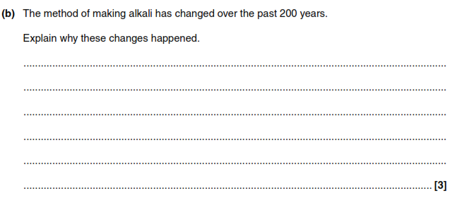
Exam Questions
Modern processes uses electrolysis of brine. This does not produce hydrogen chloride and the waste product chlorine is used for cleaning drinking water. This means the process is more sustainable or efficient.

Slide 7
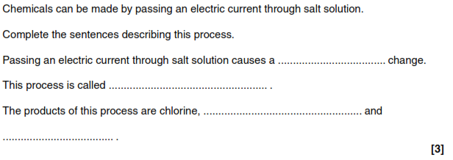
Exam Questions
chemical
electrolysis
hydrogen
sodium hydroxide

