Slide 1
P3

Slide 2
Explain why energy demand is increasing and the problem of availability of sources (8)
Higher global population
More advances in technology
More uses of electricity
More cities
Working through the night
Finite amount of fossil fuels remaining
Cannot produce enough electricity from renewable resources
Do not have trust in nuclear power

Slide 3
What are the main energy resources?
Coal
Oil
Gas
Nuclear
Biofuel
Wind
Wave
Solar
These are primary sources of energy – they occur naturally
What is a secondary source of energy?
Electricity
Why is it classed as a secondary source?
Because it is generated from a primary source

Slide 4
Energy usage
When electric current passes through a component (or device), energy is transferred from the power supply to the component and/or to the environment
So anything that is powered by electricity transfers energy from the electrical source to the appliance

Slide 5
How much energy do we use?
The power (in watts, W) of an appliance or device is a measure of the amount of energy it transfers each second to work, i.e. the rate at which it transfers energy
Calculate energy used with the equation:
Energy transferred = power x time
(joules, j) (watts, W) (seconds)
(triangle)

Slide 6
Calculate the energy usage of the following appliances...
Hair drier 1500 watts x 10 minutes
Kettle 2200 watts x 5 minutes
Laptop 50 watts × 60 minutes
CD player 3 watts x 60 minutes
Fan 3 watts x 15 minutes
LED torch 1 watt × 20 minutes

Slide 7
Appliances use lots of energy...
So we can talk of energy usage in terms of kilowatt hours:
Energy transferred = power x time
(kilowatt hours, kWh) (kilowatt, kW) (hours, h)
1kW= 1000 W

Slide 8
Calculate the energy usage, in kWh, of the following appliances...
Hair drier 1500 watts x 30 minutes
Kettle 2200 watts x 15 minutes
Why do you think energy companies talk about a households energy usage in terms of kWh, rather than joules?

Slide 9
e.g.
How much energy is transferred by a 2.5kW kettle left on for 5 minutes?
What is the power of a light bulb that transfers 54, 000 J of energy in 15 minutes?

Slide 10
Cost
You can calculate the cost of an appliance by using the following equation:
Cost = number of kWh x cost per kWh
If the cost of 1 kWh is 7.8p, what was the cost of using those appliances?

Slide 11
e.g.
Find the cost of leaving a 60 W light bulb on for 30 minutes if one kWh costs 10p

Slide 12
Power
Power is the rate of energy transfer:
The following equation also calculates the rate at which an electrical device transfers energy:
power = voltage × current
(watts, W) (volts, V) (amperes, A)
A 2 kW hairdryer is connected to the mains supply. Find the current is uses

Slide 13
Domestic power ppt

Slide 14
Cost and energy efficiency
L.O:Complete calculations

Slide 15
Energy efficiency
No appliance is 100% efficient – what does this mean?
Not all the electrical energy is converted into useful energy
How is some of the energy lost?
Mainly heat, sometimes sound
What form is the electrical energy that powers a TV turned into?
What is the waste energy?

Slide 16
Calculating efficiency
Need to know the amount of energy supplied to a device – energy input
Need to know how much of that energy is converted into useful energy – useful energy
Divide the smaller number (useful energy) by the larger number (energy input)
Energy efficiency = useful energy =
energy input
This gives you the energy efficiency as a decimal
If you want to turn that value into a % multiply by 100
Can also substitute “energy” for “power”

Slide 17
e.g.
180 000 J of energy are supplied to a kettle. 9000 J of heat are given off to the room when the kettle boils
What is the efficiency of the kettle as (a) a decimal (b) percentage
An ordinary light bulb is 5% efficient. If 1000 J of light energy is given out, how much energy is wasted?

Slide 18
e.g.
A kettle is 90% efficient.
To boil the water 420 kJ is needed.
Calculate how much electrical energy is used by the kettle. (2)
Suggest reasons why the kettle is only 90% efficient. (2)

Slide 19
420÷0.9
467
energy lost / wasted (to environment) (1)
example given
eg heats kettle / air / produces sound / evaporates water /
gives off steam
accept light from indicator light

Slide 20
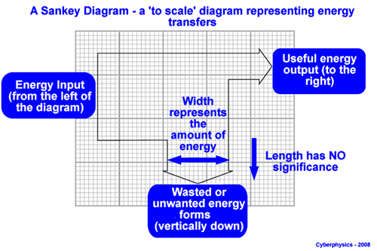
Sankey diagram
Shows the movement of energy through a system and any transfer of energy

Slide 21
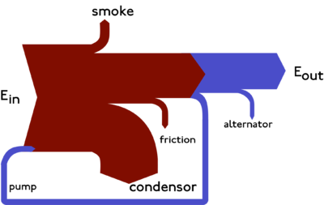

Slide 23
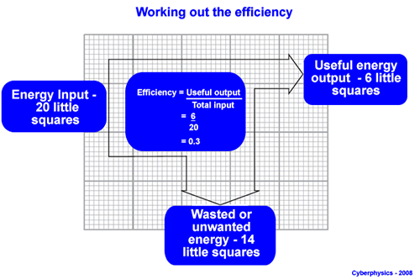
The width of the arrow is proportional to the number of joules it represents

Slide 24
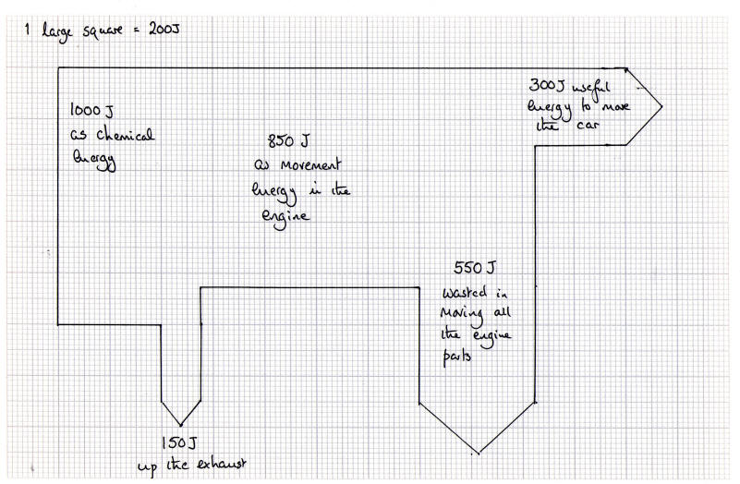

Slide 25
Efficiency on board

Slide 26
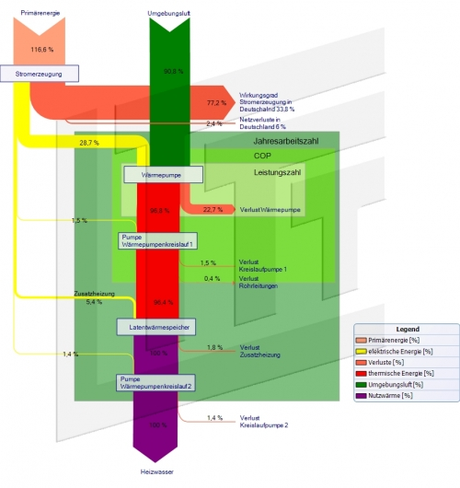

Slide 27
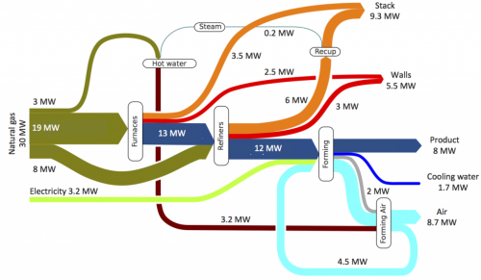

Slide 28
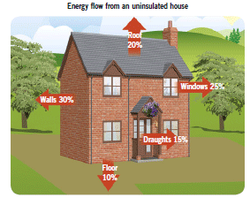
Energy loss

Slide 29
Saving energy
What is the best way to reduce energy usage at home?
Reduce heat energy transfer
Cavity walls, loft insulation, double glazing, draught proofing
Thick curtains, water tank jacket
Decrease electricity usage – switch things off, energy efficient appliances, energy saving light bulbs, turn down heating/hot water

Slide 30
Payback time
The time it takes to pay for an energy efficient improvement before you start to save money
E.g. It costs £3000 to have double glazing fitted at a home
The annual saving to the energy bill is £60
How long will it take to payback the initial cost before the family will begin to see a benefit from the windows?
The family also have energy saving light bulbs fitted in all rooms
Each bulb costs £3 to buy but saves £12 of energy annually
How long does it take to payback the initial cost
Which energy saving improvement was the most cost effective

Slide 31
Nationally
Workplace – turn off appliances when not in use, minimise unnecessary use of appliances
Car share, use public transport
Government – offers grants for improvements to home, find alternative ways of making energy, recycling

Slide 32
Generating electricity
Electromagnetic induction
Move a magnet in a coil of wire – generates a voltage
As you move the magnet in and out of the coil the magnetic field changes – this change in the magnetic field induces a voltage in the wire
If the wire is part of a complete circuit a current flows through the circuit – electricity has been generated!!!!!!

Slide 33
This is how electricity is generated in a power station
A generator contains a huge magnet that rotates in a large coil of wire
The movement of the magnet changes its magnetic field and induces a voltage in the wire of the generator, making a current flow
To increase the strength of the voltage you can rotate the magnet faster
To make the magnet move faster you have to burn more fuel to make the turbine turn quicker, using up more energy per second
Diagram

Slide 34
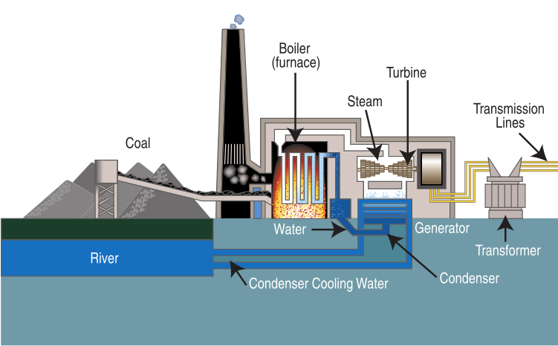

Slide 35
National grid
Network of pylons and cables that cover the UK
Takes electrical energy from power stations to homes/businesses
The network enables energy to be supplied to any part of the UK
To transmit the large amount of power through these cables you need a high voltage to “push” the electricity through
A high current isn’t used as too much energy would be lost as heat
So it’s cheaper to transmit electricity at a high voltage of about 400 000V. This keeps the current low and minimises energy loss
The high voltage is decreased to 230 V before it reaches our homes
230 V = mains voltage

Slide 36
Flow diagram
Energy is released from burning fuel in a boiler. This heats water which generates steam
The steam turns a turbine
A generator converts the kinetic energy of the turbine into electricity from the turning of the magnet

Slide 37
Non-renewable resources
Fossil fuels
Nuclear fuels
Finite – will run out one day
Damage the environment
Provides most of our energy
Fossil fuels release CO2 contributing to global warming and climate change
Coal and oil also release sulphur dioxide (acid rain)
Coal mining ruins landscapes
Oil spillages damages environment – and kills animals
So why do we still use them?
Produce lots of energy relatively cheaply

Slide 38
Renewable resources
Wind, waves, tidal, hydroelectric, biofuels, geothermal, solar
Never run out
Do some damage to the environment but not as harmful as non-renewable
Don’t provide much energy and are unreliable

Slide 39
6 mark question
A group of people live on a remote island off of the coast of Greenland
They need to build a new power station and have run out of fossil fuel reserves
What should they think about when building a new power station?

Slide 40
Answers
One or more named renewable resources
Small population – don’t need a big power station
Small land area – don’t have much room to build a large power station
Difficult to get fuel on island-nuclear or f
Impact on environment
Managing waste
Employment opportunities
Windy – wind turbines
Surrounded by sea – tidal

