Slide 1
P5: Electric Circuits
Lesson Objectives
To review and deepen understanding of key aspects of P5 including:
Electric Current
Voltage
Resistance
Parallel v Series

Slide 2
5.1
Electric Current – A Flow of What?

Slide 3
5.1:How Do Objects Become Charged? Part 1
Polythene rod
Electrons move from the duster to make the rod negatively charged
Electrons are removed from the duster making the duster positively charged
When the duster and rod are rubbed together they become charged. This is due to friction.
Electrons are transferred from the one object to another
The rod becomes negatively charged due to electrons moving from the duster to the rod.
The duster becomes positively charged due to losing electrons

Slide 4
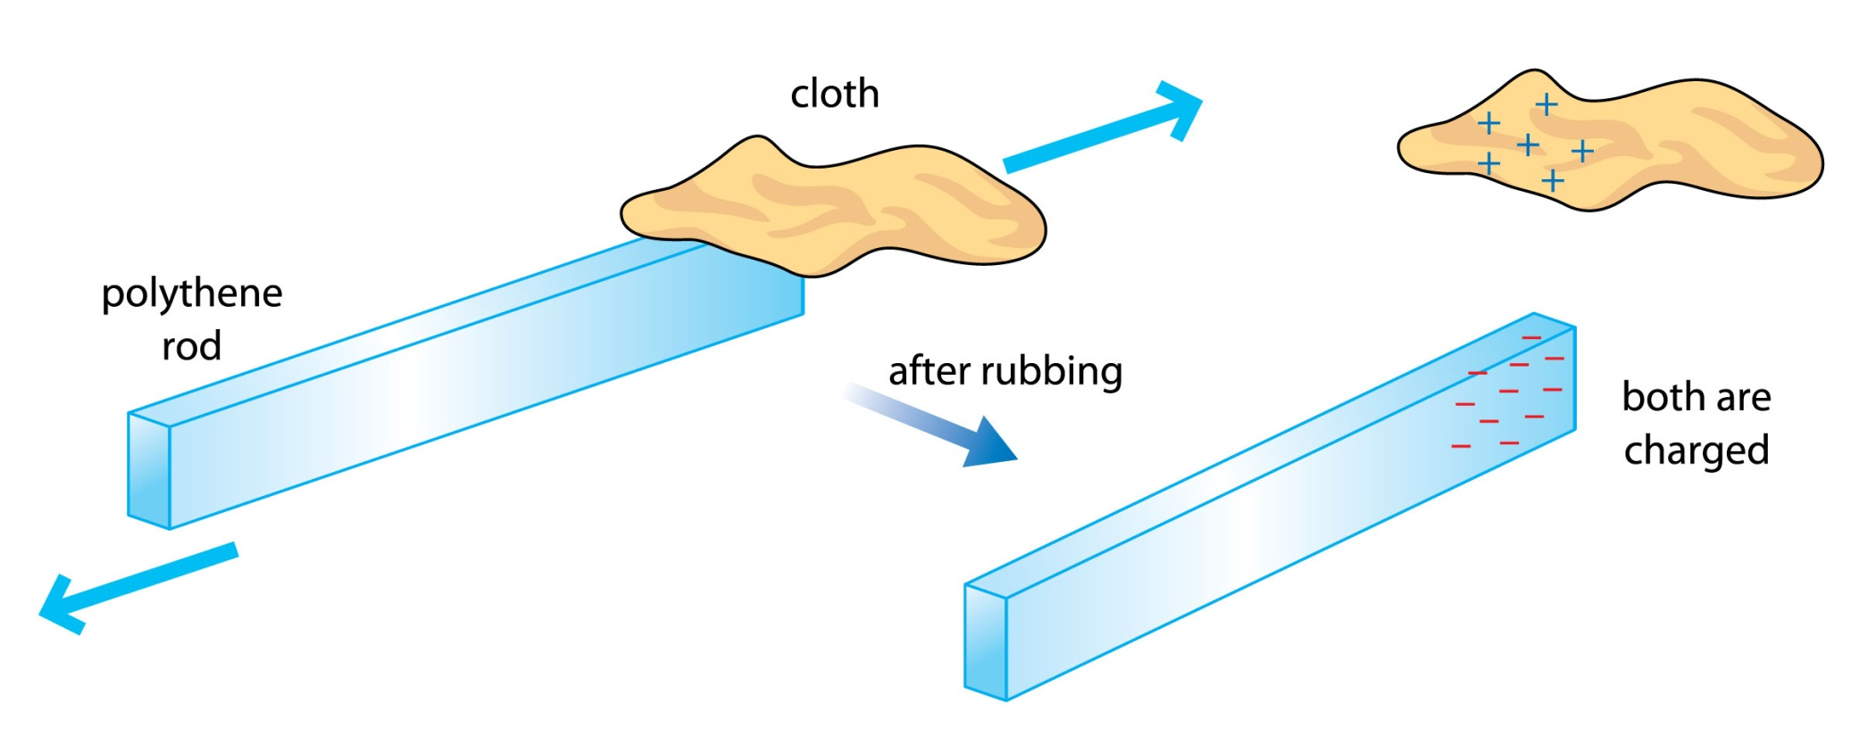
5.1 How Do Objects become Charged? Part 2

Slide 5
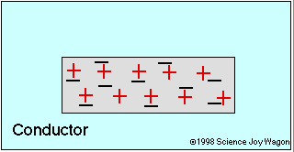
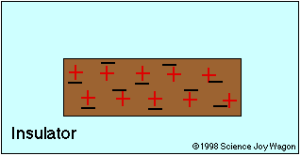
5.1Attraction and Repulsion

Slide 6

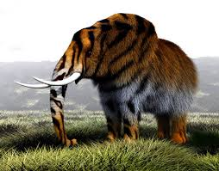
5.1Moving Charge
Watch the animation of moving charge in lesson Inside Electrical Circuits
http://www.furryelephant.com/player2.php?subject=physics&jumpTo=ee

Slide 7
5.1 Key Ideas About Moving Charge
Electric current is a flow of negatively charged electrons
The battery causes the charges to move
The metal conductors in the circuit contain the charges and are free to move

Slide 8
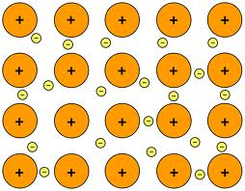
5.1Metal Conductors in Circuits
Metals are bonded so that the positive nuclei are surrounded by a sea of electrons that are free to move.
In an electric circuit the battery causes the free electrons to move and they flow in a continuous loop

Slide 9
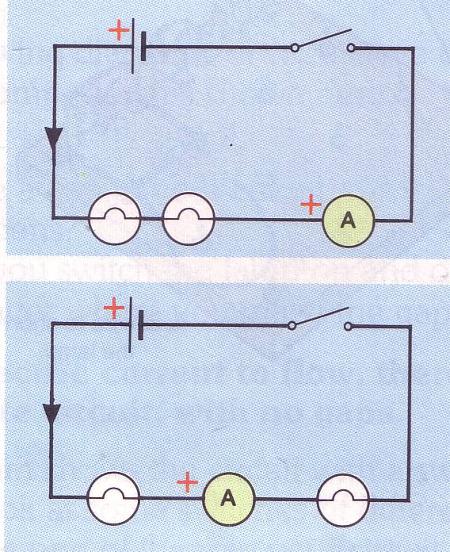
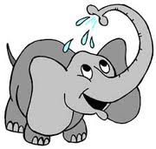
5.1 Measuring Current Flow
Current is measured in Amps
Ammeters are placed in SERIES with the other components.
Ammeters count the number of electrons ( charge) that pass through the meter every second
4Amps
A1
A3
A2
What would be the current reading at A1,A2,A3?

Slide 10
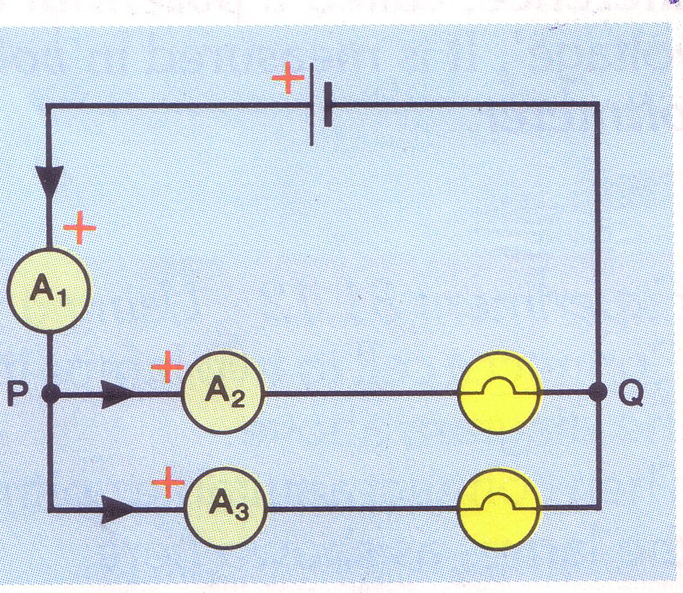
5.1 Measuring Current in Parallel Circuit
If the lamps are identical, what would be the current readings at A2 and A3 if the current at A1 is 8Amps?
If a fourth ammeter was added at position Q what would it read?
Why?

Slide 11
5.2/5.3
What Determines the Size of the Current in an Electric Circuit and the Energy it transfers?

Slide 12
Voltage and Current
http://www.furryelephant.com/player2.php?subject=physics&jumpTo=ee
Watch the animation on the Furry Elephant. Lesson 5 Voltage and Current.
Describe what the differences are between current and voltage as you watch the animations

Slide 13
Measuring voltage I
V₁
Voltmeter | Voltage (V)
V₁
V₂
V₃
1.5
NB Voltmeters are connected in parallel
0.75
0.75
For a series circuit, the sum of the voltages for each component is equal to the voltage across the cell or battery.
V₁ = V₂ + V₃
V₂
V₃

Slide 14
Measuring voltage II
For a parallel circuit, the voltage across the cell/battery is the same as the voltage across each branch.
V₁ = V₂ = V₃
V₁
V₂
Voltmeter | Voltage (V)
V₁
V₂
V₃
1.5
V₃
1.5
1.5

Slide 15
Summarising.............
Explain:
Why voltage is measured across a component or the supply.
Why the total voltage from the supply = the voltage across the components in a series circuit
Why the voltage from the supply = the voltage across each component in a parallel circuit
What is potential difference p.d?

Slide 16
Furry Elephants Number Quiz
If the voltage across the battery is 6V…
V
…and these bulbs are all identical…
…what will the voltage across each bulb be?
Explain why.
V
V
2V

Slide 17
Furry Elephants Number Quiz
If the voltage across the batteries is 4V…
What is the voltage here? Why?
4V
V
And here? Why?
4V
V

Slide 18
Current in Series Circuit
If the current here is 6 amps…
The current here will be…
The current here will be…
And the current here will be…
Explain why this happens...........

Slide 19
5.2/5.3
What is Resistance and how is it measured?

Slide 20

Electrical Resistance
Click & watch Cold wire animation!
An electron travelling through the wires encounters resistance. Resistance is the hindrance to the flow of charge. For an electron it is a zigzag path that results from countless collisions with fixed atoms within the conducting material
Why do you think the wire will get hot?
Apply this idea to explain how a filament bulb works.
http://regentsprep.org/Regents/physics/phys03/bresist/

Slide 21
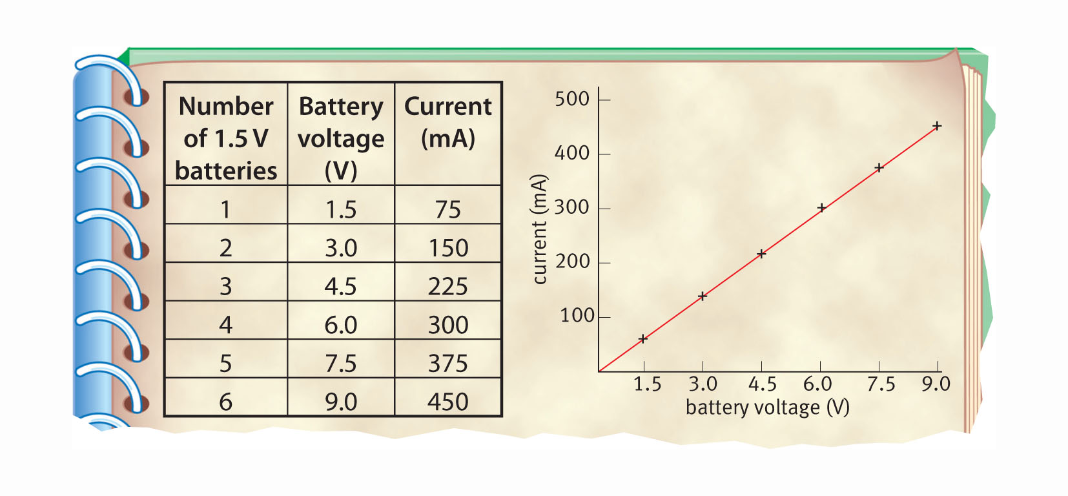
How Does Current and Voltage Vary in a fixed resistor
What is the current when Voltage is 3 V?
What is the current when the Voltage is 6V?
What is the relationship between I and V?
Notes:
3. Keiko repeated this with 3, 4, 5, and 6 batteries, to get a set of results.
4. Finally, she drew a graph of current against battery voltage.

Slide 22
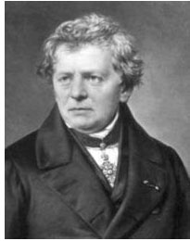
Ohm’s Law...............
You have just investigated my law!
I and V are directly proportional to one another when the resistance stays constant

Slide 23
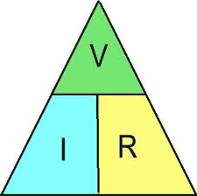
A new LAW
Voltage = Current x Resistance
(Volts) (Amps) (Ohms)
V = IR

Slide 24
How to use equation
If the current is 0.3A and the Resistance is 20 ohms, what is Voltage?
  V=IR V=0.3 x 20 = 6V
If the current is 3mA and the Resistance is 2 kil0-ohms, what is Voltage?
  V=IR V=0.003 x 2000 = 6V
If the current is 0.3A and the Voltage is 12 V, what is Resistance?
  V=IR so R = V/I R = 12/0.3= 40Ω

Slide 25
Your Go!
What is the Voltage if the current is 3.5A and the resistance is 20 ohms?
What is the Voltage if the current is 0.4A and the resistance is 3kΩ?
What is the Resistance is the Current is 0.2A and the voltage is 12V?
What is the Current if the resistance is 400Ω and the Voltage is from the mains?
As you heat the wire what will happen to the resistance, explain?
70V
1200V
30 Ω
0.57 (230V) or 0.6 (240V)
Resistance will increase as the atoms in the wire will move more causing more collision (voltage will no longer be proportional to current)

Slide 26
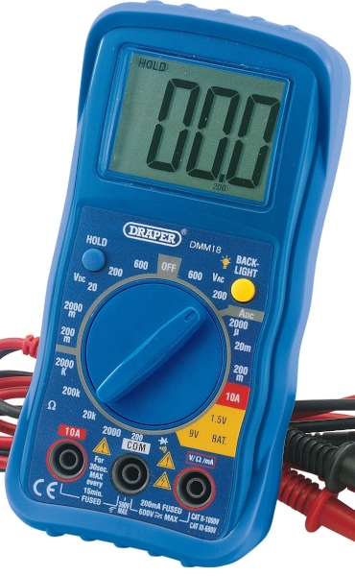
Measuring resistance
Resistance can easily be measured using a multimeter
Turn the dial to the Ω section, to measure resistance
Plug the connecting leads in at the COM and Ω sockets
Connect to whatever you need to measure

Slide 27
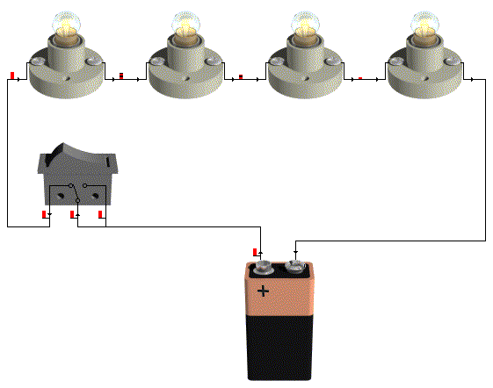
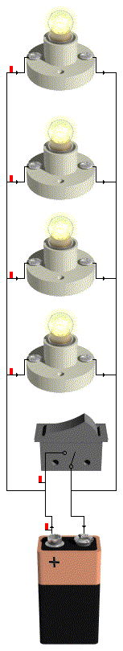
Each bulb has a resistance of 5 Ohms.
Which circuit will have the highest total resistance……. Why?
How could this be investigated?

Slide 28

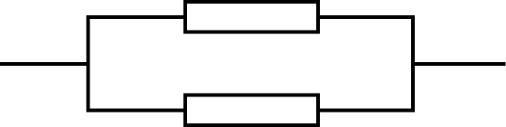
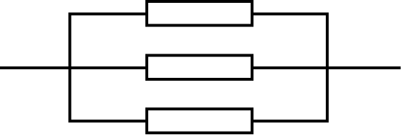
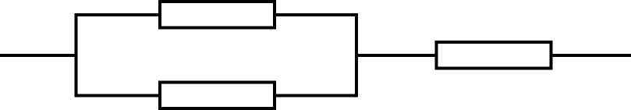
If each Resistor is 10 Ohms what will be the total resistance?
Network |  | Actual Value
 |  | 10 Ohms.
 |  | 20 Ohms.
 |  | 30 Ohms.
 |  | 5 Ohms.
 |  | 3.3 Ohms.
 |  | 15 Ohms

Slide 29

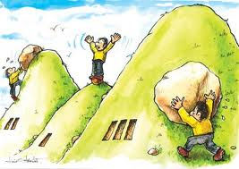

Why does this happen? What route is harder for an electron?
Series circuit:
Parallel circuit

Slide 30
5.2
Are there different Types of Resistors and how do they work?

Slide 31



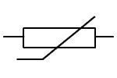
Different Types of Resistors
Light Dependent Resistor
Thermistor

Slide 32
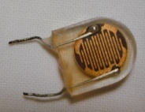
What is an LDR?
What does LDR stand for?
Light Dependent Resister
What does this device do?
It is a device that changes its resistance as different light level fall on it.
What is its symbol?
How do you think the resistance will change with how bright the light is?

Slide 33
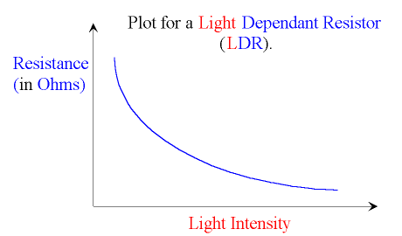
LDR
What is the relationship between Resistance & Light Intensity?

Slide 34
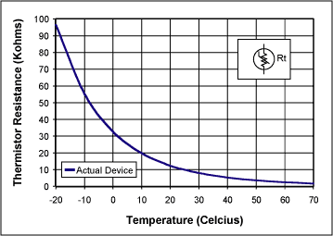
How does a thermistor work?
Describe what this graph shows as the temperature decreases.
Explain how a thermistor works in device such as fire alarm.
What normally happens when the temperature in a wire increases?
A thermistor works by releasing electrons as its heated…….. Why do you think this makes the thermistor lower its resistance as the temperature rises?

Slide 35
5.2
What is Electrical Power and how is it calculated?

Slide 36
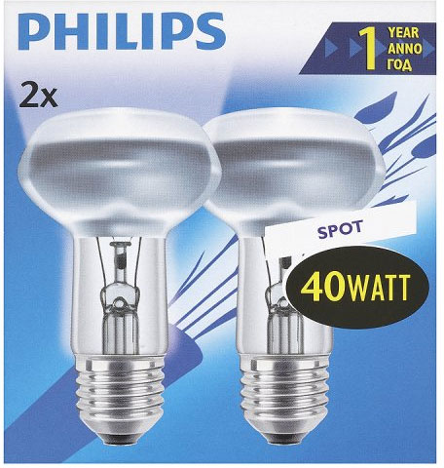
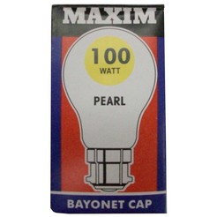
So “Watt” is power?!
Which bulb is more powerful?
What does this mean?
How could you describe it in term of the energy being used?

Slide 37
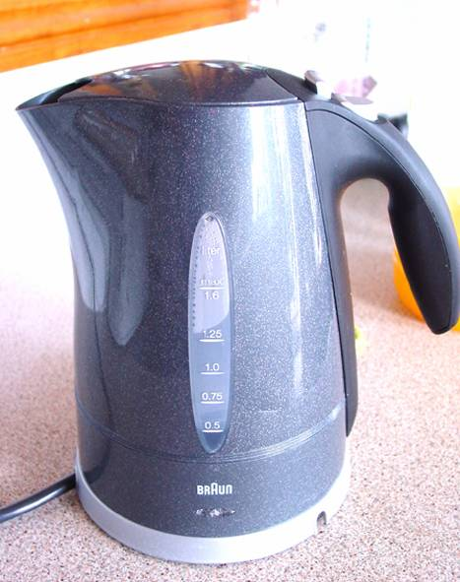
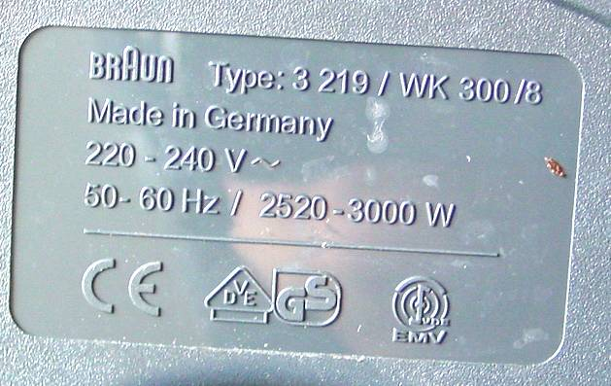
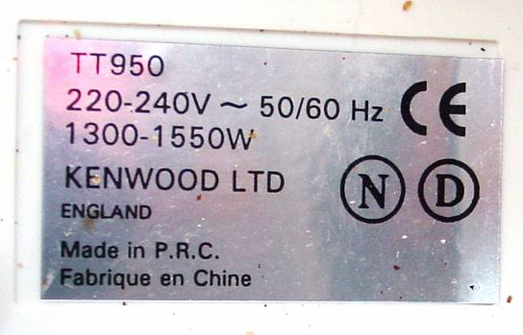
Power Ratings

Slide 38
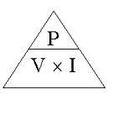
Watt is power?
Power is the rate of energy used (how quickly you use energy).
Power = energy / time
Power is measured in Watts (W)
1Watt = 1 joule of energy used every second.
In electricity we use the equation:
Power = Voltage x Current
(Watt) (Volts) (Amps)
Or use symbols
P=VI

Slide 39
Calculating Power
Power = Voltage x Current
P = V x I
Power is measured in Watts

Slide 40
Appliance | Power W | Voltage V | Current A
Kettle | 3000 | 230 | 13.0
Toaster | 1550 | 230 | 6.7
Microwave | 1300 | 240 | 5.4
Drill | 350 | 240 | 1.5
Door lift | 2300 | 230 | 10
Fax machine | 230 | 230 | 1.0
CD player | 15 | 230 | 0.06
TV | 59 | 230 | 0.26
Play station | 10 | 230 | 0.04
Vacuum cleaner | 650 | 240 | 2.7
Hairdryer | 800 | 230 | 3.5
Desk lamp | 50 | 12 | 4.2
Sewing machine | 40 | 240 | 0.17

Slide 41
5.4
How is Mains Electricity produced?

Slide 42
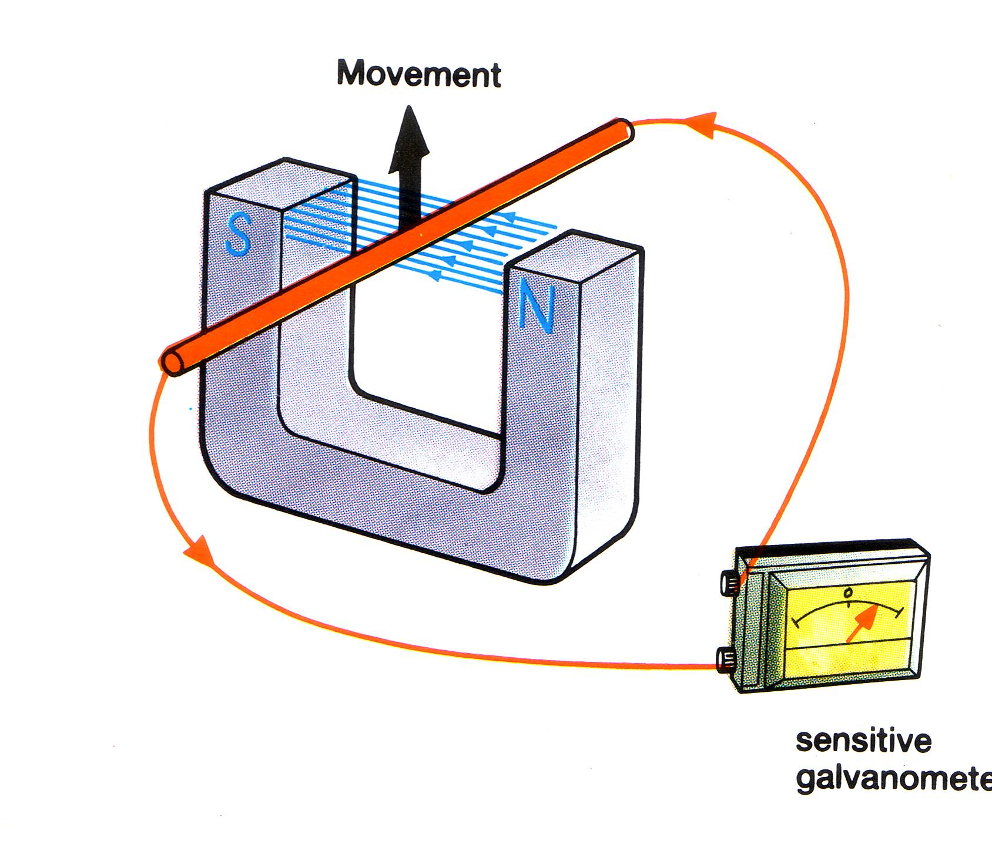
Electromagnetic Induction
When the wire is moved through a strong magnetic field what happens to the ammeter?
The current that flows is called an INDUCED current. What does this mean?
The current could be increased by:
Using a s_______ magnetic field.
Moving the wire f_______.

Slide 43
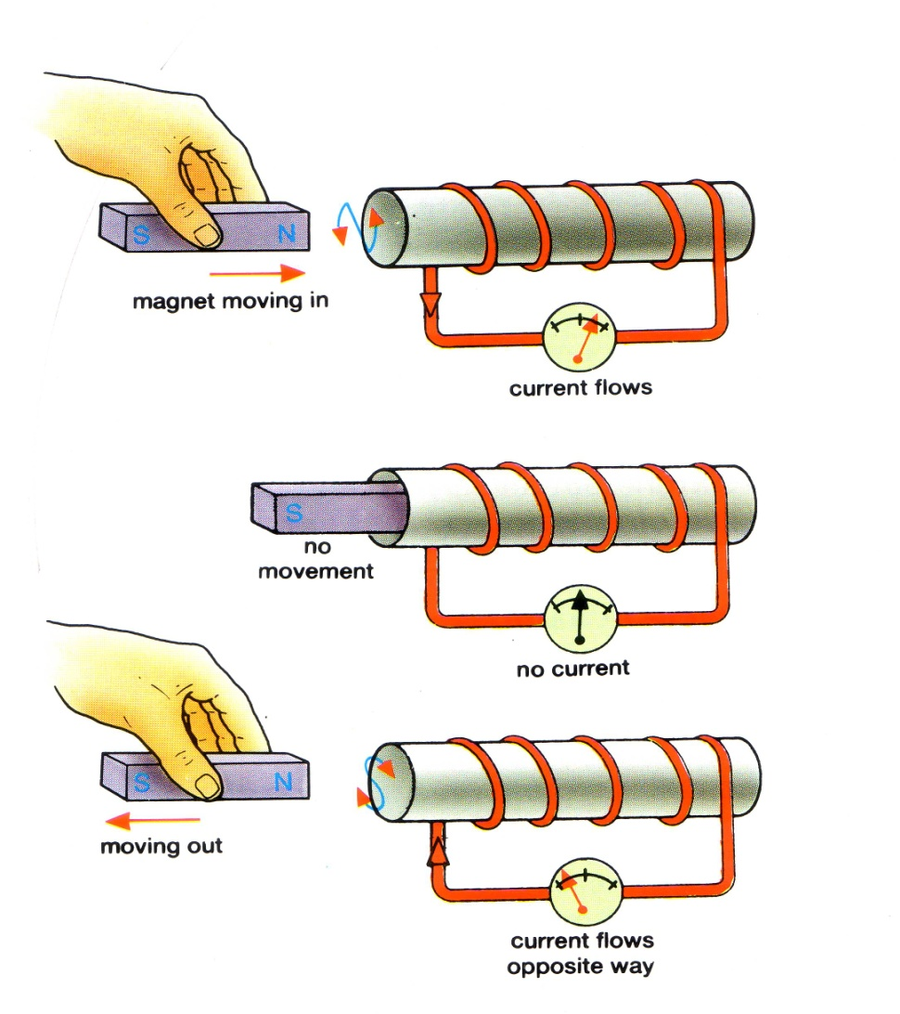
Electromagnetic Induction using a coil of wire
As the magnet moves into the coil what happens?
When the magnet is held still what happens?
When the magnet is pulled out what way does the current flow?
When the magnet is moved continually in and out of the coil what type of current is this?
The current can be increased by:
Increasing the strength of the M________
Increasing the number of c____
Increasing the s_______ of the motion of the magnet.

Slide 44
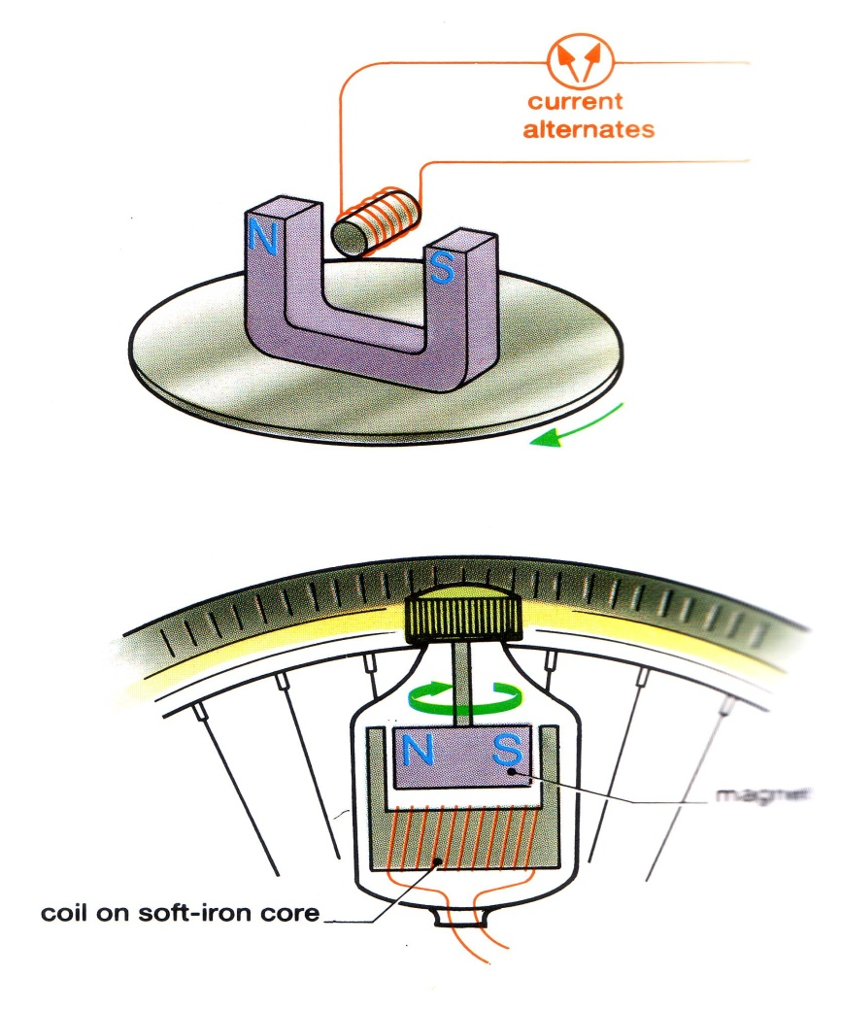
Current Generators - Dynamos
A magnet rotates next to a coil of wire.
Why is the coil of wire wound onto an iron core?
Explain how the dynamo works.
What type of current is produced in this experiment?

Slide 45
Types of Current
Dynamos and generators produce alternating current. Explain what this means.
Direct current from a battery or power pack looks like graph number
Alternating current
Direct current

Slide 46
Electromagnetic Induction.
Electromagnetic induction is when a current is made to flow in a wire.
This happens when a wire cuts the field lines of a magnetic field and the magnetic field gives the electrons a push. (Voltage). Or the magnetic field changes direction.
The voltage gives the energy to the electrons to move. This gives the electrons a push, they move, this is an induced current

Slide 47
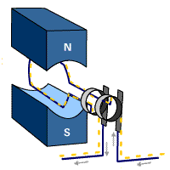
A simple a.c.generator
This is a device that uses this basic principle to create a current that alternates (changes direction).
As the coil rotates it cuts the lines of the magnetic field and a current is induced.
If a wire is moved to cut across lines of magnetic flux a current will flow.
Animation

Slide 48
Generator
Current is induced when a wire moves inside a magnet!
Open this animation and observe how current changes as coil moves.
Look when the current is zero and greatest!
Copy and complete the work sheet

Slide 49
Moving Magnets and Induced Voltage.
If a magnet rotates, the magnetic field changes. N / S S / N
As the magnetic field, changes, this induces a voltage and a current flows.
As the direction of the magnetic field changes, the direction of the induced voltage changes.

Slide 50
5.4
What are Transformers and how do they work?

Slide 51
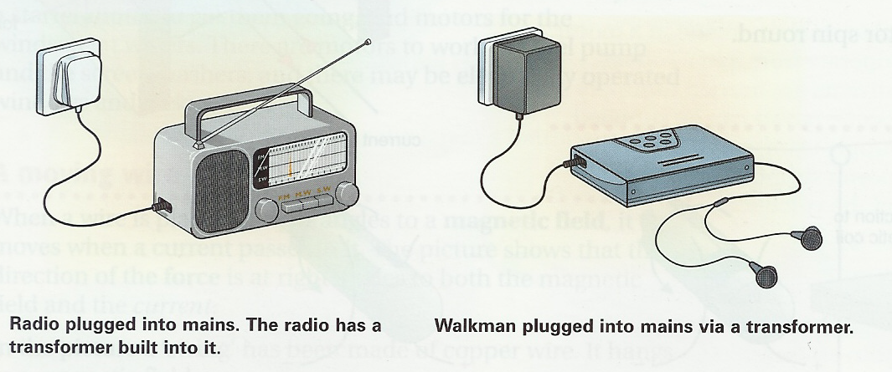
What is a transformer?
Transformers are used to change voltages, but only alternating
voltages.
For example, electricity is supplied to houses at 240V.
This is too high for many household appliances. They have
transformers in them to reduce the voltage:

Slide 52
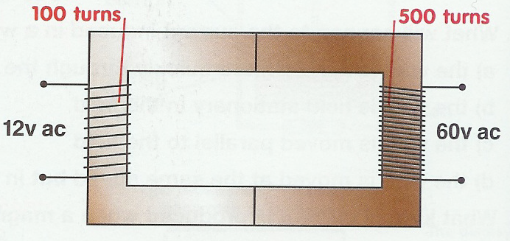
How do transformers work?
Step-up transformers
Step-up transformers increase the size of an alternating voltage
By having more turns of wire on the secondary coil, than on the
primary coil, the voltage is increased…stepped up!

Slide 53
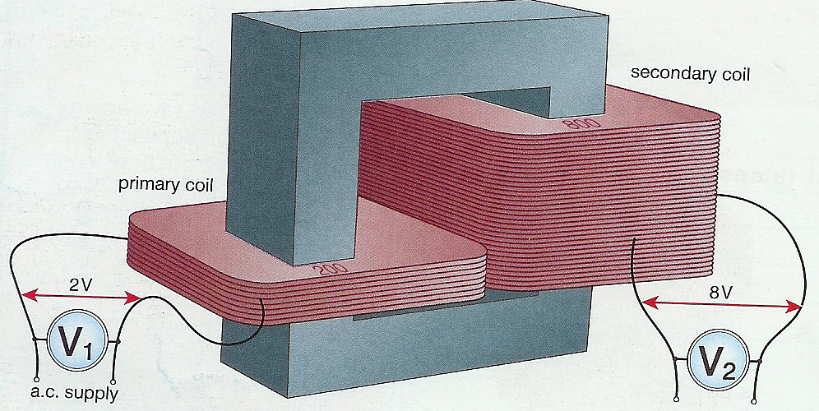
The structure of a transformer
Transformers consist of two coils wrapped around a soft iron core
soft iron core
secondary coil
secondary coil
800
primary coil
?
There are two types of transformers…step-up and step-down
What type of transformer is this? How many primary coils do you
there are?

Slide 54
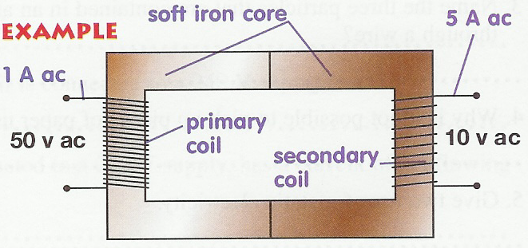
Step-down transformers
Step-down transformers decrease the size of an alternating voltage
By having less turns of wire on the secondary coil, than on the
primary coil, the voltage is decreased…stepped down!
A radio is fitted with a transformer so that it can run from the
240V mains instead of a 9V battery. Is this a step-up or step-
down transformer?

Slide 55
The relationship between voltages and the numbers of turns on each coil
Example question 1
Calculate the voltage across a secondary coil of this transformer. An alternating current of 12V is applied across the coils of the primary.
? V ac
Example answer 1
voltage (primary) = turns (primary)
voltage (secondary) turns (secondary)
Vp = np
Vs ns
12 = 100
Vs 500
12 = 0.2
Vs
Vs = 12
0.2
= 60V ac

Slide 56
Example question 2
? turns
50 turns
A step-down transformer is required to transform 240V a.c. to 12V a.c. for a modern railway. If the secondary coil has 50 turns, how many turns should the primary coil have?
240V a.c.
12V a.c.
Example answer 2
Vp = np
Vs ns
240 = np
12 50
20 = np
50
np = 1000 turns
20 x 50 = np

Slide 57
5.4
How is Mains Electricity transmitted across the National Grid?

Slide 58

The National Grid
Electricity reaches our homes from power stations through the National Grid:
Step up transformer
Step down transformer
Power station
Homes

Slide 59
The issue of supplying electrical energy!
The Problem
Electrical energy is wasted before it even gets to our homes.
To transmit the power at mains voltage, 240V, requires a huge
current.
The cables which transmit electricity to homes and industry
from the power station get hot because of the power they have
to carry.
Very thick cables are needed for this. What are the problems
with this?

Slide 60
The Solution
Keep size of transmission cable down and minimise the energy
wasted as heat in these cables.
How?
Overhead and underground transmission cables carry electrical
power at a very high voltage – 400,000 volts.
By stepping the voltage up this high, using a transformer, the
current is reduced: ( P = VI)
As the higher the voltage, the smaller the current!
Therefore, the cables do not get hot and waste too much
energy!

Slide 61
5.4
How do Electric Motors Work?

Slide 62
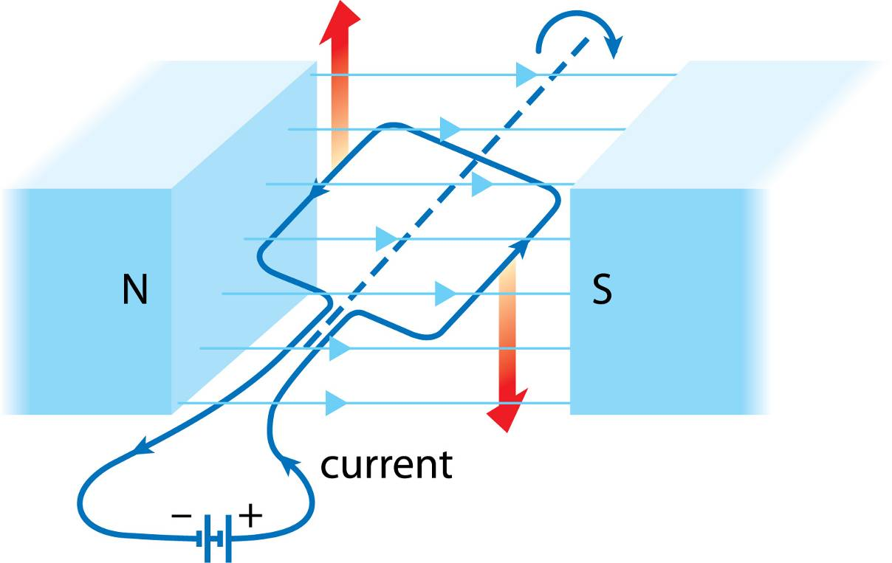
Motors and How They work
Coil of wire acts like a magnet.
When the current is flowing
the magnet in the coil and the fixed magnet will repel or attract each other.
One side of coil has different magnetic field to other side.
One side will move up one side will move down as repulsion/ attraction takes place
If the direction of the current flow changes in the coil , this reverses the magnetic field
This means that the coil can continue to spin as the repulsion / attraction reverses also.
The commutator causes the direction of the current flow to be reversed
The direction of motion of the coil of wire is determined by Flemings Left Hand Rule

Slide 63
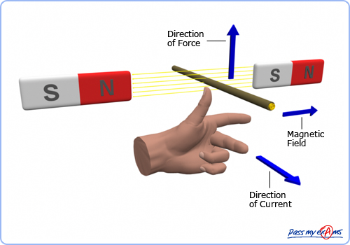
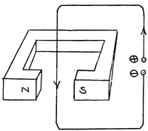
Motors – the basics
We can predict the direction of the wire by using something called “ Fleming Left Hand rule”.
Which way will the wire move?
Towards you!

Slide 64
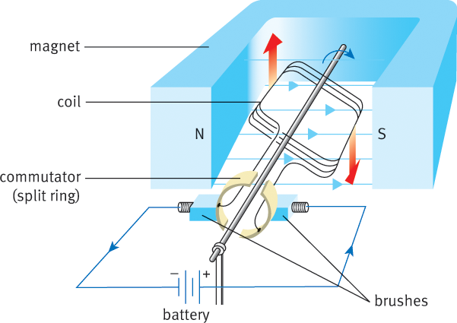
Unless we do something more, the coil will only turn until it is vertical.
Can you explain why?
By changing the direction of the current in the coil every half-turn, we reverse the direction of the forces, and this keeps the coil turning continuously
Use FLHR to prove direction of coils.
What will happen if current is reversed?
Go the other way!

Slide 65
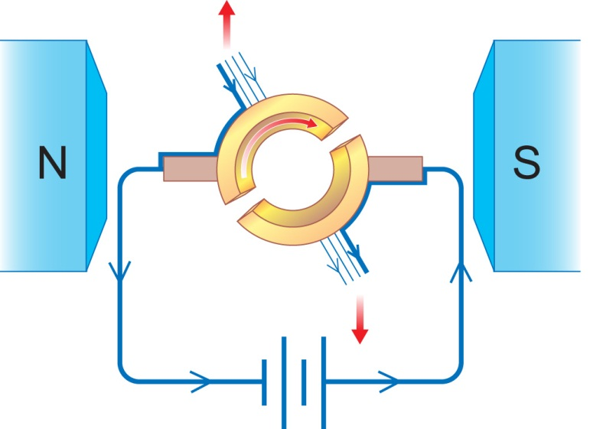
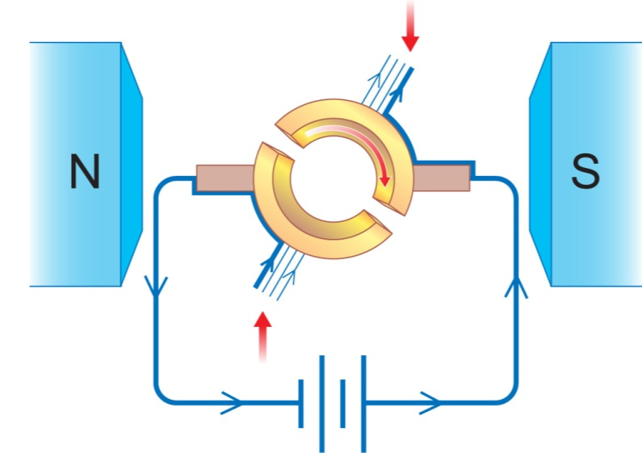
How the commutator( ring) works ( Reverses the direction of current flow in the coil which changes the direction of the magnetic field. This cause the coil of wire to keep spinning according to FLHR)
The forces on the sides of the coil make it turn towards the vertical position.
The coil’s momentum carries it slightly past the vertical. Each half of the commutator now touches the other brush.
This reverses the current direction in the coil – which reverses the forces, and so keeps the coil turning.

Slide 66
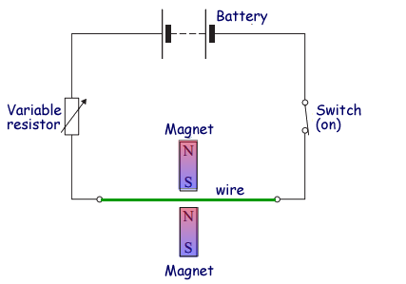
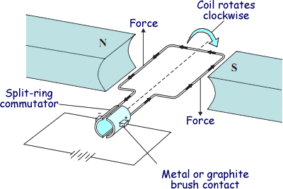
Questions
The student wants to change the electromagnetic force on the wire without changing the magnets or moving their position.
(i) Give one way in which she can increase the electromagnetic force. (1 mark)
(ii) Give one way in which she can reverse the direction of the electromagnetic force. (1 mark)
(iii)An electric motor. Give two ways of reversing the direction of the forces on the coil in the electric motor. (2 marks)
(iv) Give two ways of increasing the forces on the coil in the electric motor. (2 marks)
(i) have more batteries
(ii) change the batteries around (reserve polarity)
(iii) Reverse (the direction of the) current or reverse the connections (to the battery)
Reverse (the direction of the) magnetic field or reverse the (magnetic) poles
Do not credit 'swap the magnets (around)‘
(iv) Any two from:
increase the strength of the magnet(s) or (magnetic) field
increase the current (allow 'increase the voltage/p.d.' or allow add cells/batteries
reduce the gap (between coil/armature and poles/magnets)

