Slide 1
P6 - radiation

Slide 2
Radiation
Some chemical elements emit ionising radiation all the time
These elements are called “radioactive” elements
Ionising radiation – energy that can turn an atom into an ion
Lots of objects on the Earth emit low levels of radiation
This is called “background” radiation

Slide 3
Atom
An atom has a nucleus, made of protons and neutrons, which is surrounded by electrons
The results of the Rutherford-Geiger-Marsden alpha particle scattering experiment provided evidence that a gold atom contains a small, massive, positive region (the nucleus)
Protons and neutrons are held together in the nucleus by a strong force which balances the repulsive electrostatic force between the protons

Slide 4
Isotopes
All atoms contain protons and neutrons in their nucleus
The proton number of an atom tells you which element the atom is
The proton number of an element is always the same
But the neutron number can differ
Some elements have different forms, called isotopes, which have the same proton number, but different neutron numbers

Slide 5
Calculate the number of protons, electrons and neutrons shown below -
12
C
6
13
C
6
14
C
6
These are all the element carbon, what is the difference between them?
They have different numbers of neutrons.
What do we call atoms of the same element with different numbers of neutrons?
What do we call isotopes that are unstable and emit radiation to become more stable?
Isotopes
Radioisotopes

Slide 6
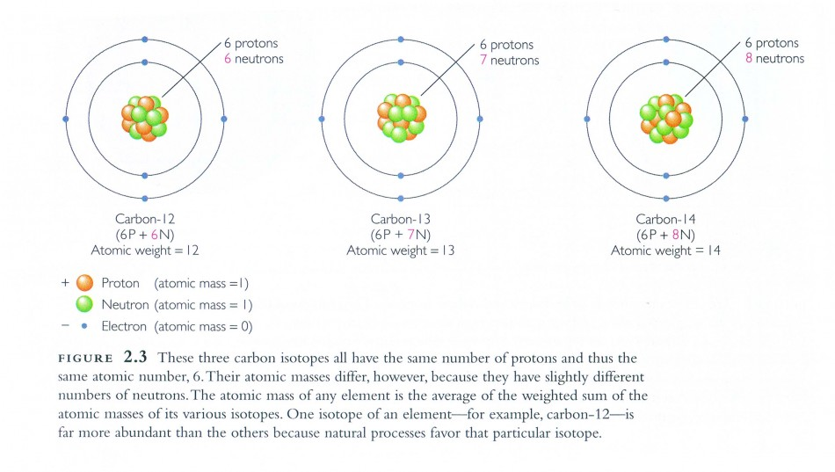
Carbon isotope

Slide 7
Radiation
Radioactive atoms are unstable – they decay (break down) to make themselves more stable
This decay happens randomly and you cannot predict when it will happen
Chemical processes (bonding) or physical processes (temperature) have no effect on radiation
Atoms often change into new elements as they lose particles and becpme new atoms

Slide 8
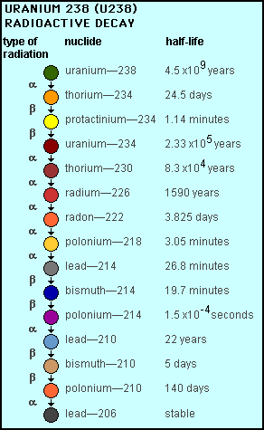

Slide 9
3 types of radiation
Alpha – 2 protons and 2 neutrons
Beta – identical to electrons
Gamma – EM wave

Slide 10
Types of radiation
1) Alpha (α) – an atom decays into a new atom and emits an alpha particle (2 protons and 2 neutrons – the nucleus of a helium atom)
Unstable nucleus
New nucleus
Alpha particle
2) Beta (β) – an atom decays into a new atom by changing a neutron into a proton and electron. The fast moving, high energy electron is called a beta particle.
Beta particle
Unstable nucleus
New nucleus
3) Gamma – after α or β decay surplus energy is sometimes emitted. This is called gamma radiation and has a very high frequency with short wavelength. The atom is not changed.
Unstable nucleus
New nucleus
Gamma radiation

Slide 11
ppt

Slide 12
Half life
The decay of radioisotopes can be used to measure the material’s age. The HALF-LIFE of an atom is the time taken for HALF of the radioactive nuclei in a sample to decay…
= radioisotope
= new atom formed
After 1 half life half have decayed (that’s 8)
After 2 half lives another half have decayed (12 altogether)
After 3 half lives another 2 have decayed (14 altogether)
At start there are 16 radioisotopes

Slide 13
Half life
As a radioactive substance decays, less radioactive nuclei are present
So the radioactivity of the sample decreases
The time it takes to decay depends on the half life
Different radioactive elements have different half life's, ranging from a few seconds to millions of years

Slide 14
q
The activity of a radioactive sample is 640 Bq. Two hours later it has fallen to 40Bq. Find its half life

Slide 15
Graphical representation of half life
Decay rate (counts/min)
What is the half life of the radioisotope represented by the following graph?
80
60
40
20
The time it takes the count rate to decrease from 80 per min to 40 per min is what?
2 mins
Double check, the time it takes the count rate to decrease from 40 per min to 20 per min is?
2 mins
2 4 6 8
Time (min)
The half life of the radioisotope is 2 mins.

