Slide 1
Pollutants
LQ: How are pollutants formed?

Slide 2
Learning outcomes….
MUST:
Explain combustion, in terms of loss/gain of oxygen (C)
SHOULD:
Describe the origin of different pollutants (B)
COULD:
Use a table of information to write a paragraph explaining how the main pollutant gases are formed (A)
Explain why nitrogen becomes a pollutant gas (it is normally unreactive) (A*)

Slide 3
Elements, atoms, molecules, compounds
Elements –pure chemicals, e.g. Carbon, Oxygen, Nitrogen, Sulphur, Hydrogen
Consist of tiny particles called atoms
In liquids and gases, if two or more atoms are joined together they are called molecules
Compounds – when two or more different atoms chemically join together

Slide 4
Which of the following are elements, mixtures, compounds? And which are/contain molecules? What is the state of matter at room temperature for each chemical?
Air
Nitrogen
Carbon
Carbon monoxide
Carbon dioxide
Nitrogen dioxide
Sulphur
Sulphur dioxide
Petrol

Slide 5
MUST:
Explain combustion, in terms of loss/gain of oxygen (C)

Slide 6
Combustion
Oxidation – addition of oxygen to a chemical
Reduction – removal of oxygen from a chemical
Which of the above two types of reaction is combustion?
Explain why

Slide 7
Candle
Which candle went out first
How has the composition of our air now changed?
How does this impact on our global atmosphere?
What effect does diffusion cause to happen, in terms of pollution?

Slide 8
SHOULD:
Describe the origin of different pollutants (B)

Slide 9
fuels
Coal-contains carbon
Petrol/oil/gas – contain hydrocarbons
Coal/gas also contains impurities of sulphur
Nitrogen also reacts with??? In???
Burn in a chemical reaction called combustion
Need oxygen – therefore fuels burn much stronger in pure oxygen than in air (obtain pure O₂ for using to weld things – oxyacetylene torch)
Complete combustion occurs when there is a plentiful supply of oxygen present-water and carbon dioxide are products
Incomplete combustion occurs when there is a limited supply of oxygen present-either carbon or carbon monoxide are products. Both these reactions will also produce water
Particulates? What are they?

Slide 10
Combustion reactions
Fuel + oxygen carbon dioxide + water
Fuel + oxygen carbon monoxide + water
Fuel + oxygen carbon + water
Nitrogen + oxygen nitrogen oxide
Sulphur + oxygen sulphur dioxide
Reactants products
Atoms rearrange in combustion reactions but number of atoms are conserved (conserving mass)
Can you state where each pollutant comes from?

Slide 11
COULD:
Use a table of information to write a paragraph explaining how the main pollutant gases are formed (A)
Explain why nitrogen becomes a pollutant gas (it is normally unreactive) (A*)

Slide 12
Pollutants – write molecular formula (C)
Carbon dioxide
Carbon monoxide
Sulphur dioxide
Nitrogen monoxide
Nitrogen dioxide
Particulates

Slide 13
Pollutants
Formed from combustion reactions
Particulates - solid pieces of unburnt fuel. Form soot on surfaces
Carbon - chemical that coal is made of. In a plentiful supply of oxygen it burns and reacts with oxygen to form carbon dioxide
If there is a limited amount of oxygen then carbon monoxide is formed
Sulphur – found as an impurity in coal and natural gas. Sulphur dioxide formed when coal is burnt
Nitrogen monoxide – formed from the reaction with oxygen in the air when petrol burns
Further reaction with oxygen forms nitrogen dioxide

Slide 14
Where do they go?
Sulphur dioxide – into the air. React with rainwater to form acid rain
Nitrogen dioxide – into the air. React with rainwater to form acid rain
Particulates – into the air. Forms soot on buildings and is suspended in the air
Carbon dioxide – into the air. Contributes to global warming

Slide 15
Pollution
Humans pollute the Earth in a number of ways:
Pollutant | Harmful to... | Why?
Carbon dioxide | Environment
Nitrogen oxides | Environment + humans
Sulfur dioxide | Environment
Particulates (e.g. Smoke) | Environment + humans
Carbon monoxide | Humans
A greenhouse gas that causes global warming
Causes acid rain and makes asthma/breathing problems worse
Causes acid rain/asthma
Makes buildings dirty and makes asthma worse
Displaces oxygen in red blood cells that can result in death

Slide 16
Name three ways in which carbon dioxide was removed from the earth’s early atmosphere.
In terms of atoms, what elements are found in (a) coal and (b) petrol?
What must a fuel react with to produce the products carbon dioxide and water?
What must be supplied to a combustion reaction to burn the fuel faster?
What visual evidence tells you that incomplete combustion has occurred?
In chemical reactions mass is conserved – what does this mean?
From which combustion reaction is (a) carbon dioxide (b) carbon monoxide (c) nitrogen monoxide formed

Slide 17
Chemical reactions that involve the addition of oxygen to chemicals are called oxidation reactions
Loss of oxygen from a chemical is called a reduction reaction- which type of reaction is a combustion reaction?

Slide 18
Dangers – how are the following pollutants a hazard?
Carbon dioxide – global warming
Sulphur dioxide -
Nitrogen dioxide
Particulates
Carbon monoxide

Slide 19
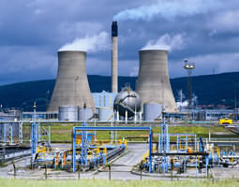
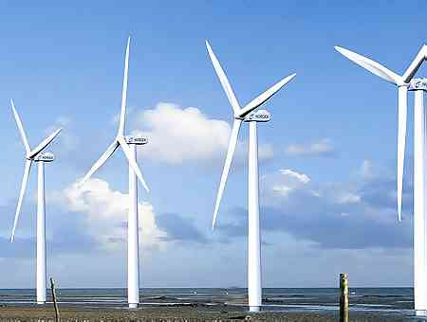
Removing Pollution
There are many ways pollution can be reduced:
Use less electricity/central heating
Remove toxic chemicals before or after they are burnt
Use alternative energy sources, e.g. wind power

Slide 20
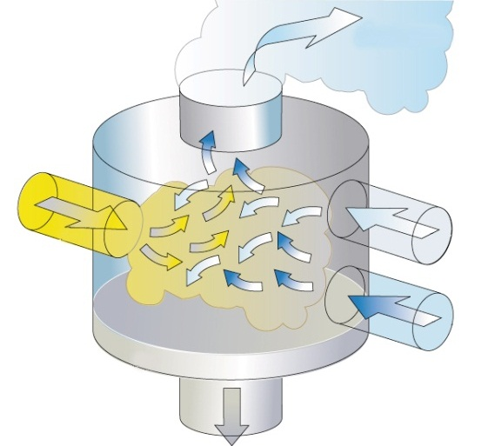
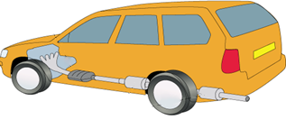
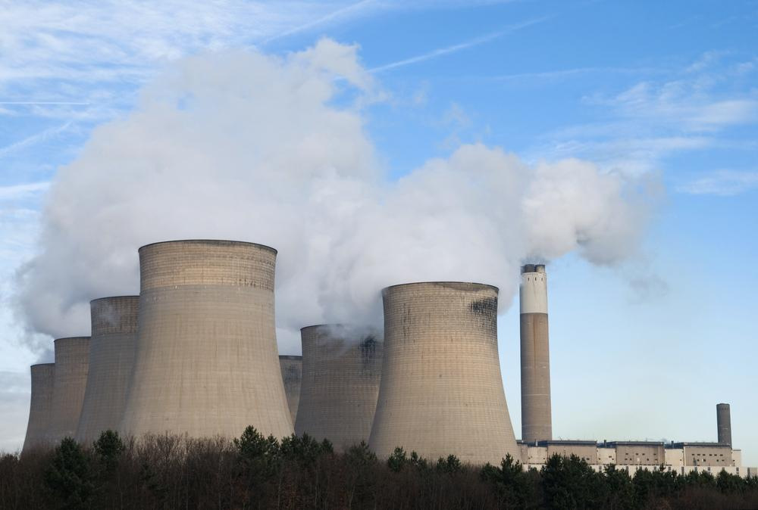
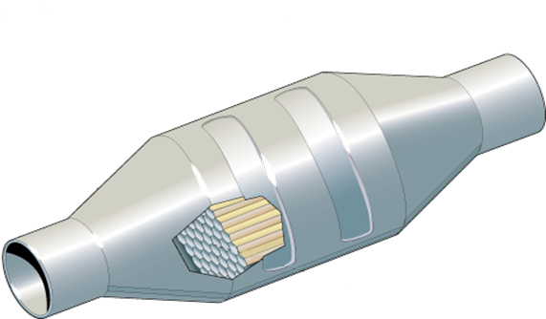
Technology can help to reduce pollution
Flue-gas desulfurisation
Catalytic converters
© Oxford University Press 2011

Slide 21
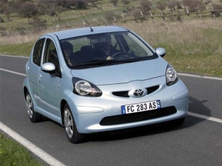
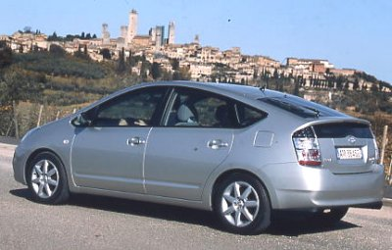
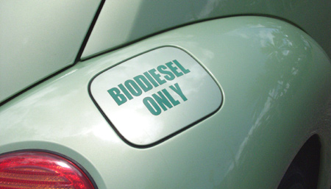
Reducing Pollution from vehicles
A number of suggestions:
1) Buy a new, smaller, more efficient car
2) Use legal limits (e.g. An MOT) to enforce lower emissions
3) Use low sulfur fuels or convert your car to run on biodiesel
4) Make sure your car has a catalytic converter:
Carbon monoxide + oxygen carbon dioxide
Nitrogen monoxide + carbon monoxide nitrogen + carbon monoxide
5) Use the train or a bus!

Slide 22
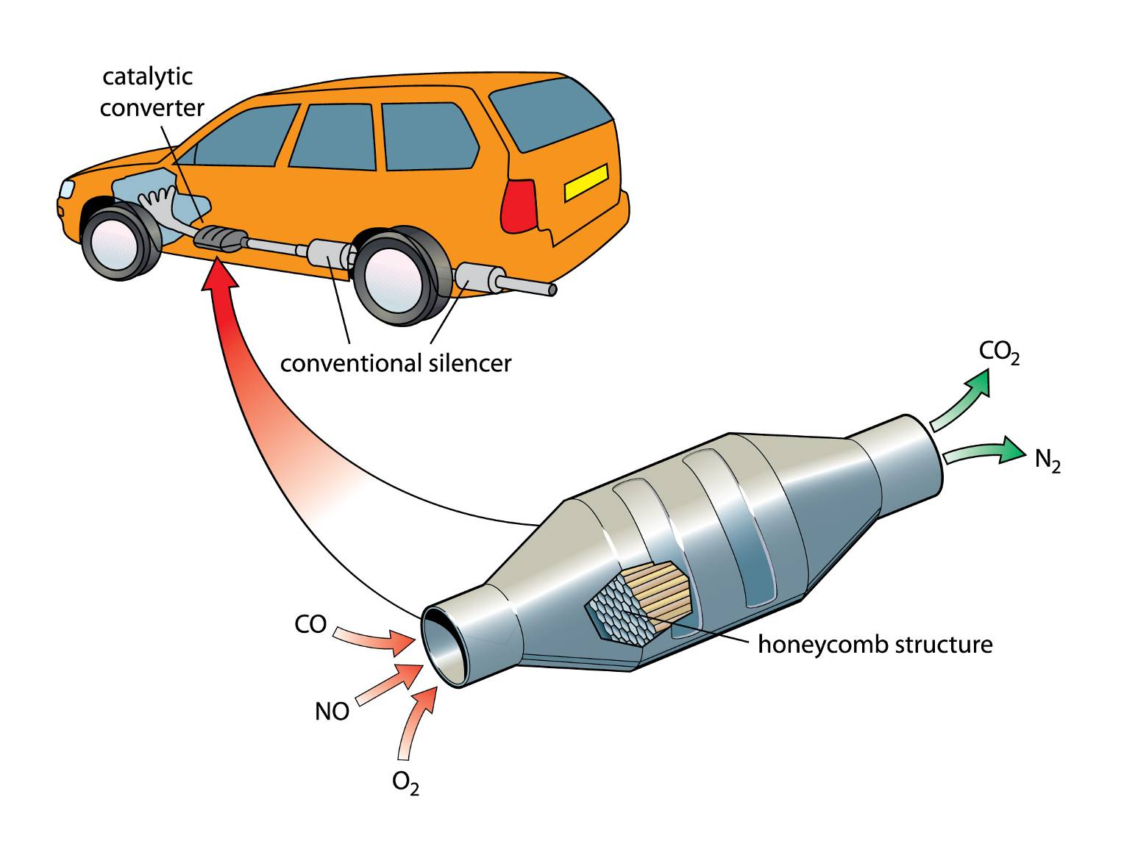
Use the diagram to explain how a catalytic converter reduces harmful emissions

Slide 23
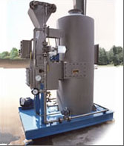
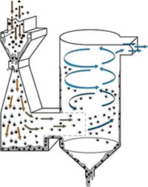
Wet Scrubbing
“Wet scrubbing” is a term used to describe the removal of sulphur dioxide and other particles using seawater or an alkaline spray:
Step 1 – the dirty gas is fed in through the top.
Step 3 – the mixture is fed into a cyclone area where the slurry is collected at the bottom of the device.
Step 2 – the “scrubbing liquid” (seawater or alkaline spray) is fed in through the side.

Slide 24
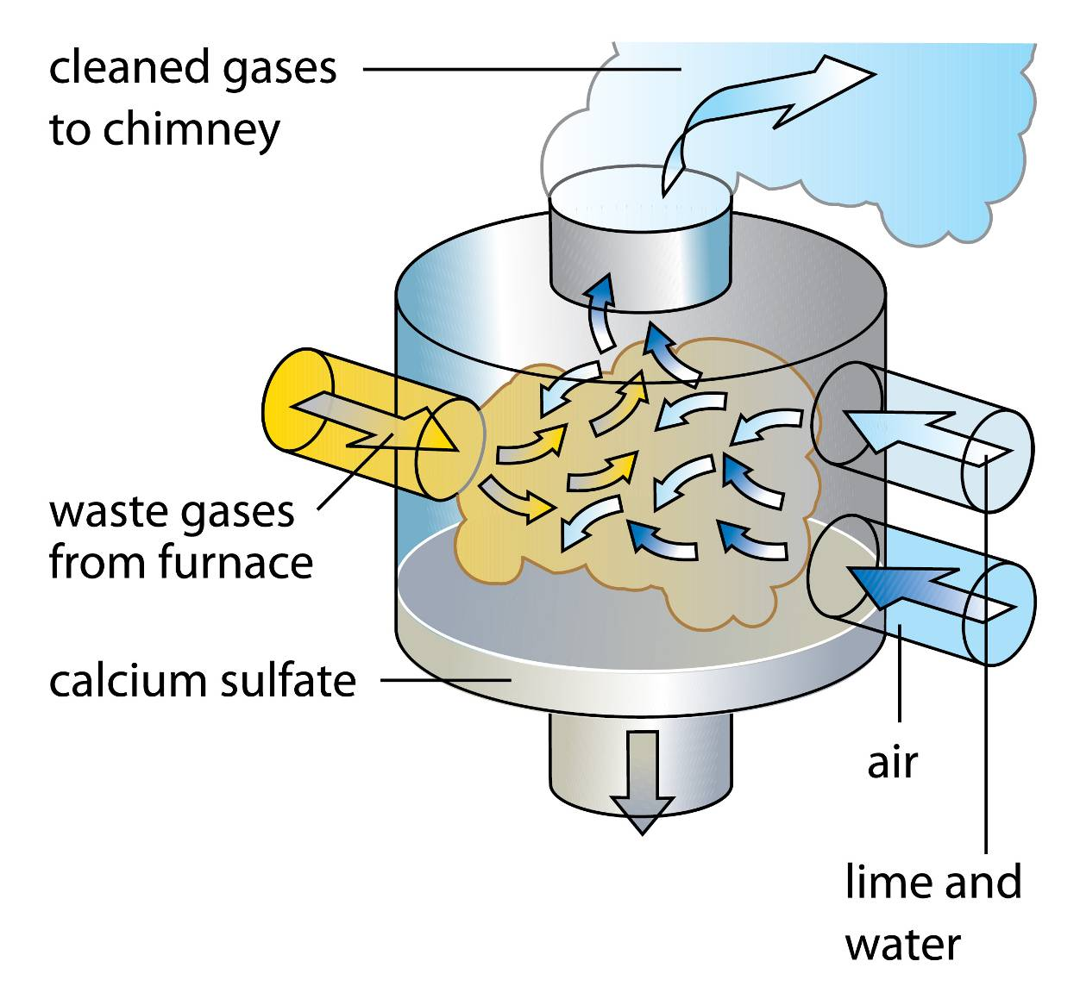
Use the diagram to explain how wet scrubbing reduces harmful gases from power stations

Slide 25
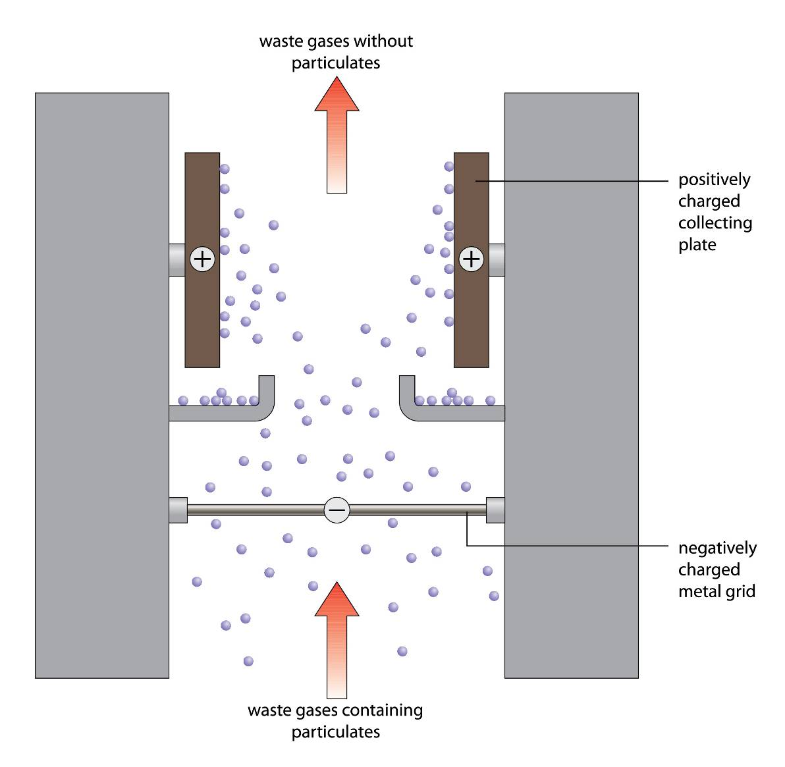
Use the diagram to explain how static electricity reduces harmful gases from power stations

