Slide 1
Radioactive waste and risk to health
L.O: explain how time and source is a factor in disposing of waste
Define the risk of radiation doses to health

Slide 2
Learning outcomes....
explain the link between half-life and the time taken for a radioactive source to become safe
describe the three categories of radioactive waste and how they relate to disposal methods
debate options for the long-term disposal of radioactive waste

Slide 3
Polonium-210 emits alpha particles and is poisonous. The fact that it is radioactive would not help doctors detect that it was in a patient’s body. Explain why.

Slide 4
Alpha particles would be absorbed by the body, so a detector outside the body would not detect them.

Slide 5
Why is it that alpha particles do not move very far?

Slide 6
Alpha particles are most ionising as they are largest and so more likely to collide with an atom as they pass through materials.
When they cause ionisation they lose kinetic energy and slow down.
Eventually, they do not have enough energy to ionise. (They attract electrons and are then just like any other helium atom.)

Slide 7
Explain why beta radiation is most suitable for measuring the thickness of paper.

Slide 8
Alpha radiation would be stopped and so not detected at all.
Gamma radiation would pass through, almost unchanged.

Slide 9
Which is better?
Uranium fuel – half life 4.5x10⁹ years
Polonium – 3.05 minutes

Slide 10
Level of risk
Waste is categorised as:
High level waste (HLW)
Intermediate level waste (ILW)
Low level waste (LLW)
HLW: waste from nuclear power stations (generates heat, stored in glass and steel and cooled before storage)
ILW: metal casing of fuel rods/medical (sealed in concrete/steel and stored)
LLW: medical/power stations (buried)

Slide 11
Risk
Ionising radiation – breaks down atoms/molecules into ions. Very reactive chemically
Cause damage to cells in body
High dose kills cells causing radiation sickness, lower dose causes cancer
IRRADIATION: exposed to radiation but not in direct contact. Once you move away from source you are no longer exposed and damage to cells stops
CONTAMINATION: absorbing radiation e.g. Drinking, breathing, on skin. Exposed to radiation damage even after you have left area

Slide 12
Sieverts (Sv)
Measure of radiation dose – also in millisieverts (1/1000th)
Dose | Effect
2 | Background
20 | Airline staff
100 | Causes cancer
5000 | Radiation sickness
10 000 | Death within weeks

Slide 13
High risk
Uranium miners
Nuclear power plant workers
Airline staff
Radiographers

Slide 14
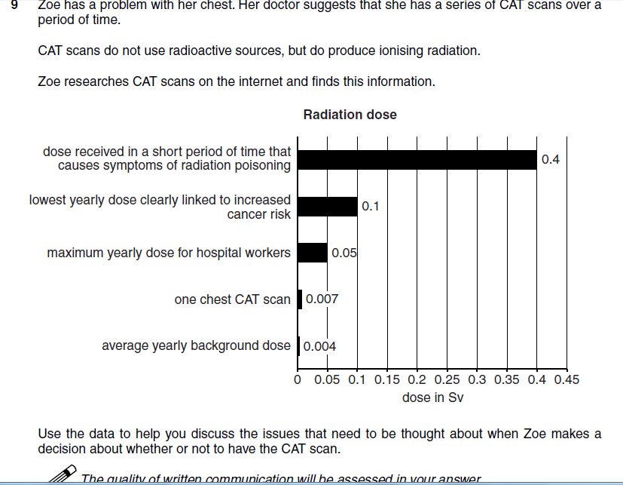

Slide 18
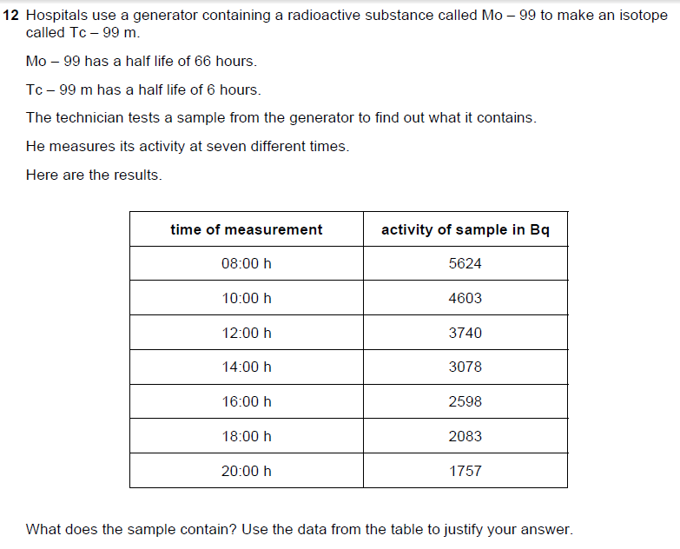

Slide 19
