Slide 1
Reactions of Alkalis
3. understand that alkalis neutralise acids to make salts
4. recall that soluble hydroxides and carbonates are alkalis (Higher)
5. predict the products of the reactions of soluble hydroxides and carbonates with acids (Higher)

Slide 2
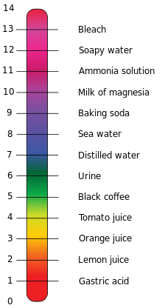
What are alkalis?
Alkalis are a substance which have a pH greater than 7 when dissolved in water.
Examples include:
Sodium carbonate (Na₂CO₃)
Sodium Hydroxide (NaOH)
Calcium Hydroxide (Ca(OH)₂)
Potassium Hydroxide (KOH)
alkalis
acids
When an acid reacts with an alkali it forms a salt and water.
This is called neutralisation.

Slide 3
More key terms
Alkali – substance which when dissolved in water has a pH greater than 7.
Acid – Something which when dissolved gives away hydrogen and has a pH lower than 7.
Salt – When the hydrogen in an acid is replaced with the metal from an alkali.
Water – H₂O
Carbon Dioxide – CO₂

Slide 4
Reactions of Alkalis – Hydrochloric Acid
Sodium Hydroxide
Sodium Hydroxide + Hydrochloric acid → Sodium Chloride + Water
NaOH + HCl → NaCl + H₂O
In this reaction the hydrogen from the acid reacts with the OH group from the alkali to form water. The hydrogen from the acid is replaced by the sodium from the hydroxide to form a salt, sodium chloride. Hydrochloric acid ALWAYS forms Chloride salts.
NB – Chemists usually use red to denote oxygen and white to denote hydrogen

Slide 5
Reactions of Alkalis – Hydrochloric Acid
Sodium Carbonate
Sodium Carbonate + Hydrochloric acid → Sodium Chloride + Carbon Dioxide + Water
Na₂CO₃ + 2HCl → 2NaCl + CO₂ + H₂O
In this reaction the hydrogen from the acid reacts with the CO₃ group from the carbonate to form water and carbon dioxide. The hydrogen from the acid is replaced by the sodium from the carbonate to form a salt, sodium chloride. Hydrochloric acid ALWAYS forms Chloride salts.
NB – Chemists usually use red to denote oxygen and white to denote hydrogen

Slide 6
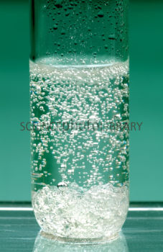
Your Turn
Complete the following word equations
Lithium Hydroxide + Hydrochloric Acid →
Potassium Carbonate + Hydrochloric acid →
Lithium Chloride + Water
Potassium Chloride + Carbon Dioxide + Water
Bonus Question:
How could you tell by looking at the reaction whether the acid was reacting with a carbonate or a hydroxide?
Answer
If it was reacting with a carbonate it would fizz, effervesce.

Slide 7
Reactions of Alkalis – Sulphuric Acid
Sodium Hydroxide
Sodium Hydroxide + Sulphuric acid → Sodium Sulphate + Water
This is the sulphate group, SO₄. Note this stays together in the reaction
2NaOH + H₂SO₄ → Na₂SO₄ + 2H₂O
In this reaction the hydrogen from the acid reacts with the OH group from the alkali to form water. The hydrogen from the acid is replaced by the sodium from the hydroxide to form a salt, sodium sulphate. Sulphuric acid ALWAYS forms sulphate salts.
NB – Chemists usually use red to denote oxygen and white to denote hydrogen

Slide 8
Reactions of Alkalis – Sulphuric Acid
Sodium Carbonate
Sodium Carbonate + Sulphuric acid → Sodium Sulphate + Carbon Dioxide + Water
Na₂CO₃ + H₂SO₄ → Na₂SO₄ + CO₂ + H₂O
In this reaction the hydrogen from the acid reacts with the CO₃ group from the carbonate to form water and carbon dioxide. The hydrogen from the acid is replaced by the sodium from the carbonate to form a salt, sodium sulphate. Sulphuric acid ALWAYS forms sulphate salts.
NB – Chemists usually use red to denote oxygen, white to denote hydrogen and black to denote carbon

Slide 9
Your turn
Complete the following word equations
Potassium Hydroxide + Sulphuric Acid →
Potassium Carbonate + Sulphuric acid →
Potassium Sulphate + Water
Potassium Sulphate+ Carbon Dioxide + Water
NB – You will not need to write symbol equations till the next Chemistry unit.

Slide 10
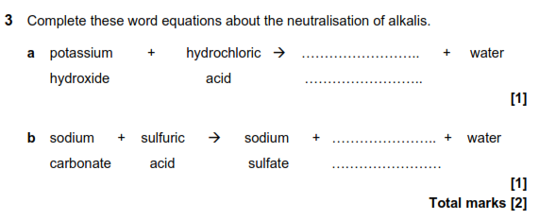
Exam Questions
Potassium
chloride
Carbon
Dioxide

