Slide 1
C5 lesson 4

Slide 2
Learning objective: To understand how unknown compounds can be identified.
Must: Explain what a precipitate is – E
Should: Be able to use different tests to identify metal and non-metal ions – C
Could: Explain how to identify common salt – sodium chloride – B
Keywords: Ion, precipitate, qualitative, cation and anion.

Slide 3
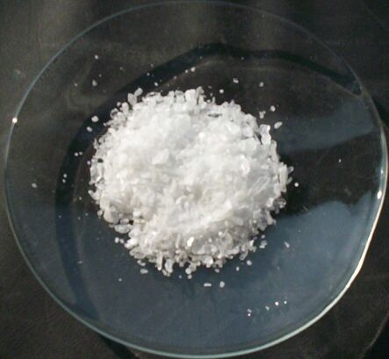
How could you find out what is in this white powder?

Slide 4
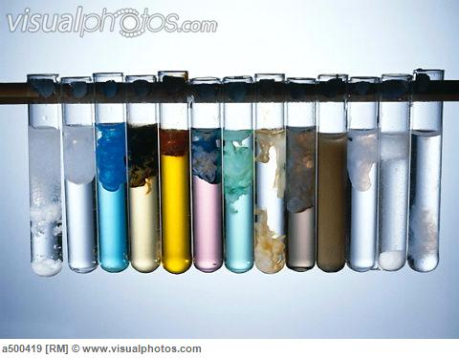
Precipitates.
Precipitates are insoluble solids formed when some ionic solutions are mixed together.

Slide 5
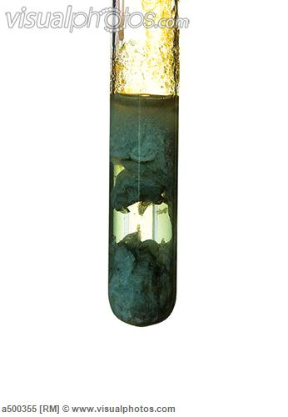
Testing for metal ions.
Some of metal ions give distinctive precipitates when sodium hydroxide solution is added.
Copper Cu²⁺ – blue
Iron II Fe²⁺ – dirty green
Iron III Fe³⁺ - rusty brown.

Slide 6
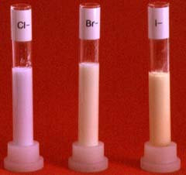
Testing for halides (group 7)
Silver nitrate can be used to detect the following halide ions;
Chloride ions – white precipitate.
Bromide ions – cream precipitate.
Iodine ions – pale yellow precipitate.

Slide 7
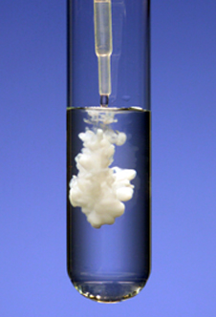
Testing for sulfates.
When barium nitrate or barium chloride is added to a solution containing sulfate ions (SO₄²⁻) a white precipitate is formed.

Slide 8
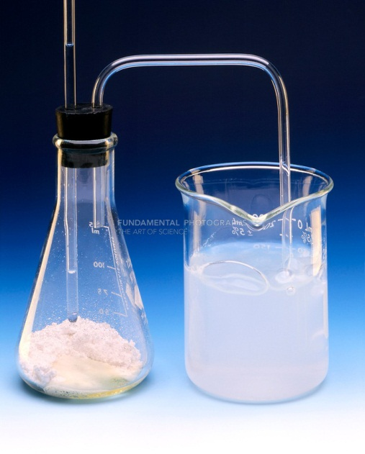
Testing for carbonates.
When an acid react with a carbonate what gas is formed?
Carbon dioxide.
How do we test for carbon dioxide?
It turns limewater milky (a precipitate is formed)

Slide 9
Keyword - definitions
Ion – charged particle.
Precipitate – insoluble solid.
Qualitative test – tells you what is present but not how much.

