Slide 1
Risks of Salt in Diet
6. understand the advantages of adding salt to food as a flavouring and as a preservative
7. recall the health implications of eating too much salt
8. be able to evaluate data related to the content of salt in food and health
9. recall that Government departments, such as the Department of Health and the Department
for Environment, Food and Rural Affairs, have a role in:
a. carrying out risk assessments in relation to chemicals in food
b. advising the public in relation to the effect of food on health.

Slide 2
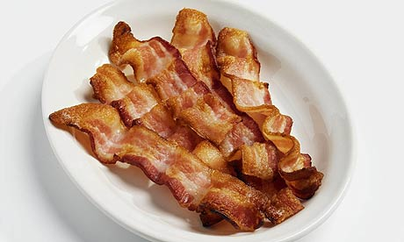
Why Use Salt in Food?
Preservative – helps preserve food against decay
Flavour enhancer – makes food taste better

Slide 3
Risks of a Salty Diet
Raises blood pressure
Increases chance of stroke/heart attack
By cutting down your salt intake you can quickly reduce your blood pressure which quickly reduces the chance of a stroke or heart attack.
The Heart Attack Grill in Las Vegas serves the “Quadruple Bypass Burger”. This contains almost 10,000 calories (that’s 4-5 times your daily allowance). There have been many cases where people have had heart attacks whilst eating there…

Slide 4
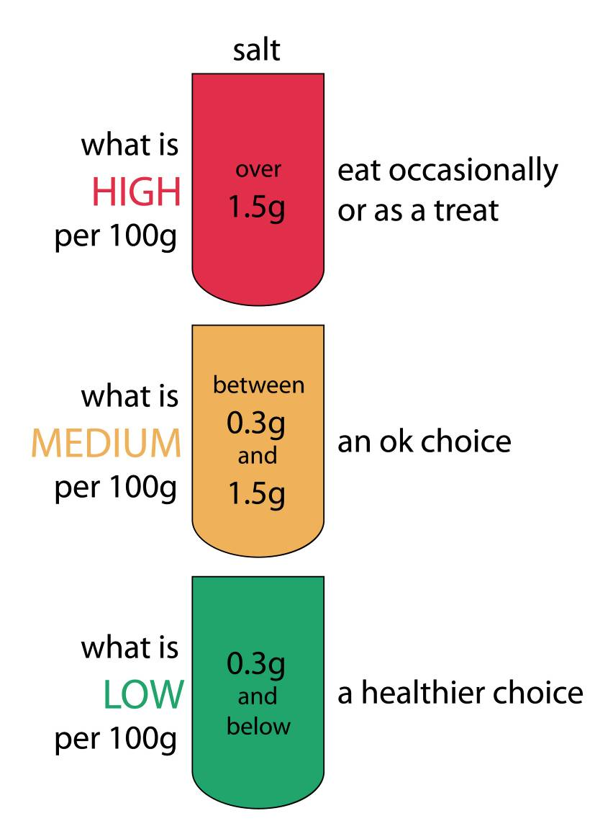
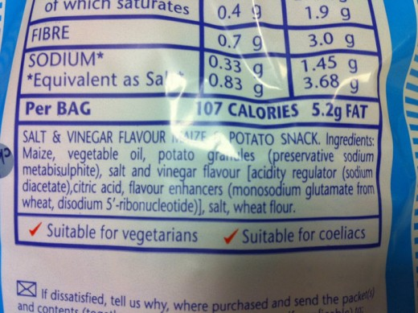
Monitoring Salt Intake
You can check the labels on foods to see the amount of salt.
Is the amount of salt in this packet of Walkers crisps a High/Medium/Low amount?

Slide 5
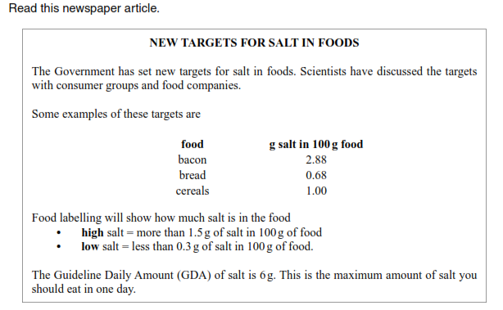
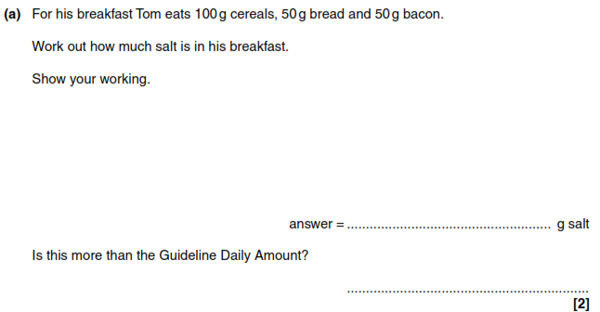
Exam Questions
Step 1: Calculate the amount of salt he eats
Cereals = 1g In 100g
Bread = 0.68g in 100g, so there is 0.68/(100÷50) = 0.34g
Bacon = 2.88g in 100g, so there is 2.88/(100÷50)=1.44g
Step 3: Is it higher than the guideline?
The GDA is 6g. 2.88 is less than 6. So no.
Step 2: Add them together
=1+0.34+1.44= 2.78g

Slide 6
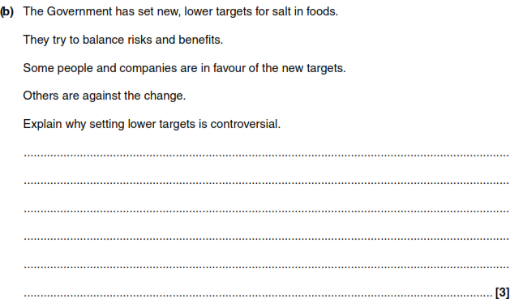
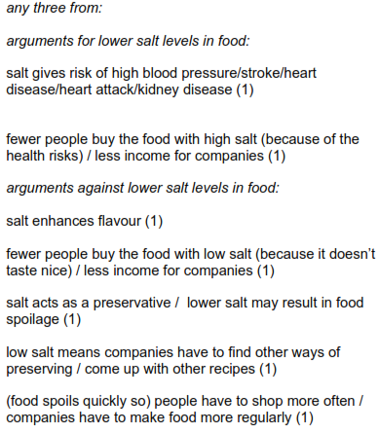
Exam Questions
Some people say salt can be good because it is used as a
preservative in food and it also enhances flavour.
Some people are against adding salt to food because it can
increase the risk of heart disease.

